Slide 1


BHNOG Transfusion Education Strategy
2025 - 2028
An Update from the BHNOG Educational Strategy Group
Stephanie Ditcham - Head of the Blood Health Team
on behalf of the BHNOG Education Strategy Group

Slide 2

Contents
BHNOG TRANSFUSION EDUCATION STRATEGY 2025–2028
01
Foundations of Transfusion Education in Wales
02
BHNOG Education Strategy Group
03
Responding to the IBI recommendatons
04
The BHNOG Transfusion Education Strategy 2025–2028
05
How do we measure impact?

Slide 3

Foundations of Transfusion Education in Wales
Approval of Blood Health Plan, WHC 2017/028 by Welsh Government. Collaboratively developed with LHBs
2021
BBTT (Better Blood Transfusion Team) was established in response to WHC 2002/137
2017
2018
Issue of the BHNOG Transfusion Education Strategy
2004
Blood Health National Oversight Group (BHNOG) was established.
Rebrand of BBTT to Blood Health Team (BHT)
Notes:
BSQR
Welsh Health Circular (Right patient, Right choice)
Education - Transfusion safety initiatives.

Slide 4

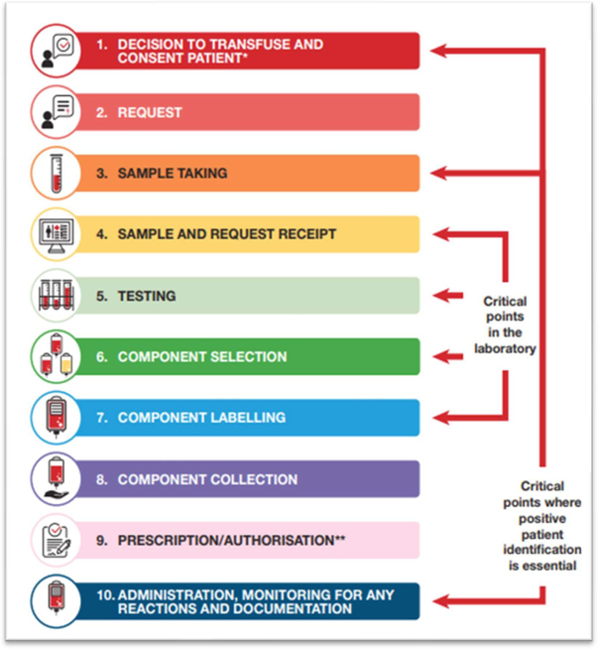
Foundations of Transfusion Education in Wales
Embedded
Embedded
Non-Medical Authorisation of Blood Transfusion (NABT)
Senior Student Assistantship (SSA)
Advanced practitioners whose scope supports authorisation of blood
All 5th year medical students in Wales
Embedded
Embedded
All Wales Transfusion Competencies
Specialist Registrar (SpR) Training
Relevant staff groups in transfusion pathway
Specialist Registrars
Priority
Priority
Learn Blood Transfusion (LBT)
SHOT inc. Human Factors (HF) Training
Relevant staff involved in transfusion
Relevant staff involved in transfusion
Priority
Priority
Scientific Training Programme
Future Nurse: Future Midwife (FNFM)
Laboratory / Scientific staff
Undergraduate nurses
Priority
FI/F2 Clinical Education
image used with permission from SHOT 2026
Newly qualified medical staff
Formally establish Educational Strategy Group and associated Terms of Reference

Slide 5
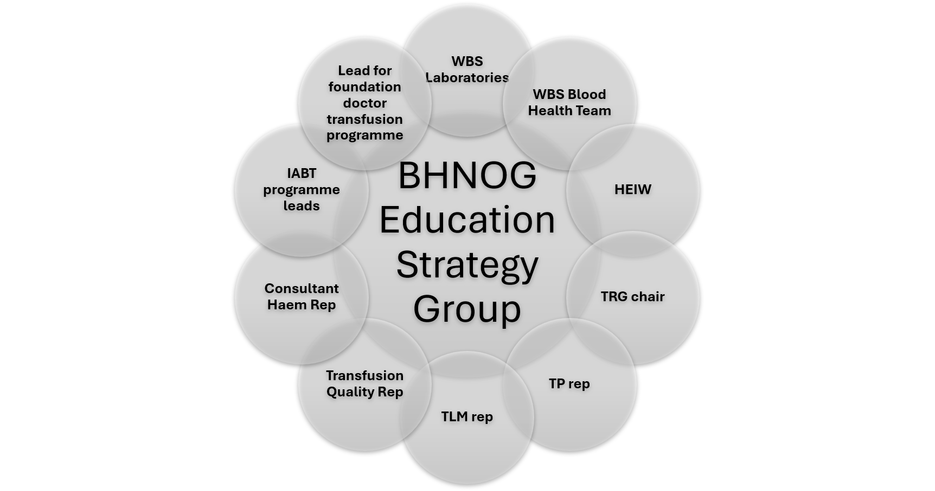
BHNOG Education
Strategy Group
Provides oversight and direction for transfusion education and training across Wales:
  Ensures a standardised approach for consistency of message
  Establishes a baseline level of knowledge
  Prevents duplication of efforts to optimise the workforce
Achieved through partnership working with:
  Education providers
  Key healthcare professionals
  Subject matter experts

Slide 6
Responding to the IBI Recommendations
IBI report published.
NHS Wales Blood Health Plan 2024-2027
2024
2024

Slide 7
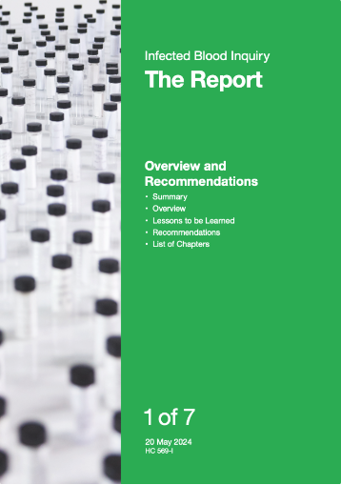
Responding to the IBI recommendations
Recommendation 3 — Learning from the Inquiry (a)
The General Medical Council, NHS Education for Scotland, Health Education and Improvement Wales, Northern Ireland Medical and Dental Training Agency and NHS England should take steps to ensure that those "lessons to be learned" which relate to clinical practice are incorporated in every doctor's training.
Recommendation 7 — Patient Safety: Blood Transfusions (d)
Those bodies concerned with undergraduate and postgraduate training across the UK of those people who are, or intend to be, working in the NHS should ensure they are adequately trained in transfusion, that the standards by which sufficiency of training is measured are defined, and accountability for training in transfusion be defined.

Slide 8
Responding to the IBI Recommendations
IBI report published.
2025
NHS Wales Blood Health Plan 2024-2027
2024
2025
Issue of the BHNOG Transfusion Education Strategy 2025-2027
2024
Revised ESG ToR

Slide 9
Strategy Focus
Ensure EQUITABLE transfusion education and ensure appropriate delivery of transfusion education across Wales
Shaped through COLLABORATION with key stakeholders
Reflecting SHARED VALUES and collective aspirations for transfusion education in Wales.
Bold vision
Ensure EVERY HEALTHCARE PROFESSIONAL involved in the transfusion process is EQUIPPED with the KNOWLEDGE, SKILLS, and CONFIDENCE they need to UNDERTAKE their ROLE.
BHNOG Transfusion Education Strategy
2025 - 2028
Produced on behalf of the Blood Health National Oversight Group (BHNOG)

Slide 10
To promote the top-to-bottom provision of standardised transfusion education to healthcare workers in Wales, enabling the delivery of high-quality care, placing safety at the forefront of transfusion practice and advancing a patient blood management approach.
Mission Statement

Slide 11

Key Stakeholders
Higher Education Institutions
HCPs involved in the transfusion process
Health Education Improvement Wales
This identifies the network of key stakeholders required to address our educational priorities. We will continue to engage with these groups and work collaboratively to ensure that we deliver innovative transfusion education and embed the principles of safe transfusion practice.
Transfusion Practitioners (TP)
Key Stakeholders
UK Blood Establishments
Pathology Networks
Digital Health and Care Wales
NHS Executive Teams

Slide 12
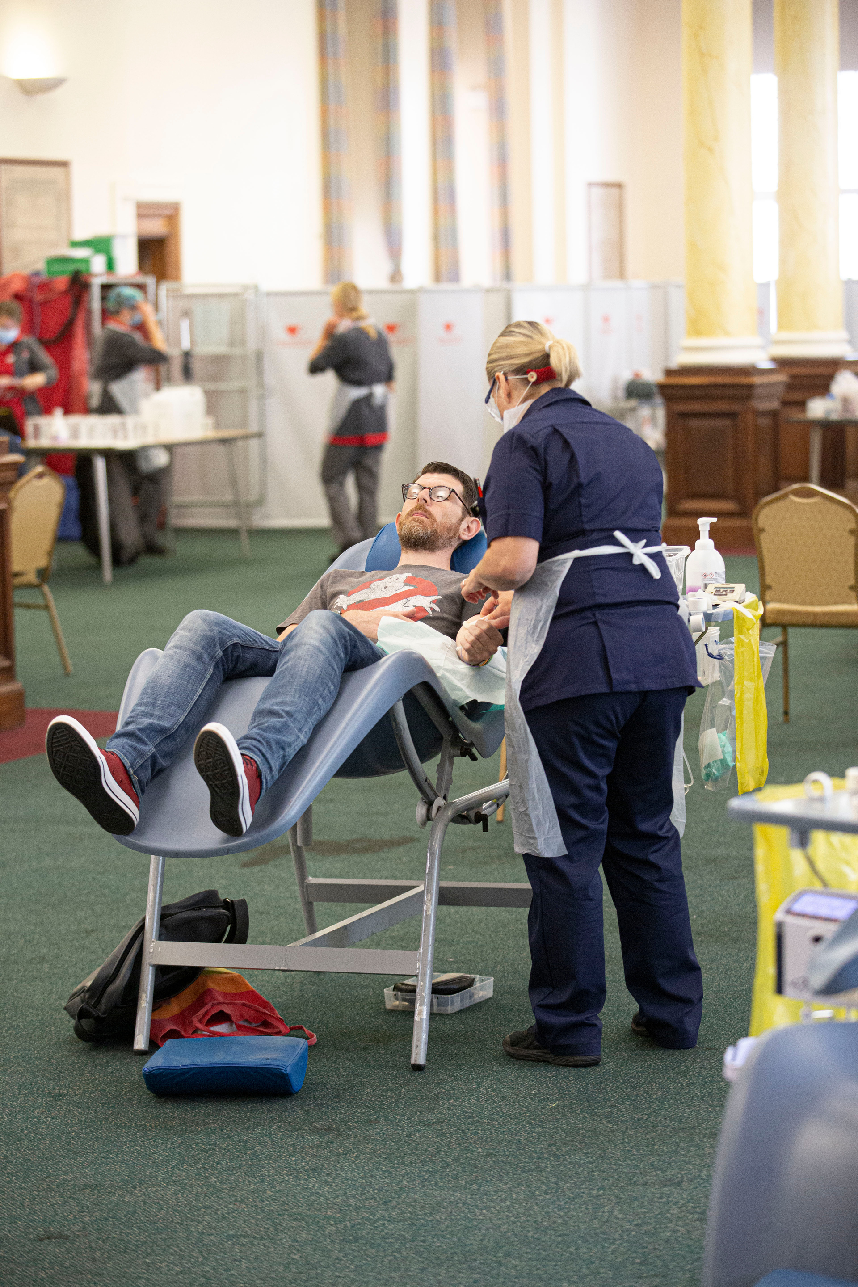
Patient Voice
A blood transfusion is not just a treatment; it is a lifeline. Whether it's your first blood transfusion or your hundredth, the impact is always significant. From exhaustion to renewed strength, from negativity to positivity.
Behind every bag of blood is the generosity of a donor and the talent of a medical team. Those needing blood place themselves in the hands of care providers whom they have faith in. They have faith that the person looking after them during the transfusion is well-trained, informed and confident in the treatment they are providing. Mostly, they feel reassured that they are safe and well looked after.
The need for a clear and visionary education strategy to keep delivering this standard of care is vital. We need to ensure the care given is clinically excellent as well as compassionate, taking into account the individual needs of patients and their families. The Education Strategy for 2025–2028 is critical to ensure we keep delivering a fantastic level of care, especially for those individuals who require blood transfusions not just to live, but to thrive.
Jemin Popat - Patient Representative to BHNOG

Slide 13

Our Priority Groups
Priority 1 - Medical
Priority 2 - Midwifery
Priority 3 - Nursing
  Foundation Programme.
  Undergraduate Medical School Programme.
  Undergraduate Education aligned with professional requirements and signals from SHOT incident reporting
  Undergraduate Education: Education package needs revision & engagement to embed across Wales
Priority 5 - Independent Prescribers
Priority 6 - Transfusion Practitioners (TPs)
Priority 4 - Scientific
  Biomedical Scientist Education: Undergraduate education in collaboration with devolved nations
  Equip appropriate HCPs to take on the responsibility for the clinical decision to authorise blood component transfusion for patients within a defined scope of clinical practice and competence.
  Review and update form a career framework for Transfusion Practitioners considering activity across the UK

Slide 14
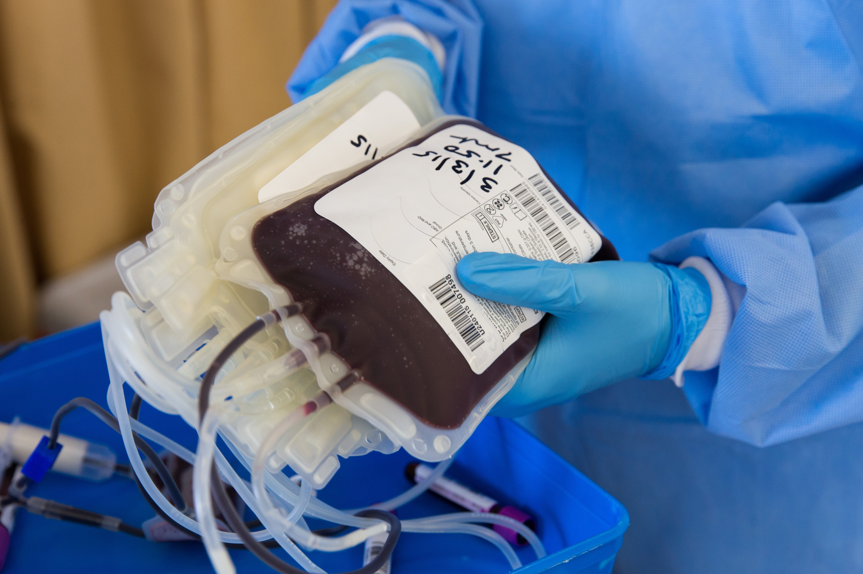
What will success look like?
Consensus on an agreed definition of educational requirements for priority staff groups.
Measurement:
National agreement in collaboration with national groups.
Improved patient confidence about transfusion safety.
Measurement:
Patient surveys
Concerns/Incident reporting.
Achieving IBI recommendations 7d.
Measurement
National reporting to governing bodies, Welsh and UK Government and UK groups.
Reduced inappropriate/avoidable usage of blood components.
Measurement:
  Audits of inappropriately used blood components (QS 138). BSMS based data of stock holding trends across the years.
  Audit of O Neg usage in MHP
Patient safety improvements.
Measurement:
Reduction in reporting of transfusion incidents via SHOT.
Gaps and variation in education will be addressed.
Measurement:
Gap analysis on each priority group
Notes:
Measurables
- Transfusion risks are reducing.
- Measurables.
- Stakeholder engagement

Slide 15
How will the education strategy deliver improvement?
  This strategy sets out aspirations for education, but the context in which this will be delivered will shift year on year, depending on the delivery plan.
  The BHNOG will receive a quarterly update on the progress of the delivery. This will be scrutinised and performance challenged as required. Overall success will be measured as outlined in the strategy and will be reported into the BHNOG annual report.
  The strategy itself will be revised on a three-year basis.
Notes:
How do we meet the mission statement.
Engagement with partner agencies. Acting as the SME and help guide and deliver/
Aspirations for education but the context in which the strategy is delivered will shift year on year.
Annual delivery plan.

Slide 16

Our pledge
We will support all healthcare workers to get the right transfusion education, in the right place, at the right time to ensure patient safety.
Notes:
Support.
The BHNOG ESG will be responsible for developing the strategies used for delivery of education ensuring that it is engaging, informative and most importantly accessible. Transfusion education will need to provide users with the knowledge and skills to inform and develop their own practice encouraging learning opportunities which can lead to behavioural changes i.e. empowering staff to do the right thing. Refer to Appendix 1 for an overview of the relationships within the BHNOG structure

Slide 17

Thank you for listening
Thank you to ESG members esp Sarah Beuschel as Chair
Notes:
.

