Slide 1
Capacity Planning:
Building Resilient Transfusion Laboratory Services in Wales
BHNOG 2026
Rashmi Rook, FIBMS
Independent Transfusion & Quality Advisor
Former Chair UKTLC (2015–2021) | BHNOG 2026

Slide 2






Why This Review Was Undertaken
Infected Blood
Inquiry (IBI)
SHOT
Haemovigilance
UKTLC
Standards
Driving this commission
Incident trends & risk
Laboratory benchmarks
It was an opportunity to understand what is needed to sustain safe transfusion services into the future- not a search for failure.
Regulatory standards

Slide 3
Regulations & Standards - Transfusion Staffing & Capacity
Blood Safety & Quality
Regulations Act, 2005
2.1 The Organisation should have an adequate number of personnel with the necessary qualifications and experience….… The responsibilities placed on any one individual should not be so extensive as to present any risk to quality.
ISO 15189 : 2022 / UKAS
International standard for quality and competence in medical laboratories.
SHOT (Safety Standard 3)
Adequate numbers of appropriately trained and supported staff are available to deliver safe transfusions, prioritising staff wellbeing and professional development.
UKTLC
Appropriate staffing levels will be in place to ensure the safe and effective delivery of all transfusion service activities.
IBI (7c)
Transfusion laboratories should be staffed (and resourced) adequately to meet the requirements of their functions

Slide 4
Method

Slide 5
Methodology: A Structured Review of Service Resilience
Multiple evidence sources informing a resilience and patient safety assessment
Questionnaire
Site Visits
→
Document Review
→
Assessment
→
Recommendations
→
Evidence Sources
  • Structured HB questionnaire
  • Rotas and staffing establishments
  • Organograms and quality manuals
  • Blood compliance reports
  • Risk registers where available
Assessment Principles
  • Protected senior capacity
  • Training & supervision
  • Quality Management
  • Haemovigilance
  • Digital/LIMS
  • OOH resilience
Building a picture of the overall service

Slide 6
Protected Senior Capacity Displaced by Routine Operational Work- Example Rota
Role | Mon |  | Tue |  | Wed |  | Thu |  | Fri
 | AM | PM | AM | PM | AM | PM | AM | PM | AM | PM
Senior BMS A | Off | Off | covered | covered | Night | Night | Off | OFF | covered | covered
Senior BMS B | covered | covered | Night | Night | Off | Off | covered | covered | covered | covered
QMS Role | covered | covered | off | off | covered | covered | covered | covered | off | off
Crossmatch BMS | covered | covered | covered | covered | covered | covered | covered | covered | covered | covered
Grouping/Serology BMS | covered | covered | covered | covered | covered | covered | covered | covered | covered | covered
Reception, Traceability, Stocks | covered | covered | covered | off | covered | covered | covered | covered | off | off
Staff in training- pressure | 1 |  |  | 1 |  |  | 2 | 2

Slide 7
Staff Levels: Monitoring
Staff capacity by function | illustrative monthly dashboard
STAFF CAPACITY
Blood Bank Post
WTE
Jan-18
Feb-18
Mar-18
Apr-18
May-18
Jun-18
Jul-18
BBM
1
Senior 1 – Supervision & Equipment
1
Senior 2 – Training
1
Senior 3 – QMS Support
1
Cross-match BMS
1
Serology BMS
1
Automation
1
Reception / Stocks
1
Red <60%
Amber 61–79%
Green >80%

Slide 8
A Simple Approach
TRADITIONAL METHOD
SIMPLE & MORE RELIABLE
Time and Motion Studies across job roles.
1
Are routine testing benches covered ~100% ?
Resource intensive and rarely reflects improvements needed.
If YES ↓
Workload does not = sample numbers and units issued
2
Are senior staff (Lead/Seniors/ TLM ) being pulled in to cover ?
Under or over-estimate task time.
If both answers are YES — capacity is already under strain, regardless of what the WTE establishment says.

Slide 9
Capacity: The Real Numbers
Nominal WTE ≠ Available WTE
WTE Adjustments
Examples
Nominal WTE is the headcount on paper.
Effective WTE is what is available for work, once annual leave, sickness absence, mandatory training, and supernumerary time are deducted.
Approximately 21-25% reduction to arrive at an effective WTE (includes UKTLC 10 days supervised working). This is the number that must meet service demand.
Nominal WTE | Capacity Reduction | Effective WTE
1.0 | -0.22 | 0.78
2.0 | -0.45 | 1.55
4.0 | -0.89 | 3.11
6.0 | -1.34 | 4.66

Slide 10

Hidden Workload
Transfusion Workload ≠ Samples tested, Blood issued
Patient Safety
Teaching/ Training & Competencies+++
Validation
Equipment management
Recalls
Blood transfers
Quality
Blood Traceability
OOH Advice
Staff development and subject matter expertise
Emergency blood protocols
Transfusion Reaction Investigations
Error management/ CAPA
Medical records merge checks
Exceptions/ Concessions
Risk management
Lookbacks
Temperature monitoring & mapping
Haemovigilance
Change Management
LIMS Testing
LIMS Rules checks
BSH Guideline checks
Specialist testing
MHRA / SHOT,
Good decision making
Pharmacy liaison: purine analogues checks
Actual transfusion workload is hidden to standard metrics
ISO 15189/UKAS
Liaising with external organisations and hospital sites
Patient history checks
Clinical staff training

Slide 11
Impact of Capacity Challenges

Slide 12
Impact of Low Capacity: MLA & AP (Band 2–4)
1
BMS Cover Routine Tasks
2
Pre-Analytical Errors Rise
3
Equipment & Stock Gaps, Traceability
When MLA/AP posts are vacant, BMS step down to cover specimen processing, stock management and equipment maintenance — pulling them from analytical bench work.
Rushed specimen handling and reduced oversight of pre-analytical steps increase the risk of errors before testing even begins, jeopardising result reliability.
Routine equipment checks, maintenance schedules and blood stock management are deprioritised under pressure, creating compliance risk and potential supply failure.
4
BMS Training Deferred
5
Increased Locum Dependency
6
OOH Vulnerability Grows
BMS time spent covering MLA-level tasks cannot be used for competency maintenance, training delivery, or professional development.
High MLA turnover drives reliance on agency staff, each requiring orientation and supervised working — increasing senior workload and cost pressure.
Out-of-hours periods become higher risk without adequate low-grade support, leaving lone BMS workers covering a wider range of tasks without backup.

Slide 13
Impact of Low Capacity: BMS (Band 5–6)
1
Senior Staff Pulled Down
2
Lone OOH Working
3
Locum Reliance & Training Burden
TLMs and senior BMS are drawn onto routine testing benches to maintain cover — vacating governance, training, quality and haemovigilance functions.
Single BMS staff cover multiple disciplines out-of-hours with no peer support, increasing error risk and placing significant pressure on individual wellbeing.
Staffing gaps drive high locum usage. Each new locum requires competency assessment and supervised practice before safe independent working can be confirmed.
4
Competency Gaps Accumulate
5
Delayed Blood Product Issue
6
Near-Miss & Incident Risk
Under operational pressure, annual competency reviews, LIMS re-validation and re-competency fall behind, creating growing regulatory compliance risk across sites.
Understaffed benches extend turnaround times for crossmatch and blood issue, including in emergency and time-critical clinical situations.
Fatigue, time pressure and reduced peer checking in understaffed shifts directly increase the likelihood of near-misses and patient safety incidents.

Slide 14
Impact of Low Capacity: Senior BMS / Leadership Team
1
Governance Functions Lost
2
Training & Supervision Reduced
3
Digital Implementation at Risk
Senior staff absorbed in bench cover cannot perform audit, haemovigilance, SHOT reporting or regulatory oversight — the core of their specialist safety role.
When senior capacity is consumed by operational pressures, junior staff development slows, competency sign-off is delayed, and training standards erode over time.
Digital / LIMS transformation and governance require dedicated senior bandwidth. Without it, workarounds accumulate and go-live safety is compromised.
4
Quality Management Gaps
5
OOH Advisory Informal
6
SHOT Primary Risk Factor
QMS reviews, MHRA preparation, ISO 15189 accreditation, change control and exception management are deferred under pressure, creating regulatory risk and audit vulnerability.
Out-of-hours advisory support relies on individual goodwill rather than documented, governed arrangements — increasing risk as less experienced staff join rotas.
SHOT identifies senior pull-down as the primary human factor in transfusion incidents. The impact of this gap cascades through the entire workforce system.

Slide 15
Thank You: To the Welsh Transfusion Teams
★
✦
✿
Your Expertise Saves Lives
Your Openness Drives Learning
Your Dedication and Commitment Go Above and Beyond
Every day, transfusion scientists across Wales make complex, high-stakes decisions. Your knowledge protects patients.
This review found staff covering extra shifts while maintaining training, quality, and standards under significant pressure.
Every team engaged candidly and thoughtfully with this review. That willingness to reflect openly is itself a hallmark of a good safety culture.

Slide 16
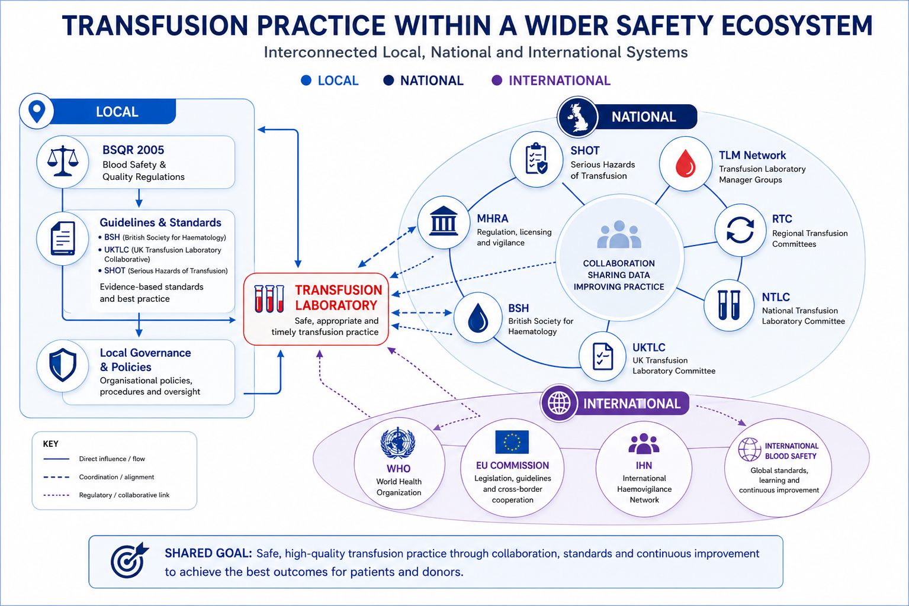

Slide 17
Actions

Slide 18
What Welsh Teams Already Do Well
✓
24/7 Services Running
✓
Strong TLM Leadership
✓
Embedded TP Services
All six Health Boards continue to provide safe transfusion services for patients despite ongoing pressures.
TLMs demonstrate specialist expertise, ownership of quality and safety, and active engagement with national networks.
Transfusion Practitioners are in place across most Health Boards, providing vital haemovigilance and clinical education.
✓
Good Reporting Culture
✓
National Collaboration
✓
Local Pride & Ownership
Staff actively identify and report incidents, near misses, and concerns. Years of investment in safety culture are paying off.
Active All-Wales TLM Group, Sharing LIMS test scripts and learning.
Staff across all sites expressed genuine commitment to patients and their service — and openness to this review.

Slide 19



Five Safety Actions
1
Protect senior leadership capacity
Ring-fence core-hours governance, training and oversight time
2
Recognise training as a patient safety function
Explicitly resource and protect training supervision across all HBs
3
Strengthen transfusion quality management
Ensure QM resource is proportionate to service complexity
4
Formalise OOH advisory support
Establish governance, recognition and remuneration for out-of-hours cover
5
Develop workforce resilience metrics
Make risk visible — embed in rota design and monthly QMS reporting
Patient and Staff Safety Requirement

Slide 20
Lab Team Actions: Simple Steps With Real Impact
1
Redesign your rota to make time visible
2
Place staffing risks on the corporate risk register
Split leadership, training, trainer, QMS, and bench time as separate rota entries. What gets named gets protected — and what's visible can be managed.
Ensure risks have clear actions, executive oversight, regular review, and linkage to incidents, errors, and near-misses.
3
Document every LIMS workaround
4
Use your TLM network
Every unresolved issue and workaround must be formally recorded. This is not optional — it is your safety record. Risk Assess and escalate for sign-off.
Strengthen networking opportunities through regular attendance at professional meetings, enabling the sharing of knowledge, documents, good practice, and innovative solutions across Health Boards.
Build a resilience tracker
Strengthening QMS oversight
5
6
Develop simple workforce resilience metrics to make pressures visible and support timely action.
Integrate and cross-reference all quality, audit, incident, and risk management systems to provide a clear and complete view of service pressures, risks, and patient safety concerns.

Slide 21
What Success Looks Like — The Markers of a Resilient Service
Protected Senior Time
Workforce Metrics In Use
Dedicated Digital Resource
Senior BMS and TLMs have dedicated, rota-visible time for supervision, haemovigilance, quality management, and governance — not absorbed by bench cover.
Monthly resilience metrics are embedded in the QMS and reviewed at governance level — enabling proactive response to emerging pressures before they reach patients.
Every Health Board has a permanent, protected senior BMS post for digital governance — recognised as a core part of the modern transfusion workforce, not a temporary project role.
Dedicated Quality Management
Formal OOH Advisory
Executive Visibility of Risk
All transfusion staffing risks are recorded on corporate risk registers with documented mitigations, review dates, and regular executive-level oversight.
A standalone transfusion-experienced Quality Manager at each Health Board — not a shared pathology role — with direct access to governance and haemovigilance systems.
Out-of-hours technical advisory arrangements are documented, consistently applied, and visible to governance — replacing informal individual reliance with a systematic framework.

Slide 22
Transfusion services continue to function because of the dedication, professionalism, and commitment of their staff. The task now is not to ask more of them, but to provide the capacity, support, and resilience that allows them to continue delivering safe care.

Slide 23
Questions & Discussion
Rashmi Rook | Independent Transfusion & Quality Advisor

