Slide 1
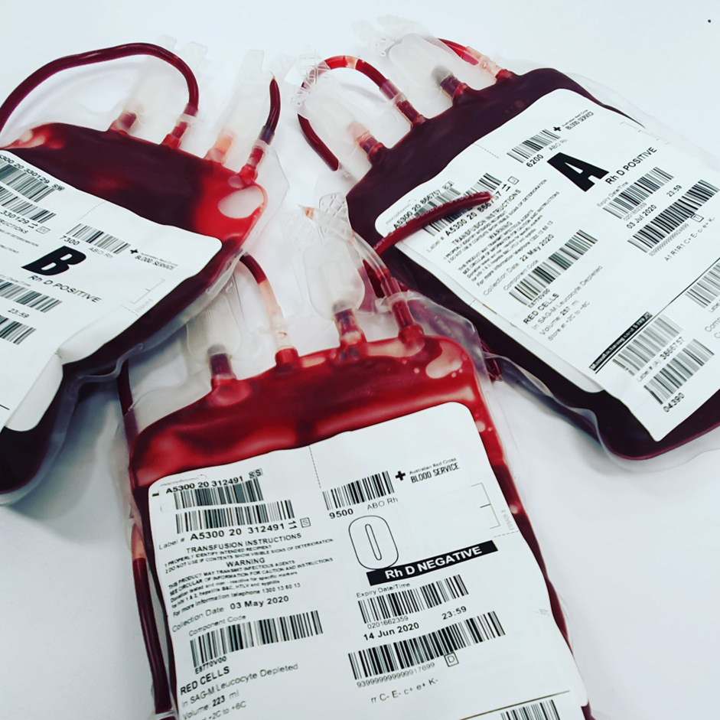
WBS
BHNOG
22 June 2026
Karin Jackson
Chief Executive NIBTS
Director Pathology Blueprint Programme
SRO coreLIMS & BPaT Projects

Slide 2






Agenda
Infected Blood Inquiry Rec 7
Pathology Blueprint Programme
Digital Infrastructure Transformation
Questions & Discussion

Slide 3
Infected Blood Inquiry Recommendation 7f
IBI Report Recommendation :
“There should be a system capable of full …traceability from donor to recipient and recipient to donor.”
“so that any recipient of blood or blood products can be identified”
“Data systems should be improved and integrated so that information about transfusion and blood products can be readily identified, shared and used for patient safety.”
UK Government Response :
“Government accepts the need to strengthen systems for transfusion safety, including improved data, traceability and haemovigilance arrangements.”
“The response commits to improved data systems, better information sharing, and strengthened traceability to ensue patient safety and rapid identification of affected individuals.”
Infected Blood Inquiry (2024), Final Report, Vol.1 – Overview and Recommendations, Recommendation 7f : Patient Safety – Blood Transfusions
UK Government (2025), Government Response to the Infected Blood Inquiry, Recommentation 7 : Patient Safety – Blood Transfusions

Slide 4
Infected Blood Inquiry Recommendation 7f
Northern Ireland Executive Response (May 2025) :
As part of an extensive programme of transformation and modernisation …. a new regional pathology management structure, will … introduce digital interoperability across the whole local system and digitalisation of pathology services through three electronic systems for blood transfusions:
  a regional Electronic Patient Record (EPR) will create a single digital care record for every citizen in Northern Ireland who receives health and social care;
  for laboratories and blood banks, the WinPath Core Laboratory Information Management System (LIMS) will significantly improve the delivery of key clinical diagnostic services; and
  the new Blood Production and Tracking (BPaT) solution will integrate blood production and tracking information to provide a fully functioning regional electronic vein-to-vein donor management, blood production and tracking system.

Slide 5

Pathology BluePrint
Programme

Slide 6

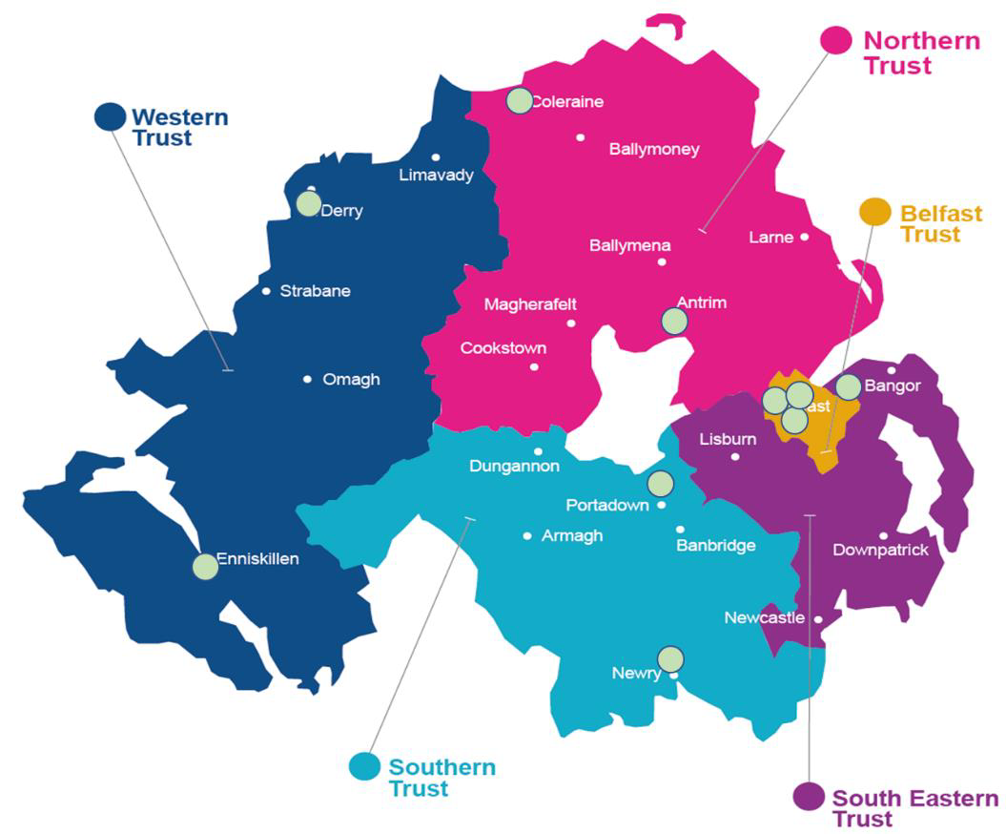
HSCNI Laboratory Locations
Population ~1.9m
HSC Labs & Routine Lab Services
HSC Regional Specialist Lab Services
NI Blood Transfusion Service

Slide 7

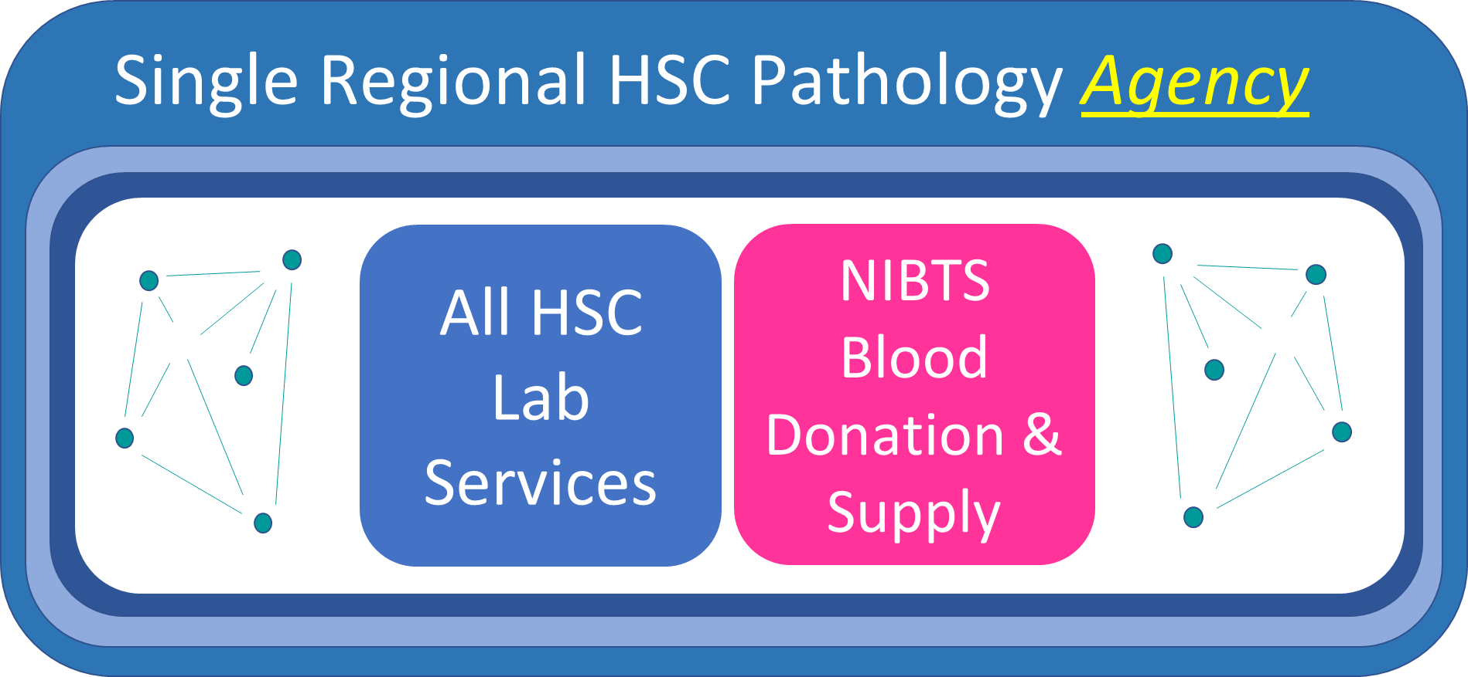
Outcome of Options Appraisal with Stakeholders

Slide 8
HSC Pathology Transformation Portfolio
Rationale for Agency:
Current governance is fragmented
Need rapid & effective regional decisions
Governance capability required does not currently exist
Emerging patient safety issues
HSC genomic testing v’s UK
Upcoming major procurements / previous challenges
Lab Estates pressures >£100m
Workforce challenges
Local demand/capacity planning = high cost model
Rising costs

Slide 9

NIPIMS
(Northern Ireland Pathology Information Systems)
Programme

Slide 10
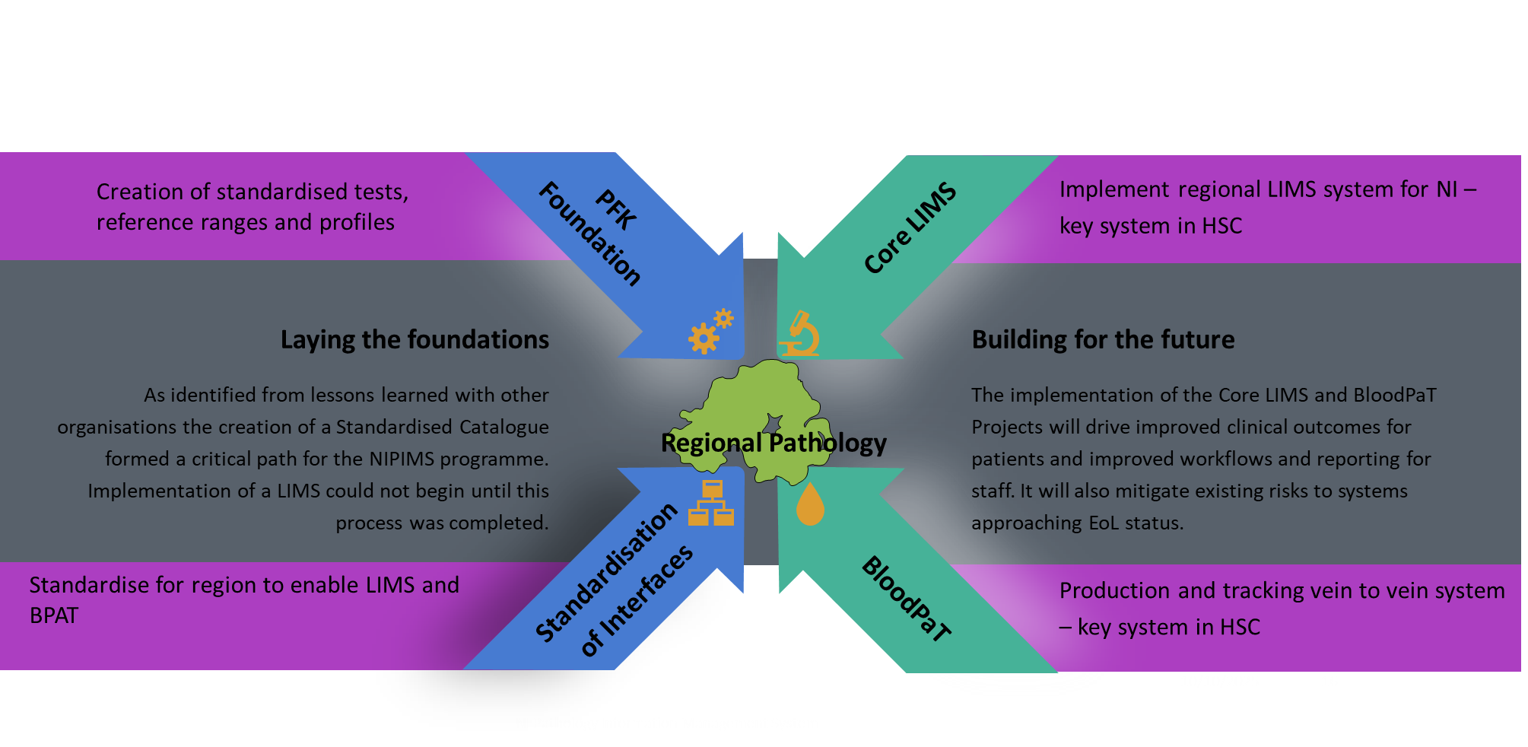
What makes up the NIPIMS Programme?
Notes:
We believe the work that went on before in relation to Pathology Foundation Keystone project has laid the foundations for the introduction of both a Regional LIMS and Regional Blood Production & Tracking solution. Indeed through various engagements with SNBTS, WBS & recently NHSBT they are quite envious of our position whereby a regional BPaT solution is enabled via a Regional LIMS, throughout other UK jurisdictions there are multiple LIMS which either complicates this or prevents it from being a reality

