Slide 1

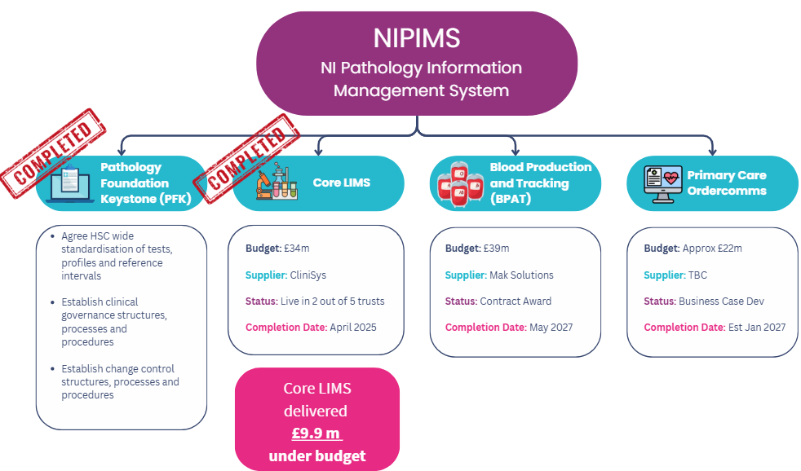
Pathology Digital Transformation

Slide 2

coreLIMS

Slide 3

LIMS Legacy State
Haematology
Biochemistry
Transfusion (Blood Bank)
Point of Care Testing
Microbiology
Virology
Serology
Immunology
Cellular Pathology
Mortuary
Molecular Diagnostics
BioBanking
Genetics
Antenatal Screening
Transfusion (Blood donation)
Hosted: NIBTS
Used: NIBTS
Pulse System
Blood Donation, Testing & Production
Hosted: NIBTS
Used: NIBTS
Diagnostic Services / DSS
Specialist Testing within NIBTS
BSO LABS (x5)
Live 1980s
BSO LABS (x5)
Hosted: BSO
Used: NHSCT, SHSCT,
SEHSCT, WHSCT
BSO LABS (x5)
BSO LABS (x5)
BSO LABS (x5)
Multi discipline routine testing
(incl. Hospital Blood Bank Modules)
Live 1990s
Hosted: BHSCT
Used: BHSCT & Regionally
LabCentre
Multi discipline routine & specialist testing
(incl. Hospital Blood Bank Modules)
Live 2000s
StarLIMS
Hosted: BHSCT
Used: BHSCT
StarLIMS
Genetics routine & specialist testing
40 Million+ tests per annum
70+ data interfaces. Multiple downstream systems, including Cancer Pathways, PHA, GP, etc.
Notes:
VUCA Volatility, uncertainty, complexity and ambiguity – now the norm in the HSCNI

Slide 4


coreLIMS
COMPLETE
COMPLETE
COMPLETE
Cell Path & BHSCT Blood Transfusion
Go-Live BHSCT
Go-Live NHSCT
Nov 2023
Nov 2023
June 2024
Oct 2024
Oct 2024
Spring 2025
COMPLETE
COMPLETE
Cervical & SEHSCT Blood Transfusion
COMPLETE
Go-Live WHSCT/SHSCT
Go-Live SEHSCT
Core LIMS was fully rolled out in 13 hospitals, over 300 GP surgeries across 5 Trusts and NIBTS over
18 Months

Slide 5
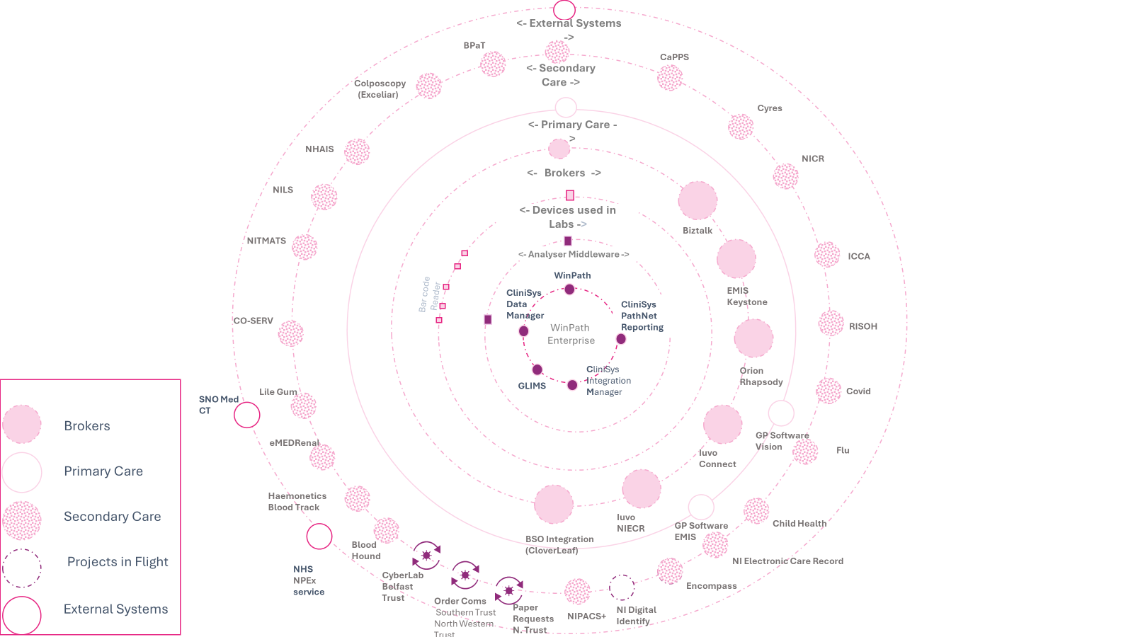
coreLIMS Integrations

Slide 6
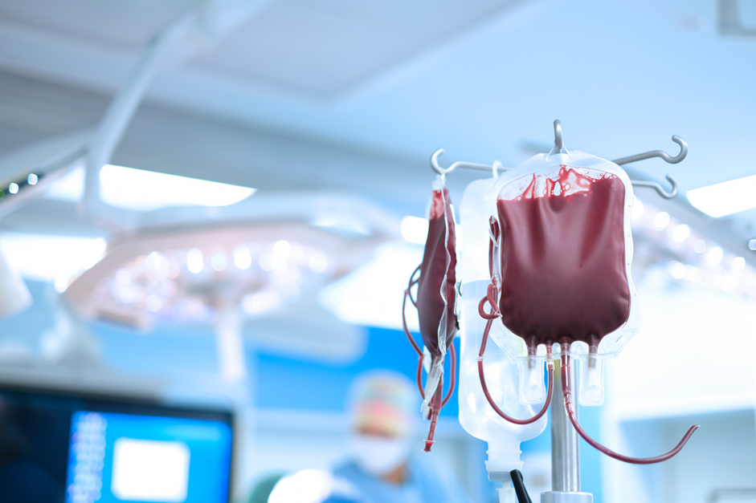
BPaT
(Blood Production & Tracking)

Slide 7


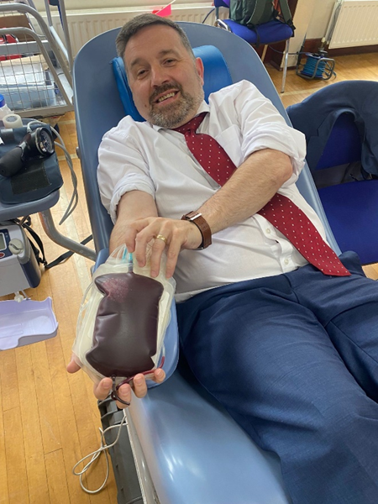

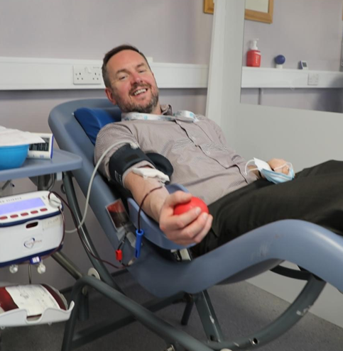
Current Situation
1 in7 people entering hospital need a blood transfusion and 1 in 4 will need a transfusion in their lifetime
500 people in NI need at least one unit transfused each week
800 blood donations at 180 different locations each year
Robust management of cold (red cells) and warm (platelets) chain essential
NIBTS issued over 52,000 blood components and processed an additional 58,000 blood samples in 2024/25
Currently, no digital information flow from blood production to hospital blood tracking systems and limited digital donor management (IBI recommendation)

Slide 8
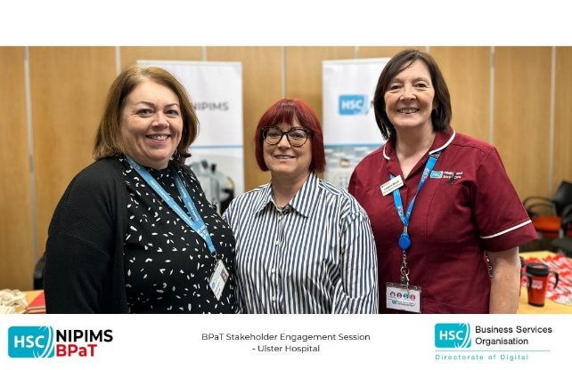

Increasing safety and quality
Pulse System hosted by NHSBT, 25+ years old, out of support July 2025
Fit for purpose Blood Production system including a CRM and online donor web portal
Enhanced stock and demand management, more effective donor management
- Increased real time surveillance
- Improved ability to demonstrate compliance
- Enhanced ability to support safety through auditability and traceability
Production
Combination of electronic and paper based tracking
Fit for purpose Blood Tracking solution, tracking from blood donor to patient prescription across regional LIMS solution
Enabling tracking audit and ensuring cold chain integrity
Tracking
Notes:
• Enhanced stock management and demand management
• More effective donor management and stakeholder
communications/engagement
• Increased real-time surveillance of control point and transactions
• Improved access to business intelligence, including ability to demonstrate compliance
• Enhanced ability to support safety and to provide auditability and
traceability
• Enhanced interoperability and potential flow of clinical staff

Slide 9
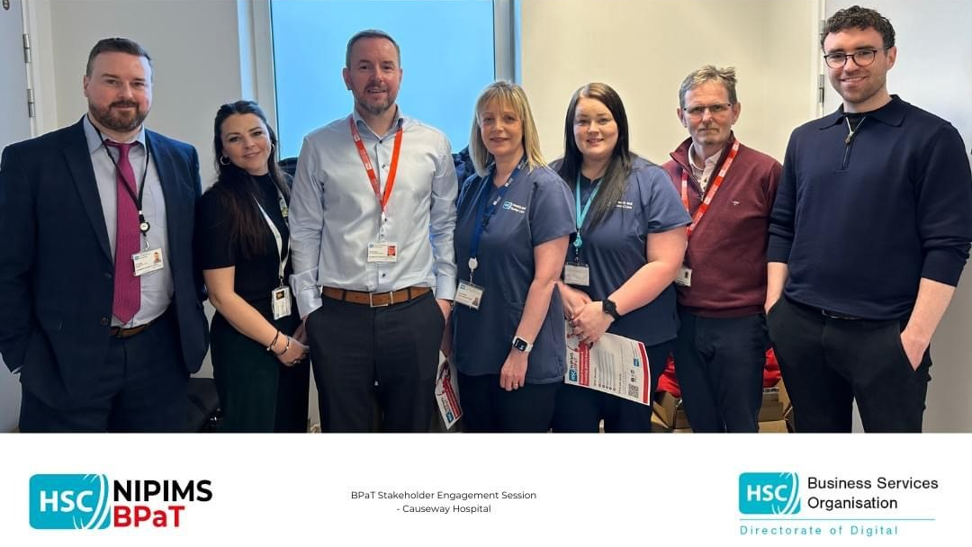
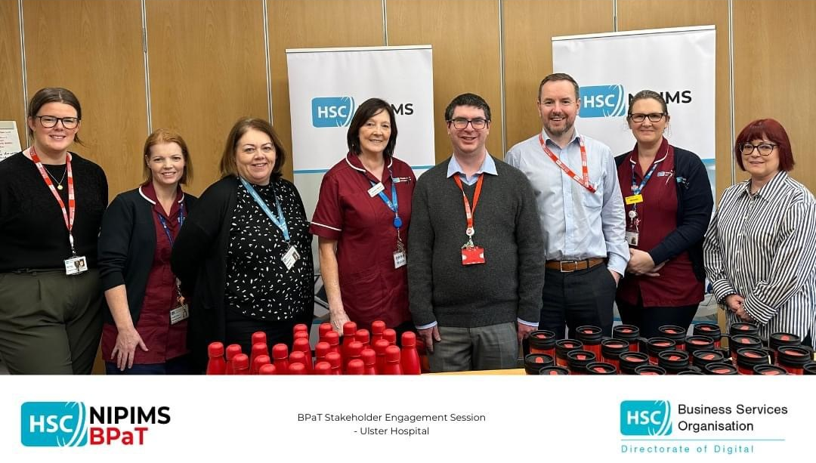





Progress and Timeline
Programme Stages
Business as Usual
Business case approval Dec 2021, procurement and contract awarded Feb 2024
Trusts -
Go Live
Design
NIBTS -
Go Live
Build
Train
Test
(Verify & Validate)
Dec 2021
Jun 23-Jan 24
Oct 2025 – Sept 2027
Project Overview
Launch Event May 2024
  Programme Manager - Patrick Breen
  Capital Budget - £20M
  Revenue Budget- £16M
  ITS Staff Compliment- 12
  Project Completion Date - March 2028
OBC
Spec
Procurement
Contract
Award
Design & Imp
BAU
Tender was published Friday 3rd Mar 2023
Jul 2022
Feb 2024
Oct 2027

Slide 10
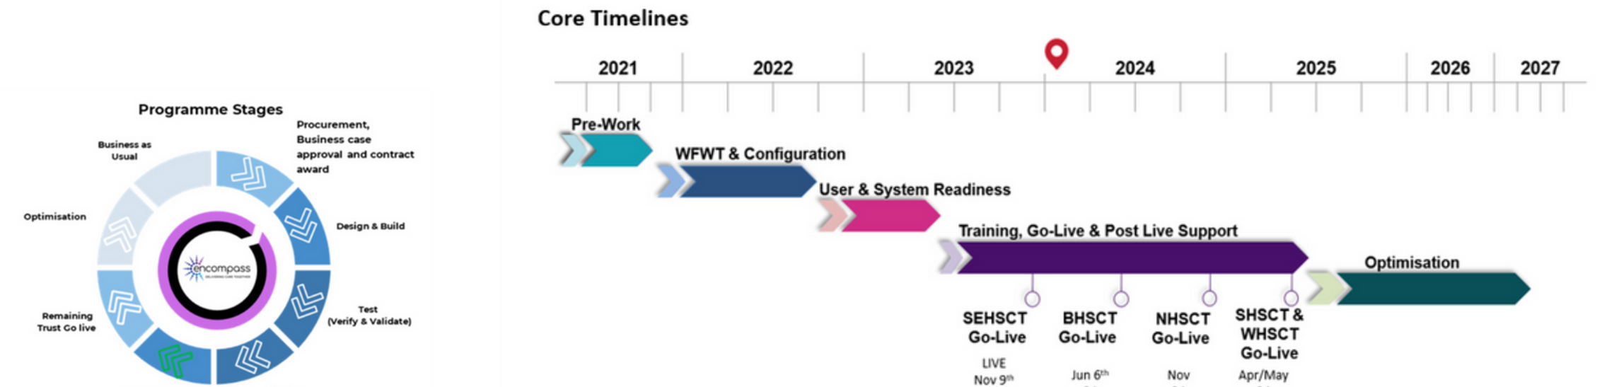
OVERVIEW OF HSC DIGITAL STRATEGY
Encompass Programme Stages and Timelines
The Programme aims to provide a single Electronic Health Care Record for all citizens within Northern Ireland, replacing legacy ICT systems and paper-based processes within all Trusts, with a “once for Northern Ireland” standardised approach across a range of clinical pathways within both the Acute and the Community Sectors.
Given the scale of digital transformation across HSCNI it has been necessary to manage encompass as a separate regional programmes within BSO but outside of ITS.

Slide 11




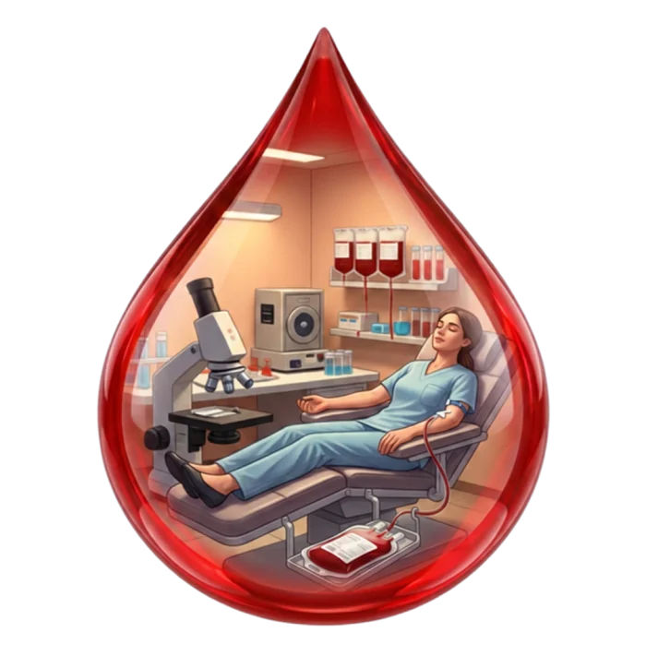

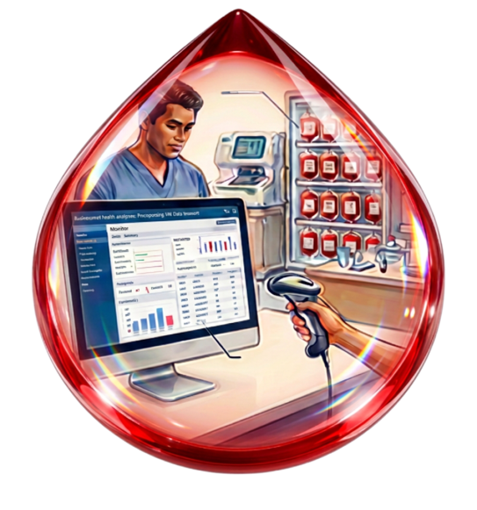





Hospital Blood Bank
Patient Bedside
NIBTS
Hemonetics Bloodtrack
Epic BPAM
WEB-BASED ORDERING
DONOR RECRUITMENT/ENGAGEMENT, DONATION, TESTING, PROCESSING, STORAGE
INVENTORY MANAGEMENT
IDENTITY VERIFICATION
BARCODE TRACING
TRANSFUSION
eProgesa
CliniSys WPE LIMS
Epic EPR

Slide 12

PS : EU SoHO Regulation 2024/1938
(applies to NI under Windsor Framework; subject to DHSC Call for Evidence, March 2026)
Traceability defined in Article 3(53) as the ability to locate and identify SoHO from collection to human application, establishing full lifecycle tracking
Applies across all activities in Article 2(1)(c), including collection, processing, distribution and clinical‑outcome registration
Loss of traceability is classified as a serious adverse event under Article 3, reinforcing its role as a core safety requirement
A central EU SoHO Platform (Articles 73–74) provides digital infrastructure for registration, data exchange and regulatory coordination across Member States
The Regulation is designed to “implement digital‑ready policies”, signalling the need for interoperable, registry‑based systems to support traceability and oversight

Slide 13


Questions & Discussion

