Slide 1
Infected Blood Inquiry – Benchmarking, Data and Digital
Paul Mason – Head of Information Standards

Slide 2
Agenda
The Importance and Purpose of Data Standards
Example of current Standards
Provide progress update on IBI data & digital work
Confirm direction of travel
Highlight next steps

Slide 3

The Importance and Purpose of Data Standards
Can you find a piece of stationery?
How many of you have a pen?
How many of you have a blue pen?
Clear instructions with well-defined definitions
“Data standards in NHS Wales ensure information is captured consistently, shared seamlessly, and trusted to improve patient care.”

Slide 4
Example – Outpatient Modernisation
Phase 1
Referrals
Phase 2
Outpatient Activity
Phase 3
New Outpatient Waiting List
Phase 4
Follow-Up Outpatient Waiting List

Slide 5
Example – Outpatient Modernisation
Requestor – Welsh Government
Development – Data Standards Team
Approval – Welsh Information Standards Board
Implementation – Across HB’s and Trusts
Analysis – Central data
Data Insights and outputs - Understand the service in more detail
Change and adaptation – Change the service following

Slide 6




Why do we need standards?
This Garage?
Can you build me a garage?
This Garage?
Or this Garage

Slide 7

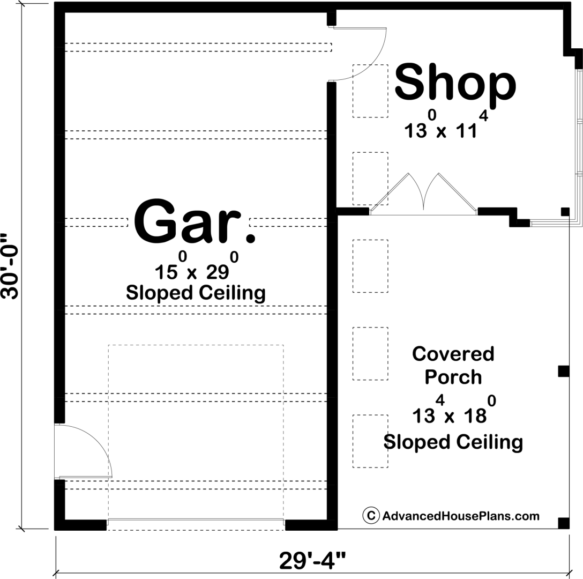
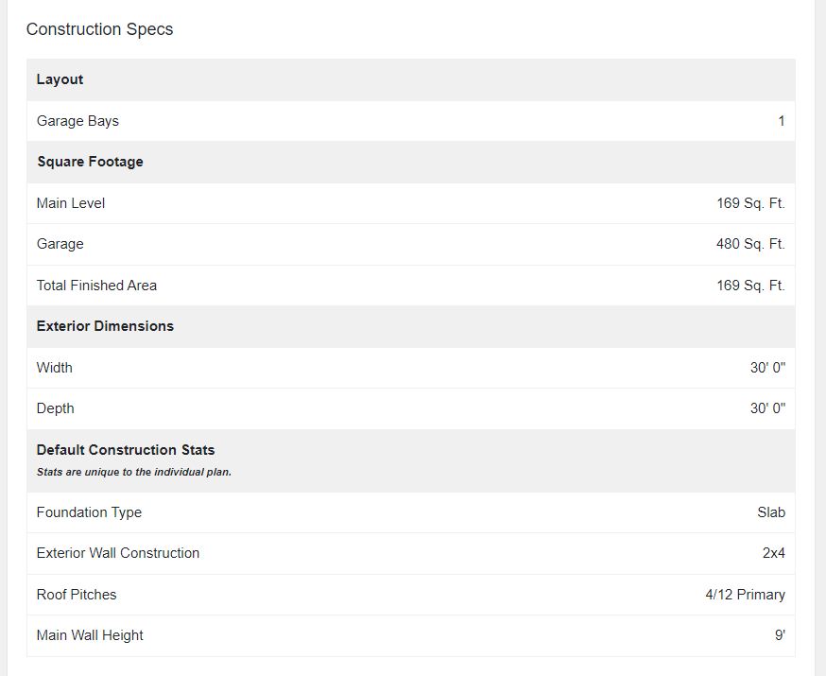
Why do we need standards?

Slide 8
Data Architecture
The Care Data Repository(CDR) will act as the central data store, enabling cross-sector data sharing.
Data stored within the CDR will be replicated into the National Data and Analytics Platform(NDAP) to support analysis and reporting.
Access will be governed through appropriate controls and approvals.
Source Systems
CDR
NDAP

Slide 9
Patient pathways
Centralised data storage within the CDR
Supports the joining of patient pathways across organisations
Improves visibility and continuity of care.

Slide 10
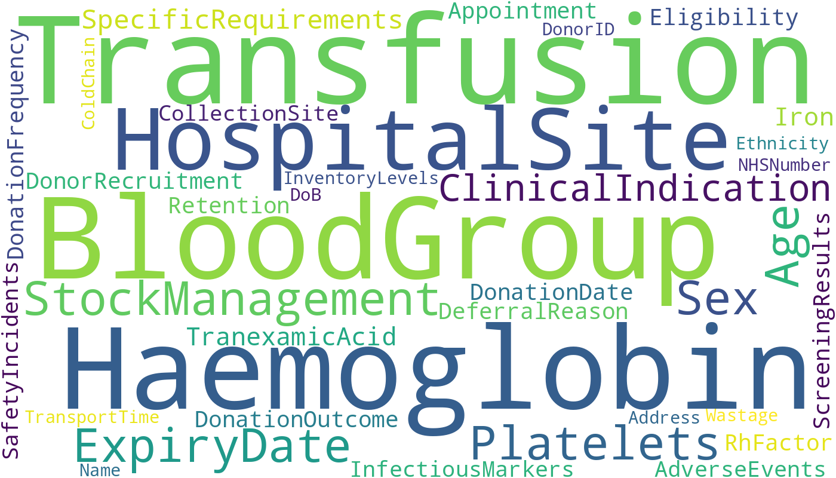
Possible data items needed for a robust data set

Slide 11
Data Governance and Secondary Use
Governance:
Robust data governance ensures data is used, shared, and accessed appropriately.
Data Protection Impact Assessment(DPIA) supports compliance and risk management.
Secondary Use:
A dataset will be developed via Data Standards Change Notice(DSCN), enabling consistent measurement and reporting. Approval at the Welsh Information Standards Board (WISB)
Use of row-level data will support detailed analysis and pathway linkage.

Slide 12
Working Group
Working Group
Heads of Information
Data Standards
CDR & NDAP
Information Governance
Clinical Rep
WBS
Business Analyst
Programme & Project Support
Working group includes:
Heads of Information (Health Boards)
Data Standards (DSCN development)
CDR and NDAP Architects
Information Governance (including DPIA)
Clinical representatives (e.g., pharmacists)
Welsh Blood Service
Business Analysts
Programme and Project Support

Slide 13
Next Steps
Confirm working group membership
Define dataset scope
Progress DSCN
Develop governance framework
Draft a Statement of Requirements and Outline Business Case

Slide 14
Any Questions

