Slide 1

CSP
Reimagining Blood Components:
Revival, Reinvention and the Road Ahead
Dr Chloe George
Consultant Clinical Scientist
Head of Component Development & Research

Slide 2

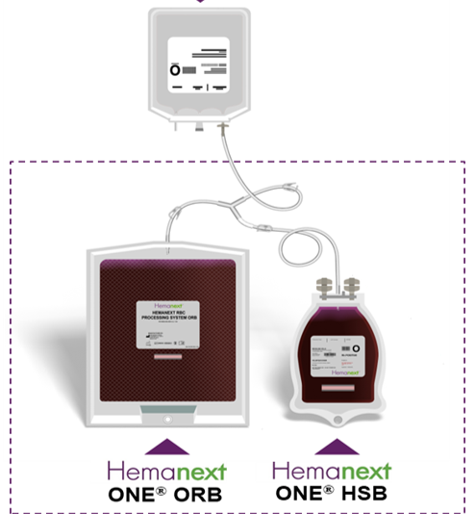
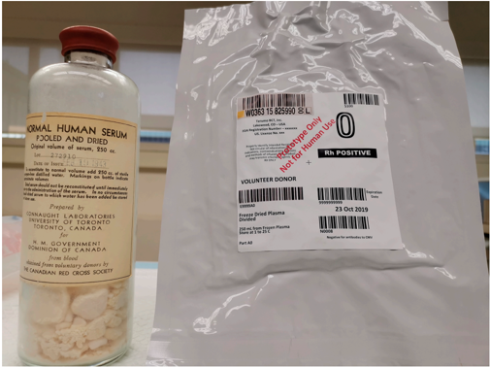
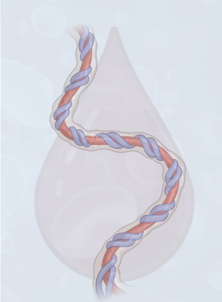
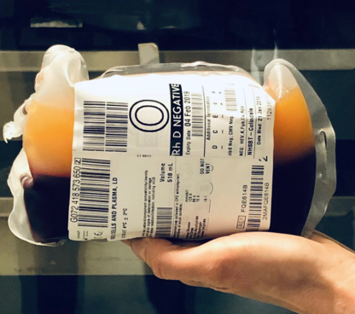
The Blood Component Horizon

Slide 3
CSP
Revival and Reinvention

Slide 4
Whole Blood

Slide 5
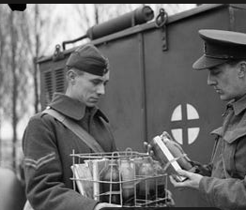
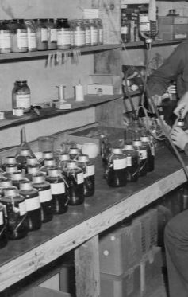
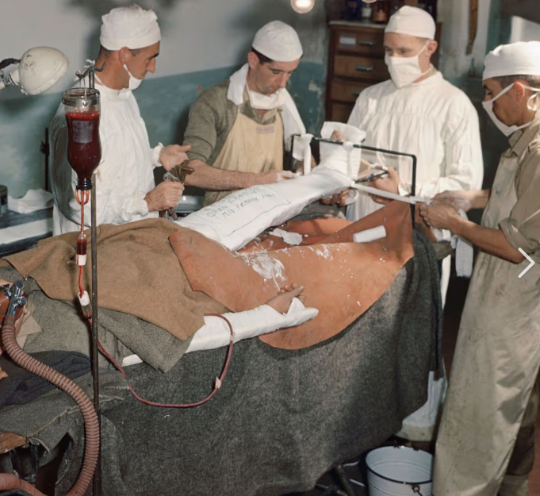
Whole Blood history
First used in WWI and WWII
During Vietnam war era WB replaced with crystalloids and colloids for haemorrhagic shock
1960’s: Transitioned to individual component therapy and WB became unavailable
Pendulum has now swung back to ‘reconstituted WB’ with components in 1:1:1 for traumatic haemorrhage
Notes:
First used WW quickly became the preferred fluid for resuscitating patients in HS Field blood banks – fresh WB collected and transfused straight away
During Vietnam war era WB replaced with crystalloids and colloids for haemorrhagic shock
Overuse of crystalloids and colloids resulted in dilutional coagulopathy and severe interstitial oedema
RCC (lacking plasma and plts) replaced WB but initially physicians did not realise that they were not as efficacious as WB in treating patients with HS (shock + coagulopathy) - led to an era of acute respiratory disctress syndrome, multi organ failure and abasarca in ICUS
Transition from WB to components influcenced by tehe conomics of blood banking and ability to provide specific blood compoonents needed for isolated defects EBC anaemia, plts thrombocytopenia, plasma for coagulopathy Also req for PfM plus maj going to haem onc patients who needed only RCC or plts to treat cytopenias
Hemostatic resuscitation is the central tenet of DCR. This concept recognizes that a blood-based transfusion strategy is optimal for severe bleeding and that crystalloid-based or colloid-based resuscitation cause hemodilution, acidosis, and a steady decline in oxygen delivery, which aggravate underlying coagulation and metabolic disorders that evolve following injury and blood loss ^{[2]}. Although a natural and obvious hemostatic resuscitation product would be whole blood, it is not commonly available in the developed world, so many substitute components are transfused at high ratios of plasma and platelets to red blood cells (RBCs) that range between 1 : 1 : 2 and 1 : 1 : 1 units, respectively

Slide 6

Whole Blood: different types
Warm Fresh WB
Military or austere settings
NOT for routine use
Stored ambient, used within 24 hrs
Pretested donors screened for TTDs
Not LD
LD Red Cells in Plasma (RCP)
Stored cold 2-6oC
21 day shelf life
Max of 4 units should be txned to non-group O patients
Approved for use in UK
Platelet sparing LD-WB
Filter that removes WBC not plts
Stored cold 2-6oC
21 day shelf life
For trial use in UK
Intended for treatment of life-threatening bleeding requiring rapid balanced txn support
Low titre Group O
LTOWB
Notes:
Norway is a pioneer in adapting military WBB concepts for civilian use to overcome the challenges of extreme weather, long transport distances, and remote communities. A decentralized system is needed to ensure local self-sufficiency in an emergency

Slide 7

Dried Plasma

Slide 8

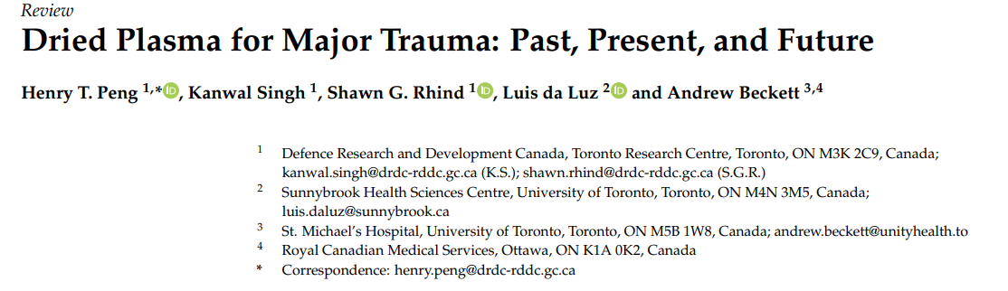
Dried Plasma
1943
2019
Peng, H.T.; Singh, K.; Rhind, S.G.; da Luz, L.; Beckett, A. Dried Plasma for Major Trauma: Past, Present, and Future. Life 2024, 14, 619. https://doi.org/10.3390/life14050619
Slide courtesy of Surg Com Tom Scorer
Notes:
Dried plasma was an essential element and undoubtably saved lives on battlefield of WW2 and beyond.
Need to have ability to manufacture, store and move at scale
SDP can be stored for 2 years at 4°C, 6 months at 20-25°C, and 3 months at temperatures up to 30°C.
The following storage times and temperatures are recommended for dried plasma systems in development:
Storage time: 15 to 24 months.
Storage temperature: +2°C to +24 °C.

Slide 9
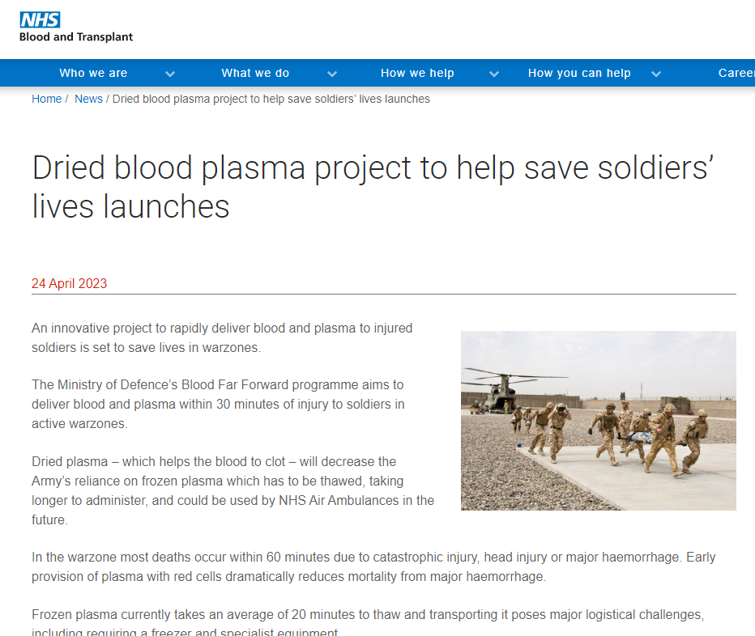
Dried Plasma
SDP can be stored:
  2 years at 4°C
  6 months at 20-25°C
  3 months up to 30°C
Reduced reliance on cold chain
Reconstitution vs thaw
Available where other blood components can’t be
Use closer to point of injury
Can be stockpiled and enable pre-positioning
Slide courtesy of Surg Com Tom Scorer

Slide 10
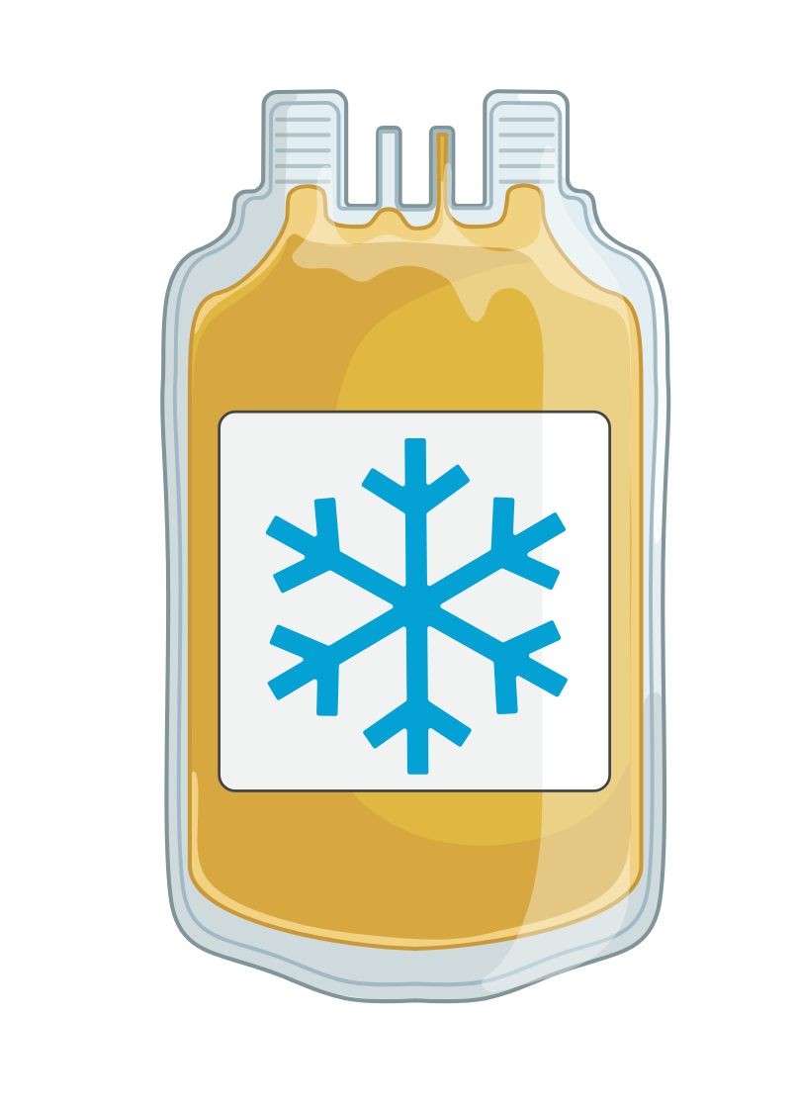
Cold Stored Platelets

Slide 11

Cold Stored Platelets: The Early Days (1960’s)
Stored at 4ºC for patients on intensive chemotherapy
Rising demand → research to extend shelf life
Cr⁵¹ labelled platelets comparing survival of RTP vs CSP:
  RTP survival ~4 days > CSP 1-2 days
CSP more effective at correcting bleeding time than RTP
Dual inventory proposed
But…… CSP abandoned by late 1970’s
Notes:
1969 ⁴ studies: RTP (7–9 days) > CSP (2–3 days) survival
CSP better at correcting bleeding time
Dual inventory proposed
CSP abandoned by late 1970s~
Initially in the 60’s when PC were first manufactured they were stored cold with a 1 day shelf life and use to treat thrombocytopenia in patients with malignant disorders undergoing intensive chemo
All in haem onc patients using microdosing to show effect based on this that CSP was abandoned!

Slide 12
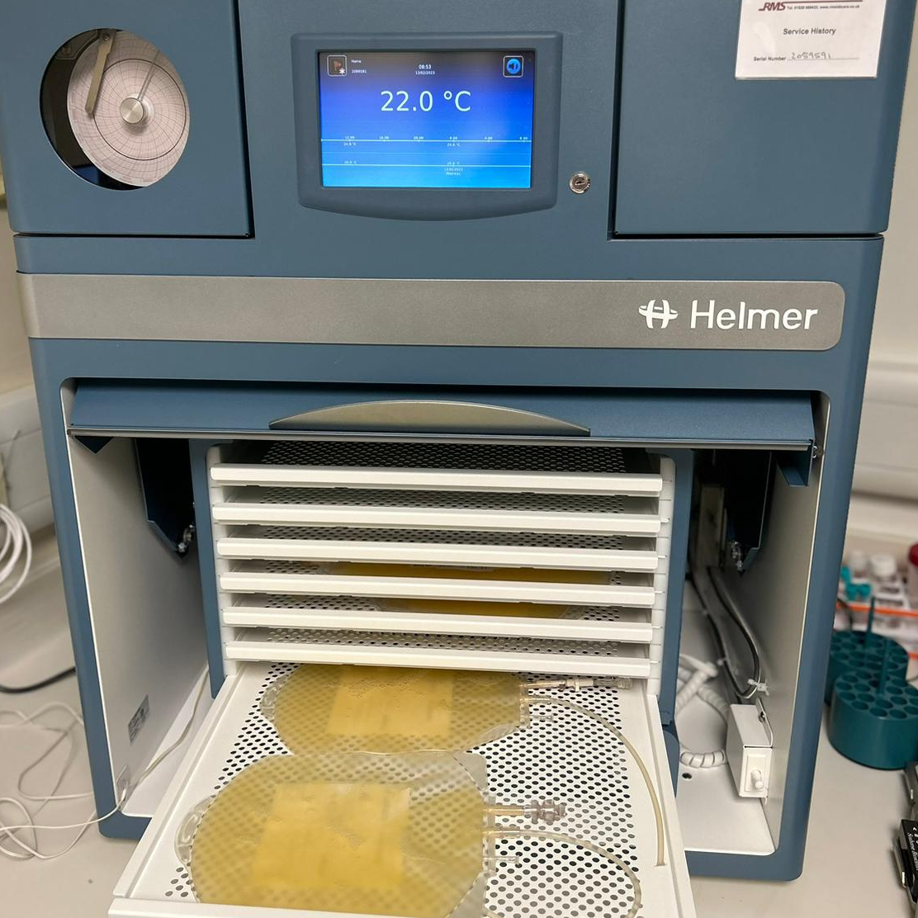
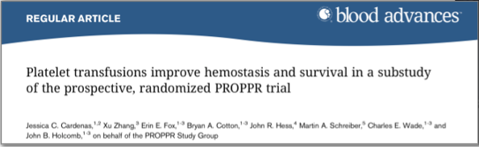
Platelets - current standard of care
Storage: 22ºC +/- 2ºC, constant agitation
Used: prophylactically and therapeutically
Platelets are included in major haemorrhage packs in hospital
However….
Short shelf life (7 days)
Risk of bacterial contamination
Only available for in-hospital use
Notes:
Early platelet transfusion in severely injured, bleeding patients improves haemostasis and reduces mortality
Pragmatic, Randomized Optimal Platelet and Plasma Ratios 2015

Slide 13
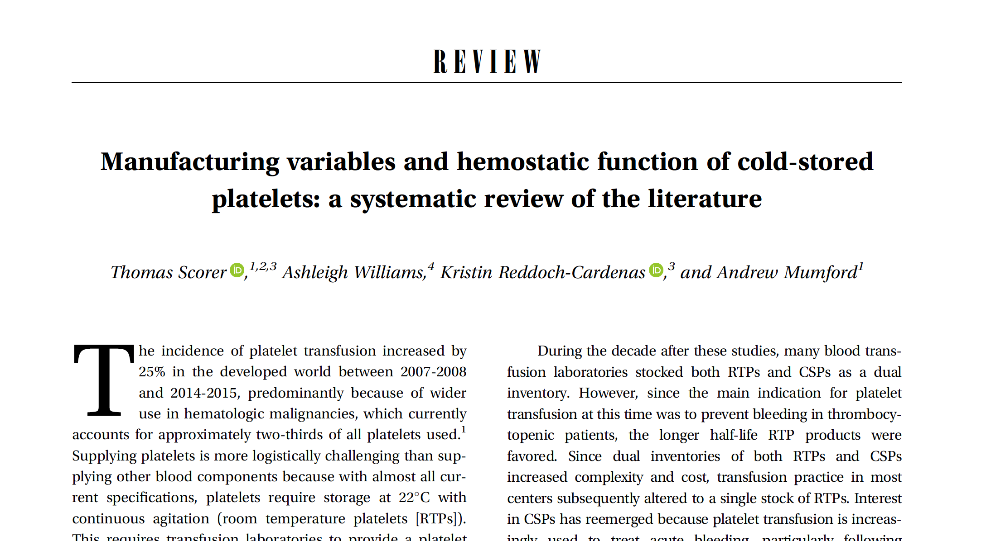
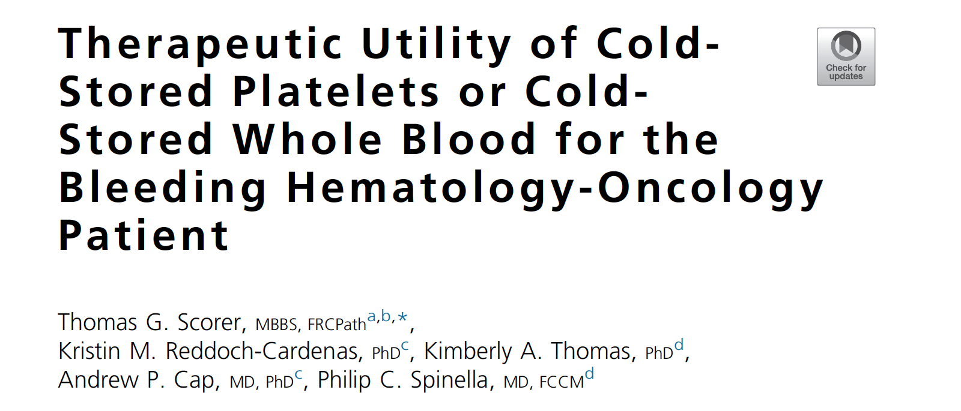
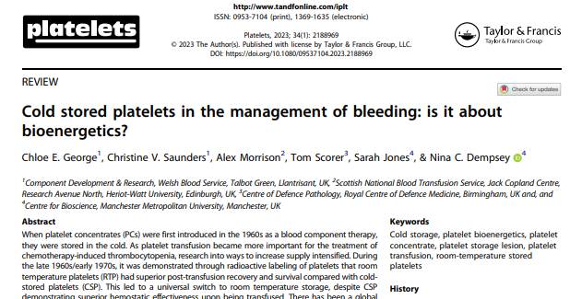
Cold Stored Platelets – New Evidence
Improved aggregation responses
Stronger clot formation
Higher basal activation
Reduced bacterial proliferation
Logistical benefits for austere and rural
environments inc. combat/mass casualty
Respond to inhibition
Cleared from circulation in 2-3 days
Safer, Better, Longer
Enables PLT transfusion in more remote and constrained settings
Notes:
Study name
So what is the evidence for CSP?
Building body of evidence suggesting CSP have a number of features which indicate suitability for managing bleeding patient.
Outlined below.

Slide 14




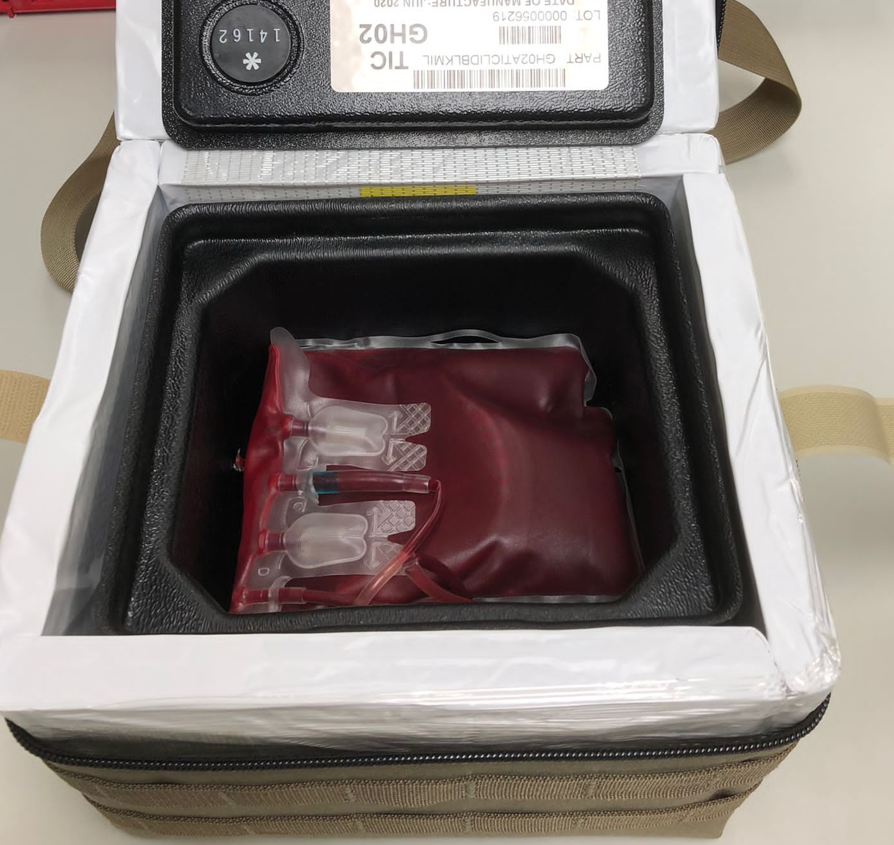
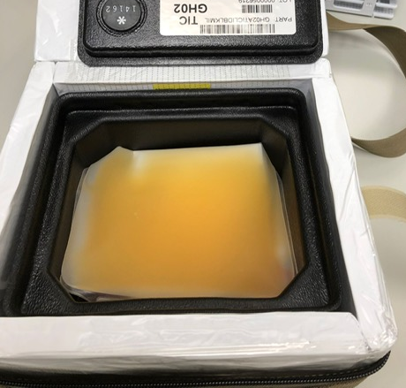

Clinical Trial: Cold Stored Platelets

Slide 15
CSP
The road ahead…

Slide 16
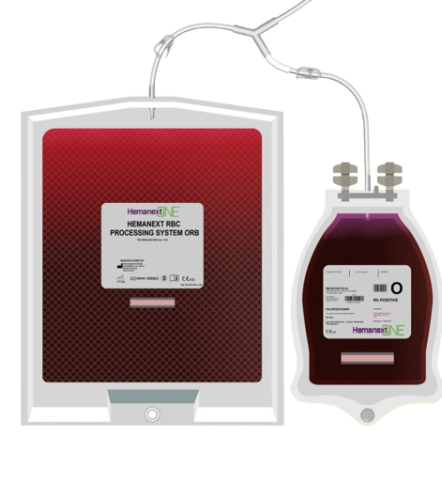
Hypoxic Red Cells

Slide 17
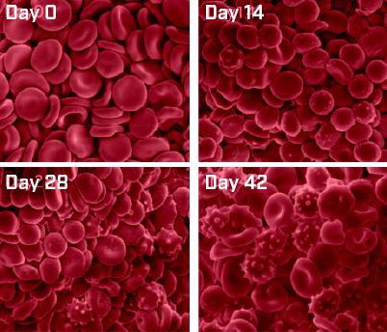
Red cell storage lesion
Storage lesion: metabolic, oxidative, and structural changes to red blood cells during refrigerated storage^{1,2}
Limited shelf life 35 days in additive solution
Quality metric of haemolysis <0.8% at end of shelf life
A median of 17.6% of RBCs are cleared from the circulation within 24 hrs of txn²
Remaining RBCs become less deformable over time^{1,2}
This impacts blood flow and reduces RBC’s ability to deliver oxygen after transfusion^{1,2}
Oxidative Damage during storage has been shown to be an important factor of why RBCs degrade5
Degradation of conventional RBCs over the storage period³
1.Orlov D and Karkouti K. The pathophysiology and consequences of red blood cell storage. Anesthesia 2015;70 (Suppl. 1). 2.Yoshida T and Shevkoplyas SS. Anaerobic storage of red blood cells. Blood Transfus 2010;8:220-36. 3.Mustafa et al. Time dependent assessment of morphological changes: leukodepleted packed red blood cells stored in SAGM. BioMed Research Intl. 2016. 4.DeSantis et al. Characterizing red blood cell age exposure in massive transfusion therapy: the scalar age of blood index (SBI). Transfusion. 2019;9999;1-10.5.Yoshida et al. Red blood cell storage lesion: causes and potential clinical consequences. Blood Transfus. 2019; 17:47-52.
Notes:
Storage of RBC in preservative medium is associated with harmful metabolic, biochemical and molecular changes to erthryoctes known collectively as the storage lesion
Most probable sites of damage will be cytoskeletal proteins in RBC membrane leading to RBC becoming fragile and increase in osmotic fragility
Day 0 – normal morphology nice biconcave shape
Day 14 – cells start transforming into spherocytes and echinocytes, the number of these cells can be seen to increase in day 28 and day 42
Echinocytic rigid cells with reduced function microvesiculation and hemolysis
Less deformable over time a characteristic necessary to adequately perfuse the microcirculation
In addition to metabolic impairments (production of nitric oxide scavengers, free and non-transferrin bound iron and bioactive lipids) prolonged exposure to oxygen can result in decreased quality of RCC characterized by increased stree mediators including thromboxaneleukotrines and methemoglobin that contribute to decreases therapeutic potential

Slide 18


Hypoxic red cells
Oxygen content is reduced to less than 20% oxyhaemaglobin [% SO₂]
CE marked & FDA approved
LD RCC collected as per standard process
Connected to Hemanext ONE system and placed on a platelet agitator – 3 hrs
O₂/CO₂ reduced RCC stored at 2-4ºC
Notes:
A potential solution to reduce oxidative stress on stored red cells is hypoxic storage
Higher levels of ATP and 2,3 DPG
Improved morphology and deformability
In vitro studies
Animal studies – improved resustation efficiency rats
Studies in haemoglobinopathies and chronic transfusion diseases MDS

Slide 19

Cord Blood for Neonatal Transfusion

Slide 20

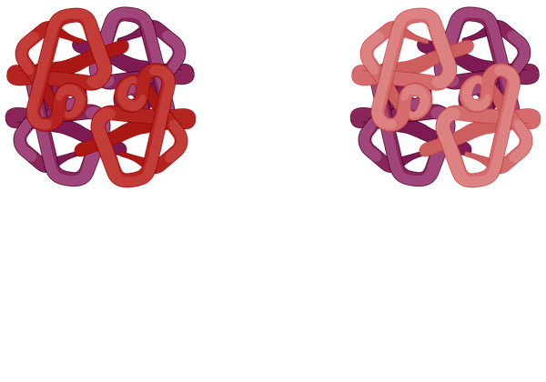
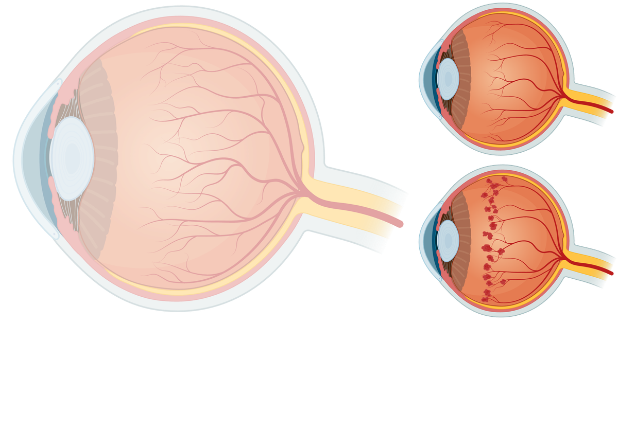
Transfusion of pre-term neonates
Background
<28
WEEKS
Extremely low gestational age neonates (ELGANs; <28 weeks) are at high risk of retinopathy of prematurity (ROP).
Standard adult RBC transfusions progressively replace fetal haemoglobin (HbF) with HbA, reducing antioxidant capacity and oxygen‑delivery characteristics.
Low HbF levels strongly correlate with higher ROP severity in multiple prospective and retrospective studies.

Slide 21
Cord blood for neonatal transfusion
Cord blood RBCs have high HbF
Transfusion with cord blood would prevent HbF depletion and could reduced ROP severity
Cord blood is collected from consenting mothers
Processed into RCC and stored

Slide 22
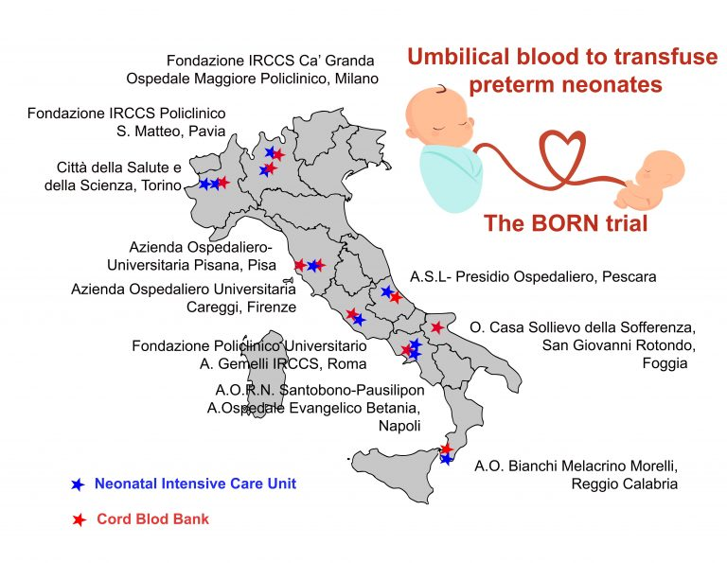
BORN Trial: Results
BORN trial results
Severe Eye Disease (ROP)
0% developed severe ROP
34% developed severe ROP
Need for Eye Treatment
0% needed treatment (laser or injections).
26% needed treatment.
Lung Disease (BPD)
29% exhibited moderate/severe BPD.
63% exhibited moderate/severe BPD.
Safety
No safety concerns were linked to cord‑blood transfusions.
Both blood types raised routine blood parameters equally well.
When babies received cord‑blood transfusions, they had far better eye and lung outcomes.
Teofili, L. et al. (2025)
Notes:
Unbilical blood to transfuse preterm neonates multicentre double blind trial in ital 146 ELGANS control adult RBC transfusions
If effective, this strategy could reduce ROP severity, improve neurodevelopmental outcomes and be rapidly adopted even in resource‑limited settings.
1. Severe Eye Disease (ROP)
When babies actually received cord‑blood transfusions (not mixed with adult blood):
0% developed severe ROP
34% of babies who received only adult blood developed severe ROP
➜ Cord‑blood seemed to eliminate severe eye disease in this group.
[BORN Study...702500358X | PDF]
In the full analysis (including babies who couldn’t get cord blood due to supply limits):
➜ Rates looked similar between groups.
(Because 43% of “cord‑blood” babies received adult blood instead.)
[BORN Study...702500358X | PDF]
2. Need for Eye Treatment
0% of babies who received only cord‑blood needed treatment (laser or injections).
26% of babies who received only adult blood needed treatment.
➜ Cord‑blood greatly reduced the need for eye procedures. [BORN Study...702500358X | PDF]
3. Lung Disease (BPD)
Moderate/severe BPD:
29% with cord‑blood
63% with adult blood
➜ Cord‑blood was linked to healthier lungs.
[BORN Study...702500358X | PDF]
4. Safety
No safety concerns were linked to cord‑blood transfusions.
Both blood types raised blood counts equally well. [BORN Study...702500358X | PDF]
⭐ Overall Message
When babies truly received cord‑blood transfusions, they had far better eye and lung outcomes.
Cord‑blood may offer important protection — but supply issues meant not all babies could receive it.

Slide 23
Thank you and any Questions?

