Slide 1

PREMs and PROMs
ABUHB Preoperative IV iron
Dr Christopher Whitfield
Consultant Anaesthetist ABUHB

Slide 2
Our Service Structure
ABUHB is a hub and spoke model Health Board
General PAC clinic and Orthopaedic PAC clinic
Clinic codes have been key in automation
Remote referral and prescribing
Online documentation

Slide 3
What are PREM and PROM forms?
PREMs (Patient-Reported Experience Measures):
Focus on patient experience of care
Example: communication, comfort, accessibility
PROMs (Patient-Reported Outcome Measures):
Focus on patient health outcomes
Example: symptoms, quality of life, fatigue

Slide 4
Timelines for PREM and PROM forms
PREMS
3 days following a clinic attendance triggered automatically as a text to our patients.
PROMS
Triggered 2 days pre clinic appointment and if not completed pre appointment in person second opportunity using Promptly Kiosk function at clinic attendance.
Follow up form triggered at 6 weeks post clinic attendance.

Slide 5
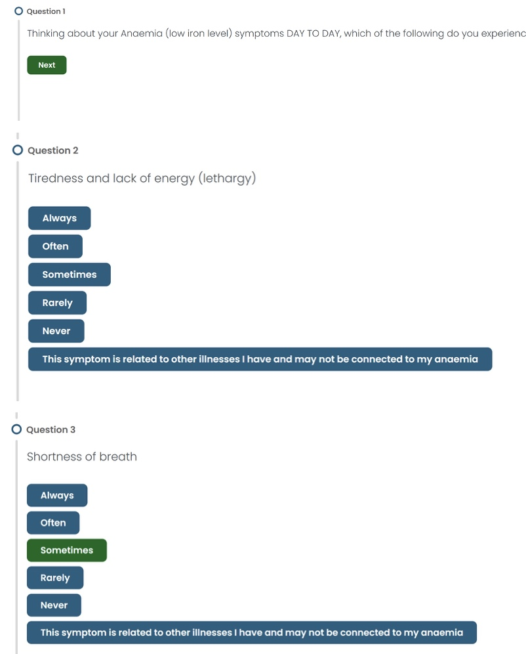
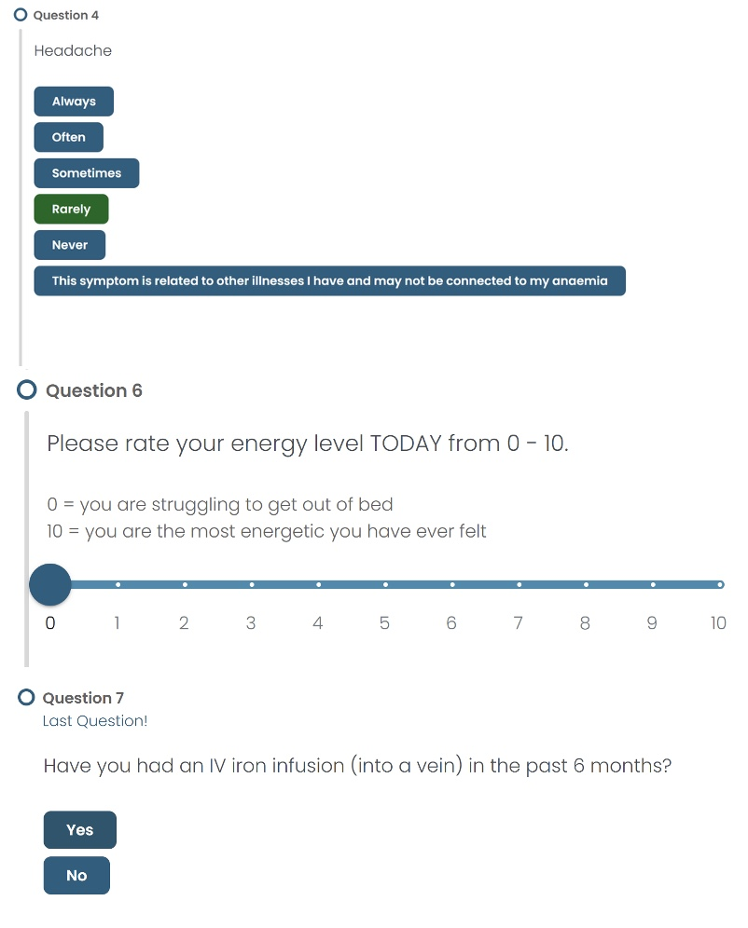
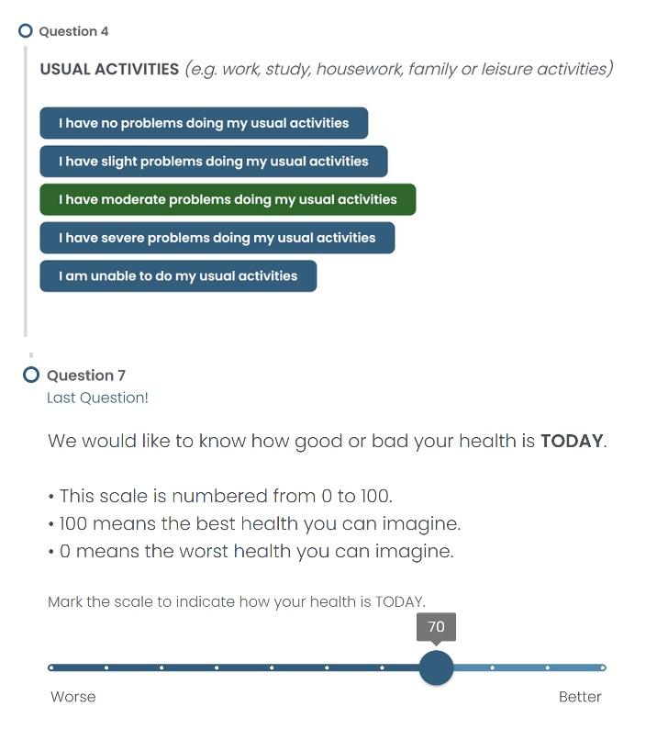
What the patient receives

Slide 6
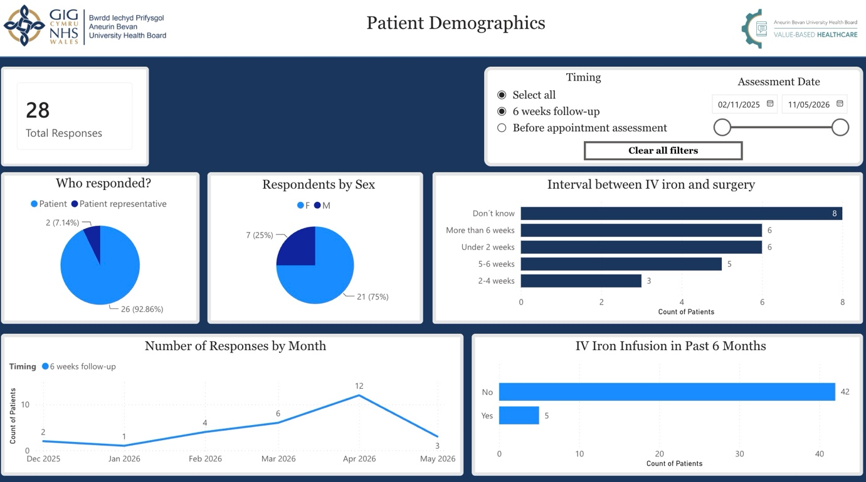
The PROM Dashboard

Slide 7
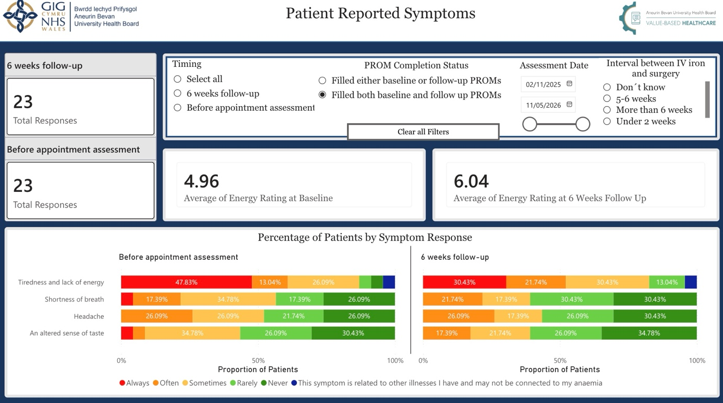
The PROM Dashboard

Slide 8
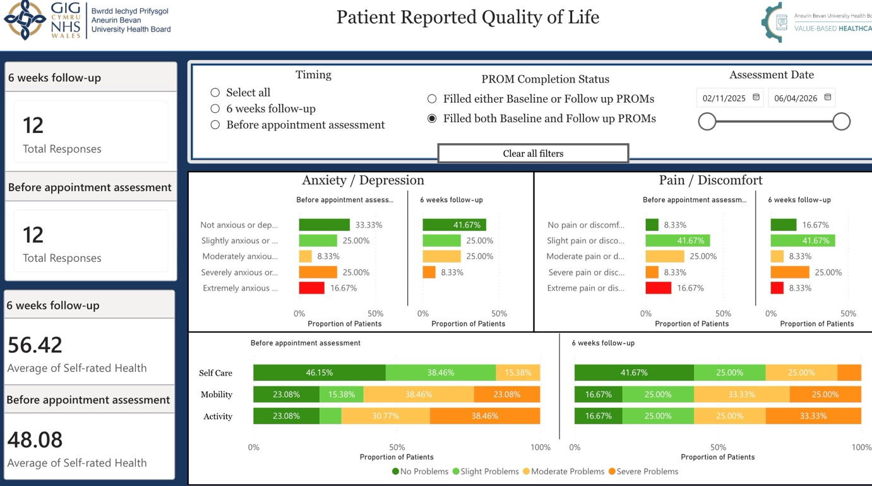
The PROM Dashboard

Slide 9
The PROM Dashboard
Summary of responses

Slide 10
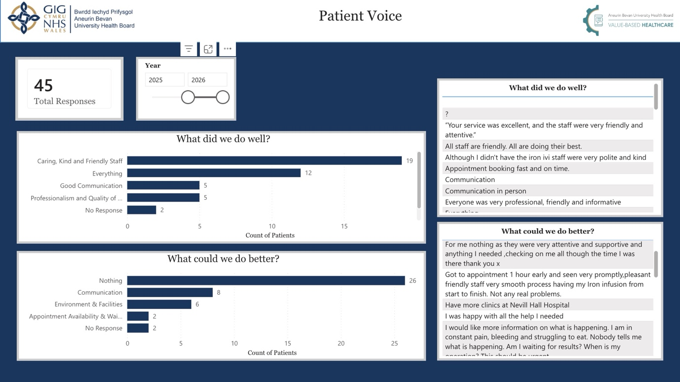
The PREM Dashboard

Slide 11
What next?
More data
Remove EQ5D
New focused questions
Await live updating dashboard upgrade

