Slide 1
Intraoperative Cell Salvage (ICS)
Workstream Update
Dr Louise Webster
Consultant Anaesthetist, Aneurin Bevan UHB & EMRTS
BHNOG ICS Workstream Lead & All Wales ICS Network chair
Notes:
We’re here to give an update on the activity of the BHNOG ICS workstream, which is supported by the All Wales ICS Network.

Slide 2
ICS
Patient Blood Management (PBM) invention
Surgery, trauma and obstetrics
Recommended by NICE¹, and SaBTO²:
“Consideration must be given to whether the blood transfusion is the only available treatment, whether any alternative treatments are available and suitable, and the risks and benefits of those alternatives to blood transfusion.”
¹ https://www.nice.org.uk/guidance/NG24
² https://www.gov.uk/government/publications/blood-transfusion-patient-consent
Notes:
So just to give a recap introduction;
ICS is in use in all UHBs in Wales,

Slide 3


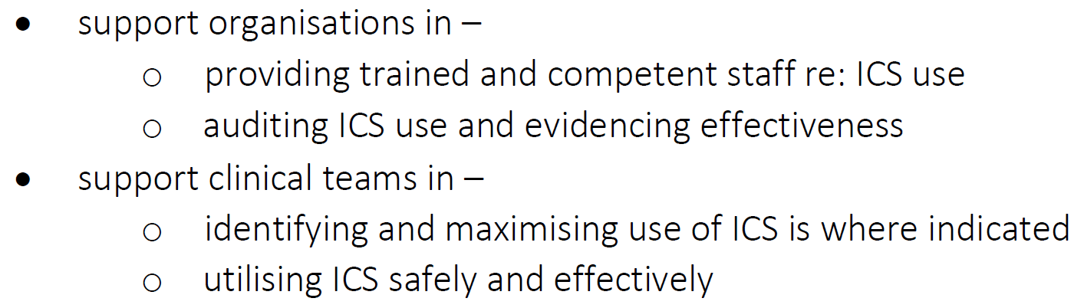
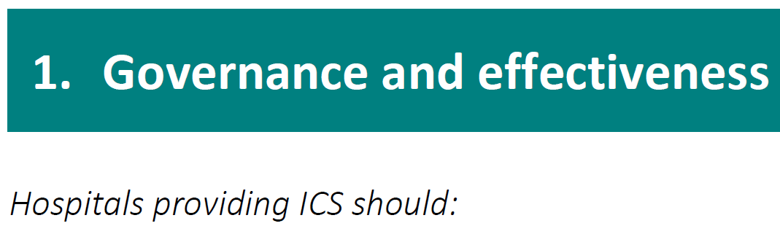
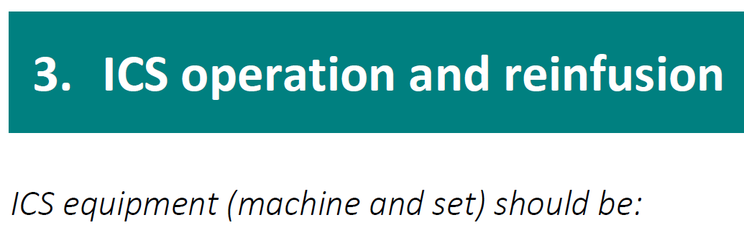
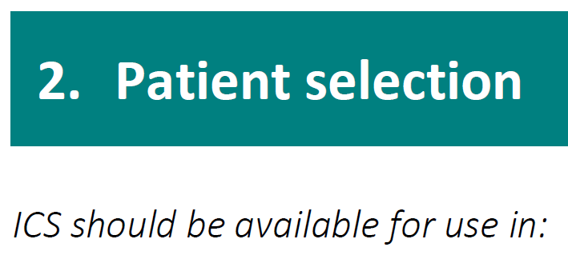
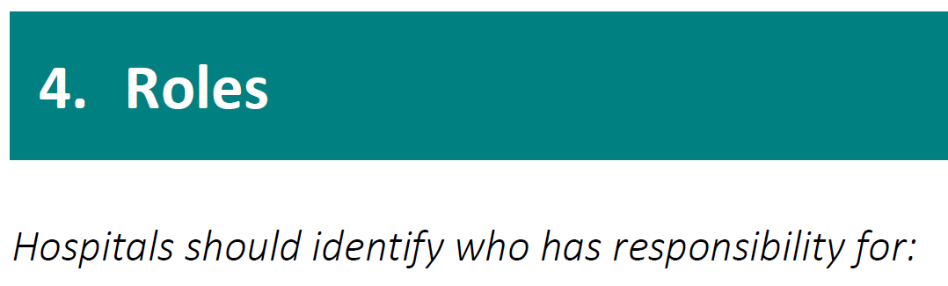
The aim of this guidance is to:
https://bhnog.wales.nhs.uk/wp-content/uploads/2025/12/All-Wales-ICS-Guidance_v1_2025.pdf
Notes:
Last year we presented this guidance in draft.
It was published in July 2025 and circulated to all ICS leads;
It contains 52 recommendations across 4 areas

Slide 4
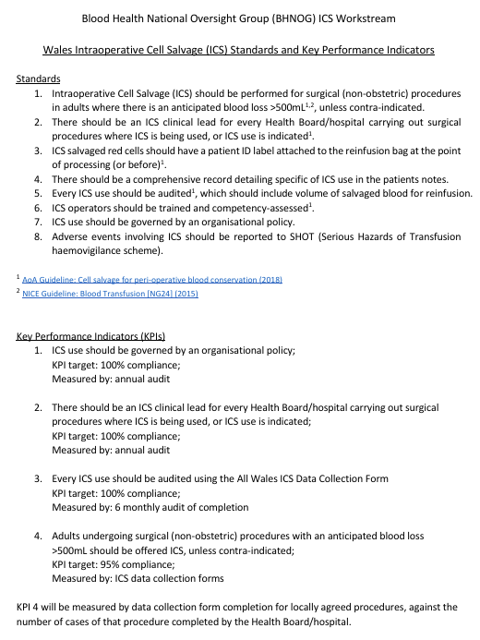
Notes:
…and it builds on and supports the ICS standards and KPIs published in 2023.

Slide 5
All Wales Guidance for the Management and Use of Intraoperative Cell Salvage: baseline gap analysis of compliance with recommendations
Sent to every health board / hospital to complete
Self assess compliance with each recommendation: Full, Partial or None
Provide evidence to support where assessed Full or Partial
Provide commentary re: barriers where assessed None, or reasons where Not Applicable documented
Notes:
And then in Oct-Nov of 2025 we conducted a baseline gap analysis of compliance with the recommendations

Slide 6
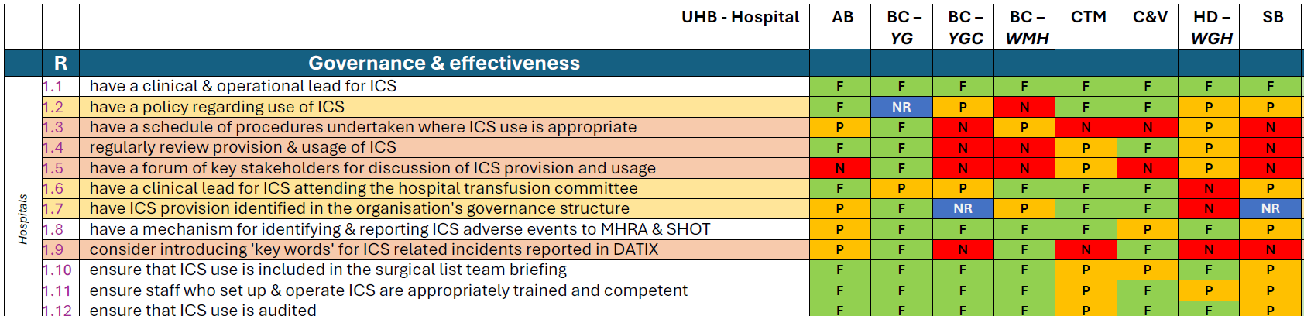
'Full' compliance (F); 'Partial' compliance (P); 'None' compliance (N)
‘Not Applicable’ (N/A); No Response given (NR)
Notes:
Responses have been received from all health boards – but in one HB it was representative of only one hospital.
The results were then tabulated and analysed…

Slide 7
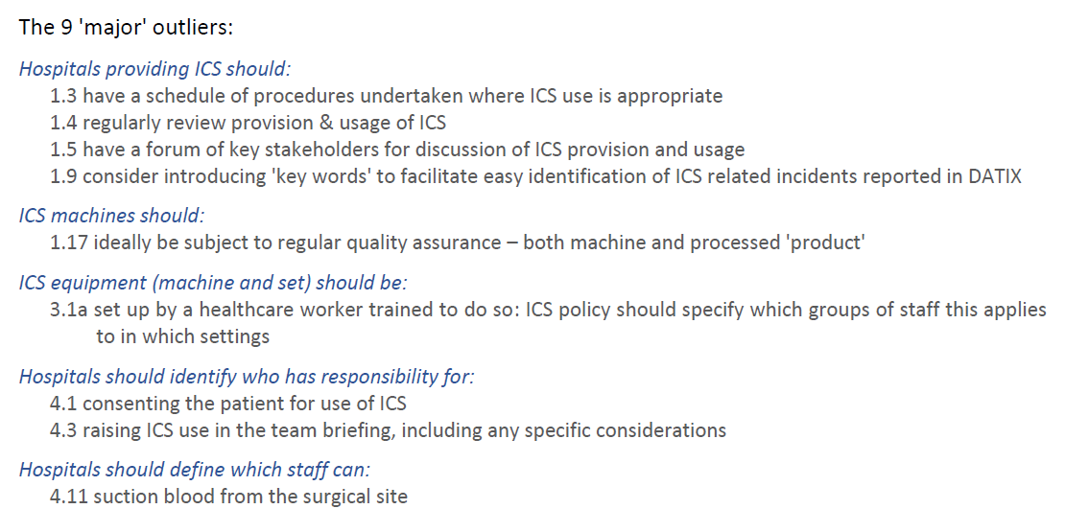
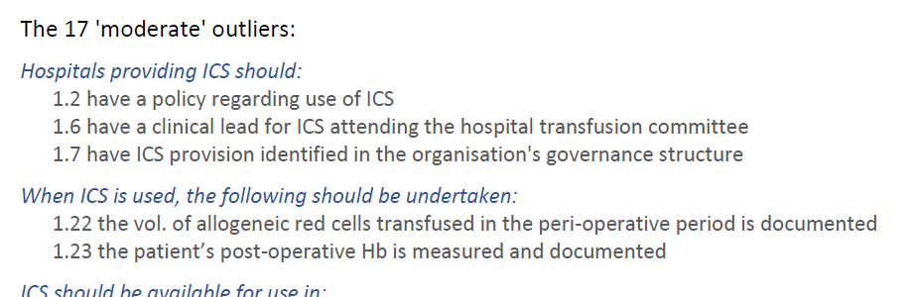
Notes:
…and significant outlier recommendations in regard to compliance were identified:
there were 9 ‘major’ and 17 ‘moderate’ outlier recommendations

Slide 8
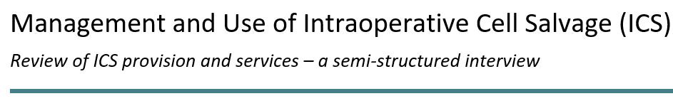
Nov. 2025 – a series of interviews were set-up with ICS leads in the health boards
The findings informed an evaluation of where ICS is and what is needed to progress activity
Notes:
Also in Nov 2025…..
The evaluation was reported to BHNOG in an SBAR.

Slide 9

This SBAR was presented at BHNOG in March 2026.
The ‘Assessment’ posed 4 options:
Maintain current funding model
Allocate funding based on 'effective’ ICS use
Pilot reinstatement of a national ICS coordinator role
Repurpose CSCRS funding to broader PBM initiatives
The ‘Recommendation’ was to go with option 3.
but other resource was then identified to support this, and option 1 was defaulted to.
Notes:
…..however, following this, resource within Welsh Blood Service was secured to support a national work;
therefore option 1 was defaulted to (as no re-directing of CSCRS funds would be required).
These decisions were outlined in a letter to ICS leads on 26th March 2026.
It was recognised that the ICS programme supports health boards with patient blood management; the short-medium term plan is to draw in the additional resource referred to above for 12- 18 months to really unpick the current position and bottom out how to optimise.

Slide 10
Re-focus on ICS
National ICS (WBS) resource to lead on a more direct engagement with ICS leads in the Health Boards/ hospitals
Notes:
The revisiting of the purpose of ICS and the support it attracts, along with a wider consideration of the investment in the resource required and the finding of the interviews and gap analysis has stimulated a re-focussing on ICS.
This is also motivated by the findings of the IBI, and it there is noticeably greater engagement across Wales in regard to ICS activity and delivery.

Slide 11
ICS guidance recommendations –
the ‘outliers’ in the gap analysis will help to shape this engagement
Remodelling data processing and data gathering
Measurable outcomes
Improving safety surveillance
Notes:
ICS guidance recommendations - covered in the preceding slides

Slide 12
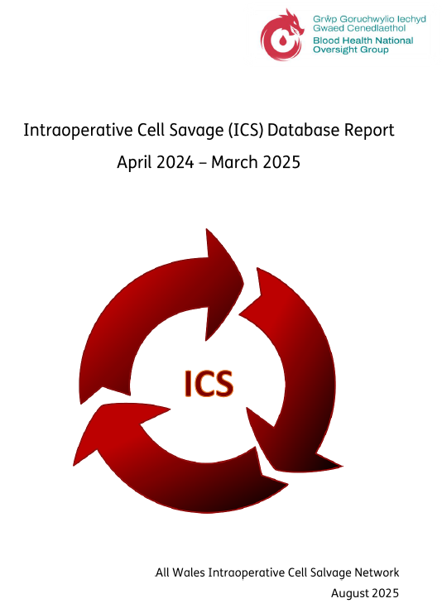
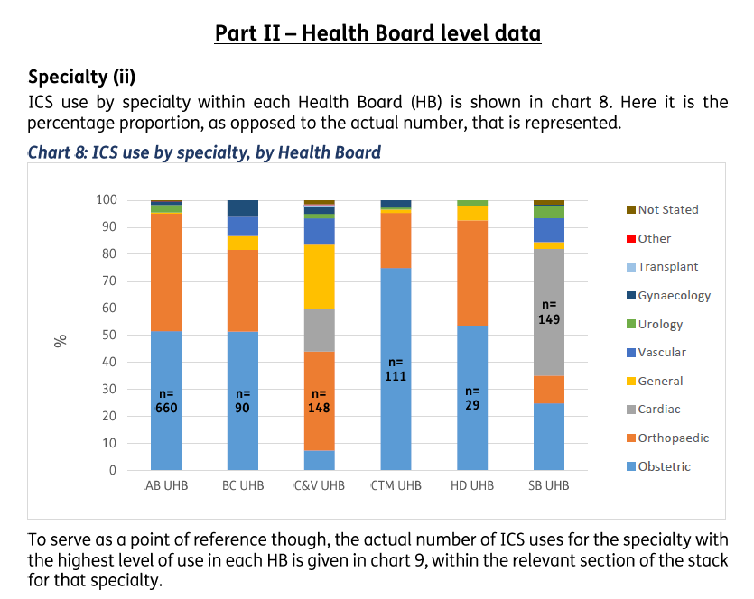
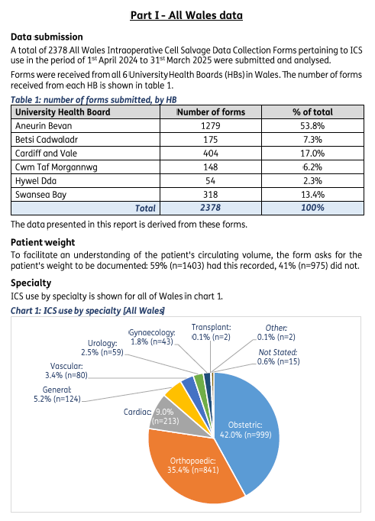
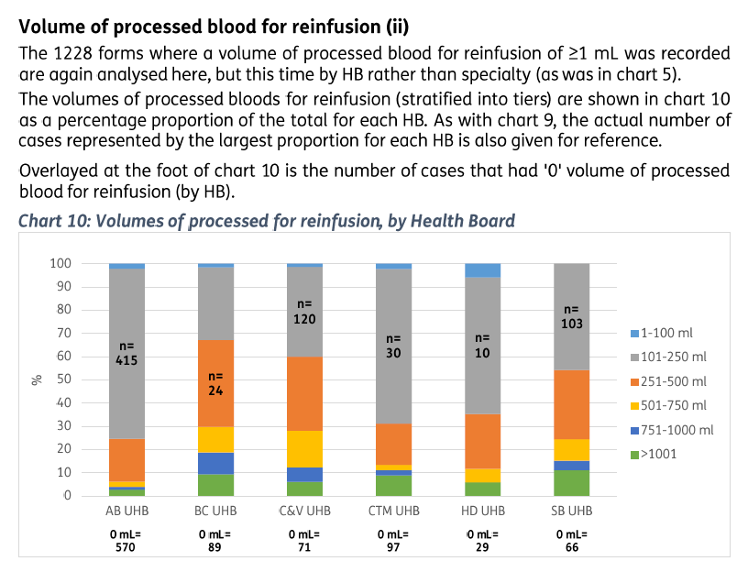
Notes:
Data insight is a key asset in supporting practice change;
However, lag has always been a limiting factor in using this.
Process of forming an understanding of the use and impact of ICS has been through continual audit of use.
The historic method of data analysis and reporting (annual report) has provided some useful insight but it is ‘static’ and labour intensive…

Slide 13
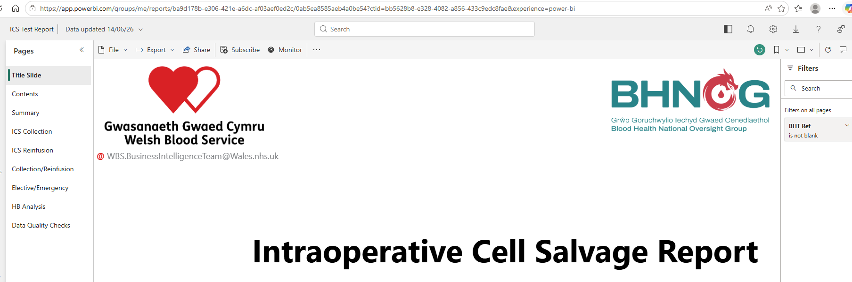
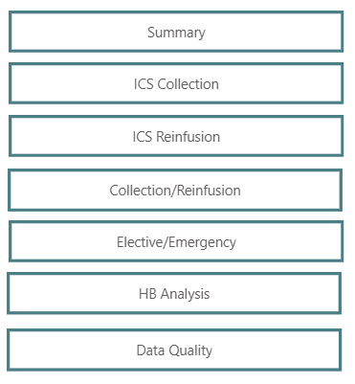
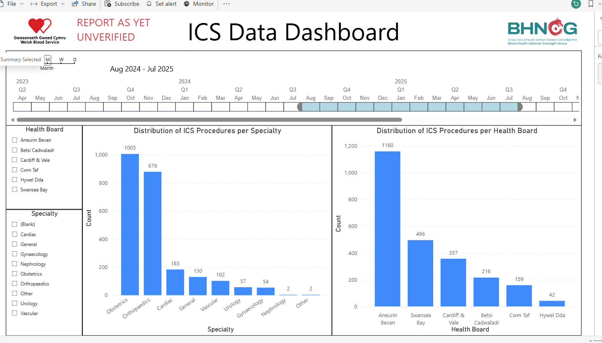
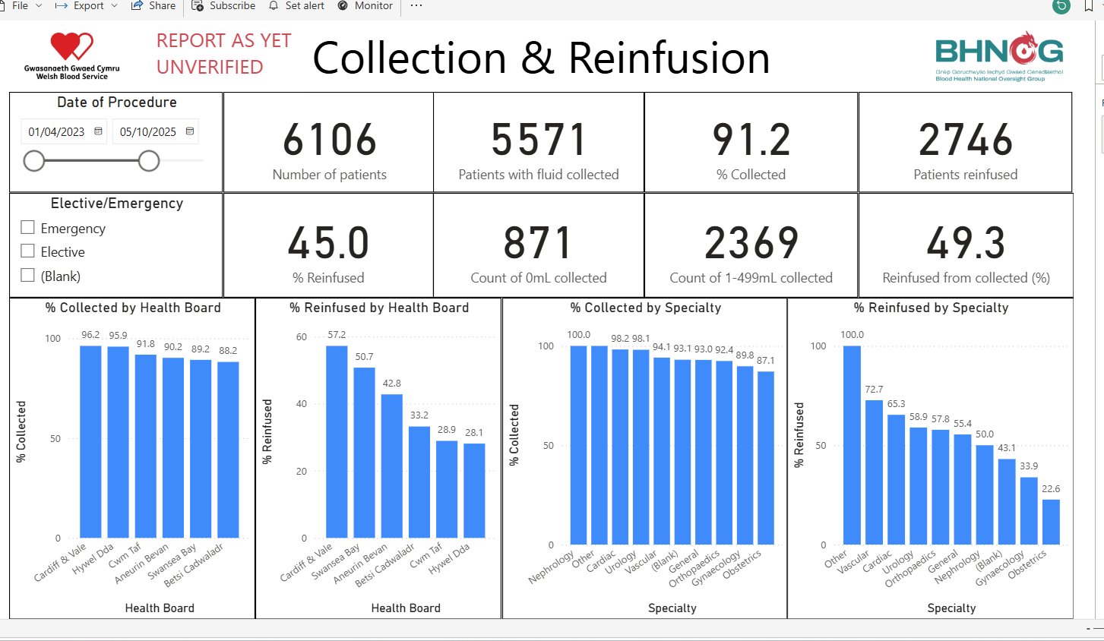
Notes:
…now in the process of being replaced by ‘live’ dashboard of data

Slide 14
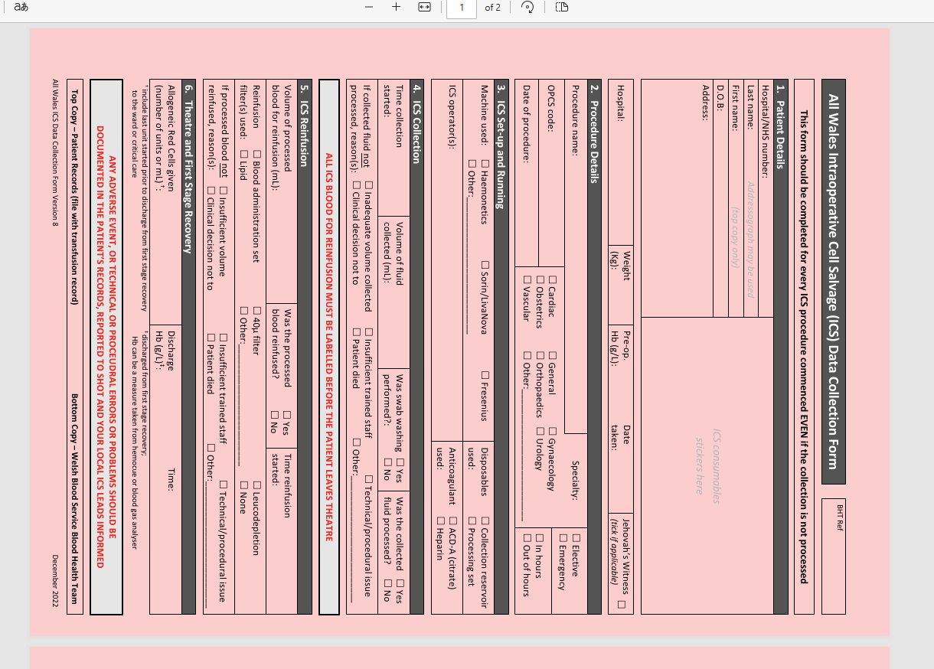
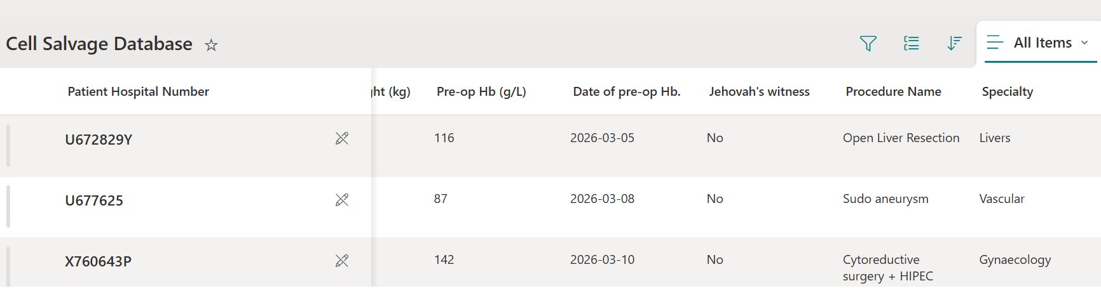
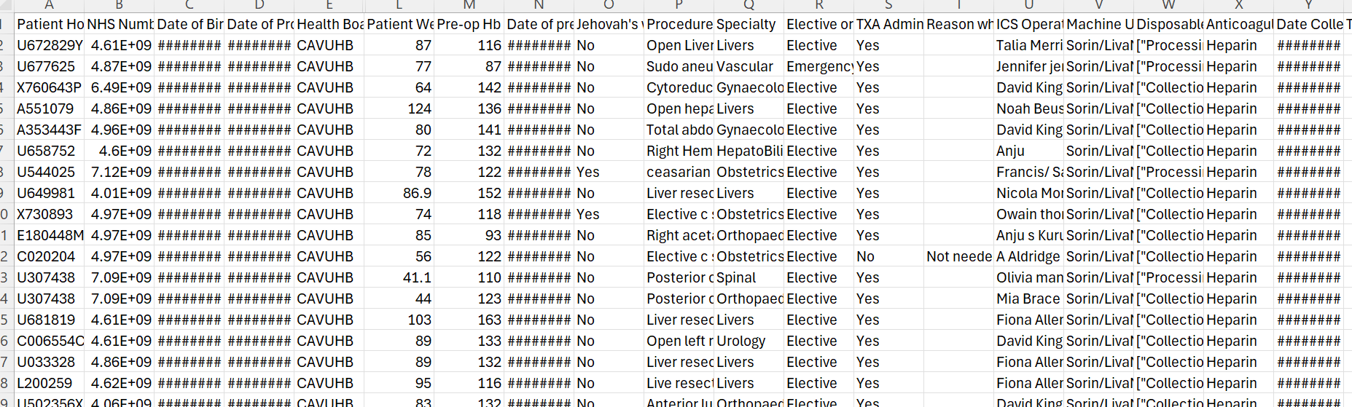
Notes:
The paper audit form –
One health board is currently trialling an MS forms version of this;
Live data capture and (potential) immediate data utilisation, and more prompt transfer (via XL spreadsheet) make this a more responsive process.
It has also allowed inclusion of data points that can be used specifically on a local level (such as staff deployment).
Another health board is trying to establish am electronic linkage between two relevant Haemonetics products - the ICS machines (which ICS capture data) and the allogeneic blood usage audit system.

Slide 15
ICS guidance recommendations –
the ‘outliers’ in the gap analysis will help to shape this engagement
Remodelling data processing and data gathering
Measurable patient outcomes
Improving safety surveillance
Notes:
3. Using the data to define and track measurable patient outcomes
The slides above give a push to wards the preferrable state in terms of ICS data management;
but further to this, it may help with linking to other patient outcomes measures.
- it remains to be seen how the All Wales LIMS may also help in linking the use of donor blood to blood loss surgeries

Slide 16
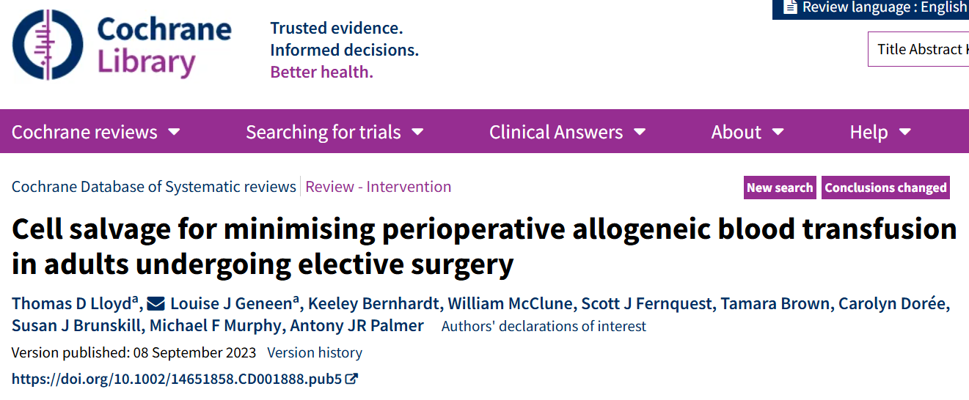
106 studies involving 14,528 participants from 24 countries, published between 1978 and 2021.
Studies focused on different types of surgery.
Notes:
…..because the problem is, at the moment we don’t have much good evidence
[https://pmc.ncbi.nlm.nih.gov/articles/PMC10486190/pdf/CD001888.pdf ]

Slide 17
Plain language summary – main results
Cancer-; Vascular-; Hip replacement-; Knee replacement-; Mix of hip, knee, & spinal- surgeries Inconclusive evidence means we are unsure of the impact of cell salvage.
Cardiovascular (heart surgery without bypass) – 6 studies (372 participants) There is probably a reduction in the risk of needing a transfusion of donated blood because of cell salvage. For other outcomes, we are uncertain of the impact of cell salvage.
Cardiovascular (heart surgery with bypass) – 29 studies (2936 participants) There may be a reduction in the risk of needing a transfusion of donated blood because of cell salvage. For other outcomes, we are uncertain of the impact of cell salvage.
Obstetrics (Caesarean section) – 1 study (1356 participants) Inconclusive evidence suggests there may be no difference in the risk of needing a transfusion of donated blood, alongside strong evidence that suggests there is no difference in the average amount of donated blood that is needed by the patient, because of cell salvage.
Spinal surgery only – 6 studies (404 participants) There is probably a reduction in the risk of needing a transfusion of donated blood because of cell salvage. For other outcomes, we are uncertain of the impact of cell salvage.
Notes:
It is interesting to note that cardiac and obs. are well recognised as high ICS users in the Wales (and UK) data.
More reliable and wide ranging outcomes data/evidence will facilitate better research into ICS effectiveness.

Slide 18
ICS guidance recommendations –
the ‘outliers’ in the gap analysis will help to shape this engagement
Remodelling data processing and data gathering
Measurable outcomes
Improving safety surveillance

Slide 19
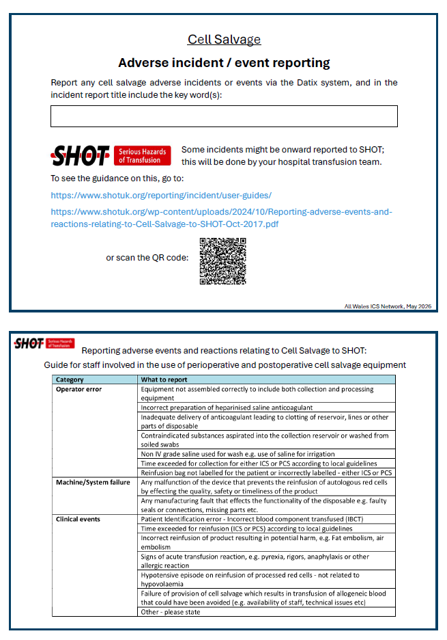
Autumn 2026 - new category for cell salvage on Wales DATIX
Notes:
The AWICSN is working to increase awareness and completion of ICS incident reporting

Slide 20
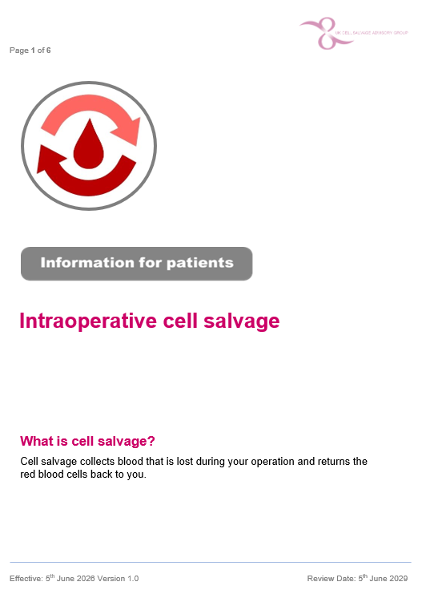
To be posted here: https://bhnog.wales.nhs.uk/home-page/intraoperative-cell-salvage/
Notes:
…and finally.
Bridging to another PBM issue (consent) being discussed today…
The UK Cell Salvage Advisory Group has just published a revised patient information leaflet, to be used to support the discussion with the patient around consent to ICS. To be posted here on the BHNOG ICS pages.

