Slide 1




Evolution of Transfusion Risk in Wales
Rachel Borrell
Chair of BHNOG Transfusion Risk Group
Blood Health Team Operational Manager
Welsh Blood Service
Notes:
Good morning, my name is Rachel Borrell and I am the blood health team operational manager within the Welsh blood service and I am the chair of the BHNOG transfusion risk group.
During this presentation we will go through the development of a National Approach to Transfusion Risk Oversight in Wales, and why this change was required

Slide 2

Content
Evolution timeline and background of BHNOG Transfusion Risk Group
Infected blood inquiry (IBI)
Transfusion Governance
SHOT recommendations to SHOT transfusion safety standards
Further TRG accomplishments
Summary
Notes:
We’ll go through the ‘why’, ‘what changed’, and the ‘impact’ so far, in alignment with national drivers such as SHOT and IBI

Slide 3
Timeline
2017
BHNOG established
2021
BHNOG Wales SHOT working group
2024
Infected Blood Inquiry report released
2025
SHOT working group evolved into Transfusion Risk Group (TRG)
2025
SHOT Transfusion Safety standards released
2025
Welsh Health Circular (WHC/2025/037) released
2025
TRG Terms of reference revised and remit expanded
2026
All Wales Gap analysis completed against standards
Notes:
This slide outlines the journey of the Transfusion Risk Group, showing how the key drivers have shaped its development and progress, which will be expanded on as we move through the presentation

Slide 4


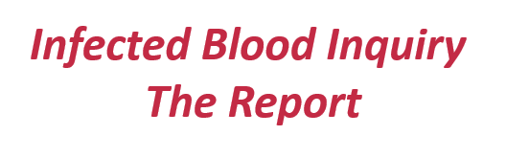
Blood Health National Oversight group (BHNOG) – key role in strategic leadership of transfusion in Wales - 2017
Established the Serious Hazards of Transfusion (SHOT) Working Group in 2021
Infected blood inquiry (IBI) report released in May 2024.
  Recommendation 7e - That all NHS organisations across the UK have a mechanism in place for implementing recommendations of SHOT reports, which should be professionally mandated, and for monitoring such implementation.
Recognition by BHNOG of the broader transfusion risk
Background
Notes:
Blood Health National Oversight group (BHNOG) was established in late 2017, to oversee the implementation of the blood health plan
The BHNOG created the SHOT working group in 2021, this was
to support implementation of SHOT recommendations and focus on externally reportable incidents and human factors
Meetings are held quarterly with representation across Wales
A highlight report is taken to the BHNOG meeting to discuss current priorities and concerns
Then in May 2024 the infected blood inquiry report was released – particularly relevant to this group is recommendation 7e, this highlights the importance of embedded reporting for transfusion incidents and implementation of SHOT recommendations
It is also recognised by BHNOG of the broader transfusion risk,
What risks might we be missing if we only focus on externally reportable incidents?

Slide 5


Transformation of the
SHOT Working Group
TRG membership
TLM
TP
PSQR
Welsh Risk Pool
BHT
Quality leads
SHOT
WBS
SCRIPT
Terms of reference were revised
Expansion of the remit and scope
Membership increased – broader subject matter experts
Governance pathways defined
Transformed into the BHNOG Transfusion Risk Group (TRG)
Notes:
To address this, the BHNOG proposed a revisit of the group to meet the requirements of the IBI recommendations through development of a broader approach to transfusion risk oversight and improve safety governance across NHS Wales.
The terms of reference were revised and the remit and scope have been expanded examples are inclusion of locally reported incidents and using a RAID log to capture and address transfusion risk within Wales and develop mechanisms to drive improvements and defined governance pathways
the membership increased for additional representation from broader subject matter experts including Patient Safety and Quality (PSQ), Welsh Risk Pool, SHOT and quality leads
This has opened greater system opportunities and collaboration.
the SHOT working group transformed into the BHNOG transfusion risk group (TRG) to acknowledge this expansion

Slide 6
Transfusion Risk Group (TRG)
Strategic Aims:
- Provide national oversight of transfusion-related risk across Wales
- Promote a more proactive, systems-based approach to improving transfusion safety
Key Focus:
- Monitor incidents reported across Wales.
- Enable shared learning, and support the development, mitigation and escalation of actions.
- Consolidation of compliance to standards.
Notes:
Strategic Aims
- Provide national oversight of transfusion-related risk across Wales
- Promote a more proactive, systems-based approach to improving transfusion safety
Key Focus
- Monitor incidents reported across Wales.
- Enable shared learning, and support the development, mitigation and escalation of actions.
- Consolidation of compliance to standards.

Slide 7

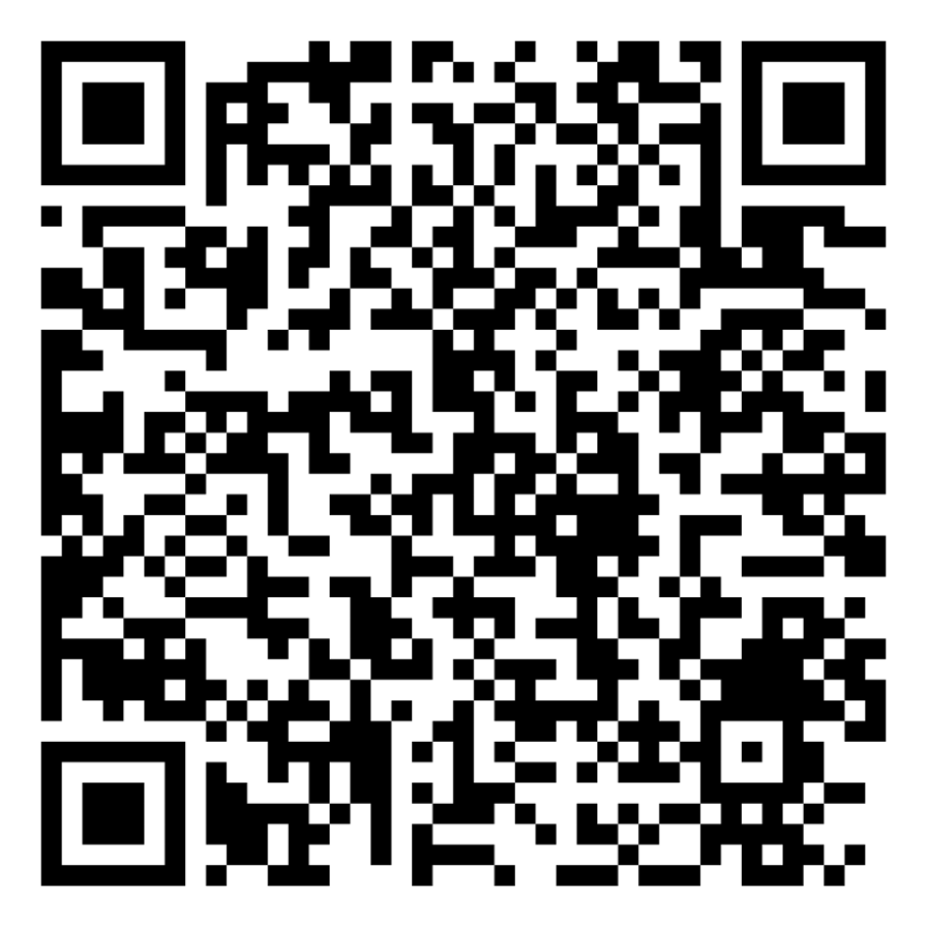

SHOT Recommendations
In July 2025, the SHOT recommendations were replaced by SHOT Transfusion Safety standards
Base line tool created to complete gap analysis
Identified that responsibility lay with operational Hospital transfusion teams (HTT)/committees (HTC)
Recognised that strengthened governance and board level oversight was required
Notes:
In July 2025 the SHOT rec were replaced by the SHOT Transfusion safety standards, this was to address recurring trends and embed a proactive approach to enhance safety.
The SHOT recommendations and standards are produced from haemovigilance reporting and learning from these incidents to improve patient safety.
These eight standards cover all aspects of the SHOT 10 steps of the clinical and laboratory transfusion pathway
SHOT also developed a base line tool for the gap analysis
One of the roles of TRG is to support the implementation of these standards along with coordination of the gap analysis and benchmarking
It has long been recognised that responsibility for compliance often falls to the operational Hospital Transfusion Team and or committee
Strengthened governance and board level oversight is required by incorporating into the health boards’ patient quality and safety governance reporting structures and framework

Slide 8
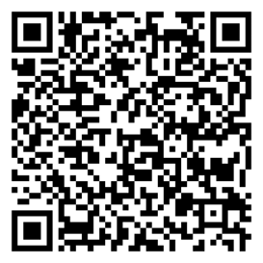
Welsh Health Circular (WHC/2025/037) was released in Sept 2025
Actions;
Establish a governance framework
1
Report findings and proposed actions to TRG
4
Regular compliance review
5
Appoint an executive director with designated responsibility
2
Undertake a gap analysis
3
Reporting and monitoring of the compliance is through TRG - report and escalate to BHNOG and WG
Notes:
To help transfusion teams obtain this governance structure a Welsh health circular was released in Sept 25
Actions included establishing a governance framework and appointing an executive director with designated responsibility
this strengthened expectations for patient safety and quality to support the Transfusion Teams and committees
The expectation is to support completion of the gap analysis to the SHOT standards and support development of improvement action plans for compliance
It also reiterated the governance route through the TRG for benchmarking and identification of national gaps and the escalation route through BHNOG and welsh government

Slide 9
All Wales SHOT Standards Gap Analysis Compliance Summary
Notes:
Gap analysis completed by all Health boards in Wales
And Submitted to TRG and compliance mapped
Overall the Strengths:
Standard 7 haemovigilance and risk management
Standard 2 transfusion IT and equipment
Standard 5 safety culture
Std 3 supporting staff to work safely
Strong national consistency in incident reporting and investigation indicating an embedded safety and regulatory systems in place which indicates a good safety culture

Slide 10

All Wales SHOT Standards Gap Analysis
Non-Compliance Summary
Notes:
Non-compliance gaps in
Std 1 – transfusion safety
Std 4 –staff education and training
Std 6 – pateitns as safety partners
Std 8 - governance
Opportunities to Shift focus toward:
Patient partnership (biggest gap)
Workforce capability and training and human factors
Executive governance and ownership
Gap analysis provided insights to key national gaps and collective actions are to be developed to address these issues.

Slide 11


TRG accomplishments
National Incident reporting expansion
Datix incident transfusion categories revised
Human factors resource and Wrong blood in tube (WBIT) investigation tools reviewed
Hospital Transfusion Committee (HTC) survey completed
Notes:
Some further TRG accomplishments
National Incident reporting expansion
Recently started monitoring all incidents not just externally reportable to SHOT and MHRA
Datix incident transfusion categories revised with NWSSP Welsh Risk Pool
Human factors resource and WBIT investigation tools reviewed and developed
HTC survey was completed by all health boards to determine medical speciality representation and governance pathways.
Determined that poor representation across particular specialities and gaps in governance structure - awaiting UK framework and review in 1 year

Slide 12

Incident reporting
Local and external (SHOT/MHRA) incidents reported by Hospital/Health Board
Data collated quarterly, and submitted to BHT; internal, SHOT and MHRA (SABRE)
Report completed for quarterly meeting and reviewed for trends and transfusion safety risks
Trends and actions escalated to BHNOG for oversight and assurance.
Wrong Blood in Tube (WBIT) remains the most frequently reported SHOT incident across Wales. Deep dive highlighted prevalence across all clinical areas and health care professions which reflects a system-wide failure in positive patient identification – not just a transfusion related issue. Feeding education risk into Education Strategy group (ESG).
Notes:
All incidents, externally and locally reported by the health boards are submitted quarterly to blood health team.
These are reviewed for trends and transfusion safety risks
and fed back into the TRG meeting (along with the TLM and TP meetings)
Since Oct 2024, almost a third of the clinical incidents reported to SHOT are WBIT – this initiated a deep dive
This highlighted prevalence across all clinical areas and health care professions and reflects a system-wide failure in positive patient identification – not just a transfusion related issue.
We also have a mechanism to feed education risk into Education Strategy group (ESG)

Slide 13
Datix Incident reporting
Identified that existing Datix incident categorisations were not fit for purpose for transfusion
Limited ability to effectively monitor trends and assess risks across Wales
Issue escalated within the Transfusion Risk Group (TRG) - National Risk Pool representation
A task and finish group was established to address the gap
Transfusion-specific reporting categories have been reviewed, revised, and formally approved
Will enable improved consistency of reporting across Wales
Support enhanced trend analysis and risk identification
Notes:
Another action of the group, was that it was identified that
The existing Datix incident categorisations were not fit for purpose for transfusion
Limited ability to effectively monitor trends and assess risks across Wales
Issue escalated within the Transfusion Risk Group (TRG) nand as there is National Risk Pool representation – suggested that the codes were reviewed by the subject matter experts
A task and finish group was established to address the gap, including representation from WBS and all HBs for clinical, and lab
Transfusion-specific reporting categories have been reviewed, revised, and formally approved by the Datix coding group
This will enable improved consistency of reporting across Wales
And Support enhanced trend analysis and risk identification

Slide 14
Summary
TRG established to strengthen national transfusion risk oversight
Expanded remit, and national collaboration
Strengthened national oversight and governance
Delivered All-Wales insight on compliance and risk
Addressing key risks: WBIT & patient ID failures
Improved incident reporting and data visibility
Driving standardisation, learning, and safety improvement
Notes:
So in summary;
TRG was established to strengthen national transfusion risk oversight
The remit was expanded, and there is national collaboration
national oversight and governance is strengthening
We have delivered All-Wales insight on compliance and risk
We are addressing key risks: such as WBIT & patient ID failures
Improved incident reporting and data visibility
Driving standardisation, learning, and safety improvement
The real opportunity now is how we translate this national insight into consistent improvement across wales

Slide 15

Thank you for listening

