Slide 1

Transforming Transfusion Governance: Insights, Improvements, Impact
Dr Shruthi Narayan,
Medical Director, SHOT

Slide 2


Slide 3

Notes:
Take a moment to remember and acknowledge Those Infected and Affected including those who gave evidence to the Inquiry
Everyone at SHOT is deeply mindful of the experiences that led to this inquiry and are determined to ensure that patient safety remains the guiding principle for all haemovigilance activities.
By learning from the past with humility and acting with transparency and urgency, we honour those affected and commit to facilitating meaningful change.

Slide 4

Outline
Why this and why now?
Work done so far and progress with IBI 7e implementation
Ongoing improvement workstreams
Next steps
Q&A

Slide 5
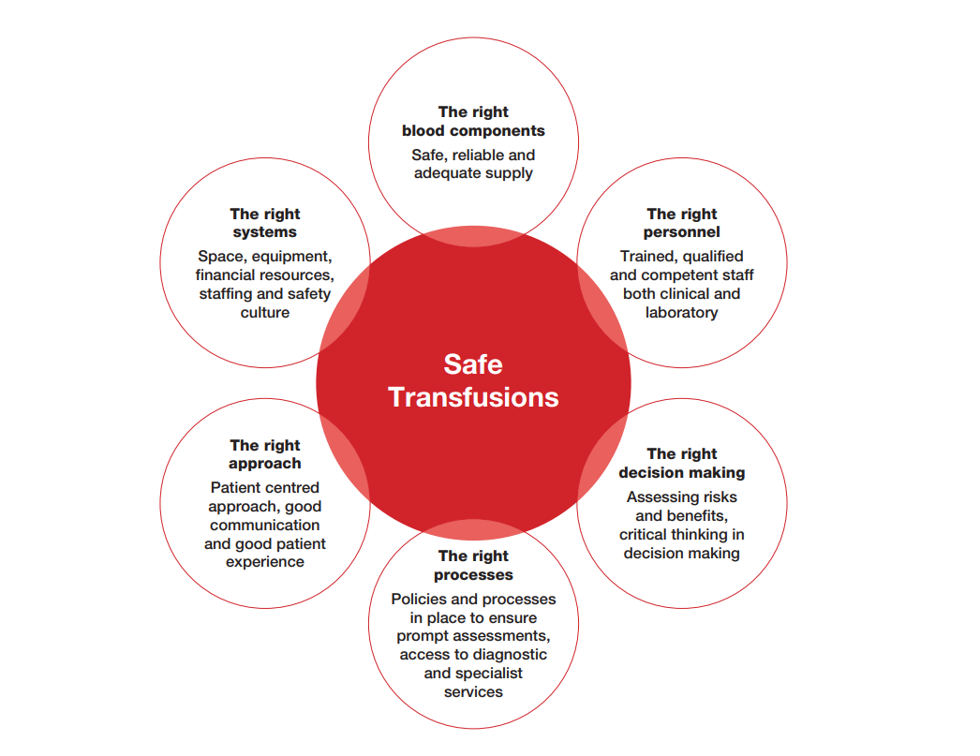

Behind every safe transfusion is strong governance. Safety is the outcome—governance is the driver.

Slide 6
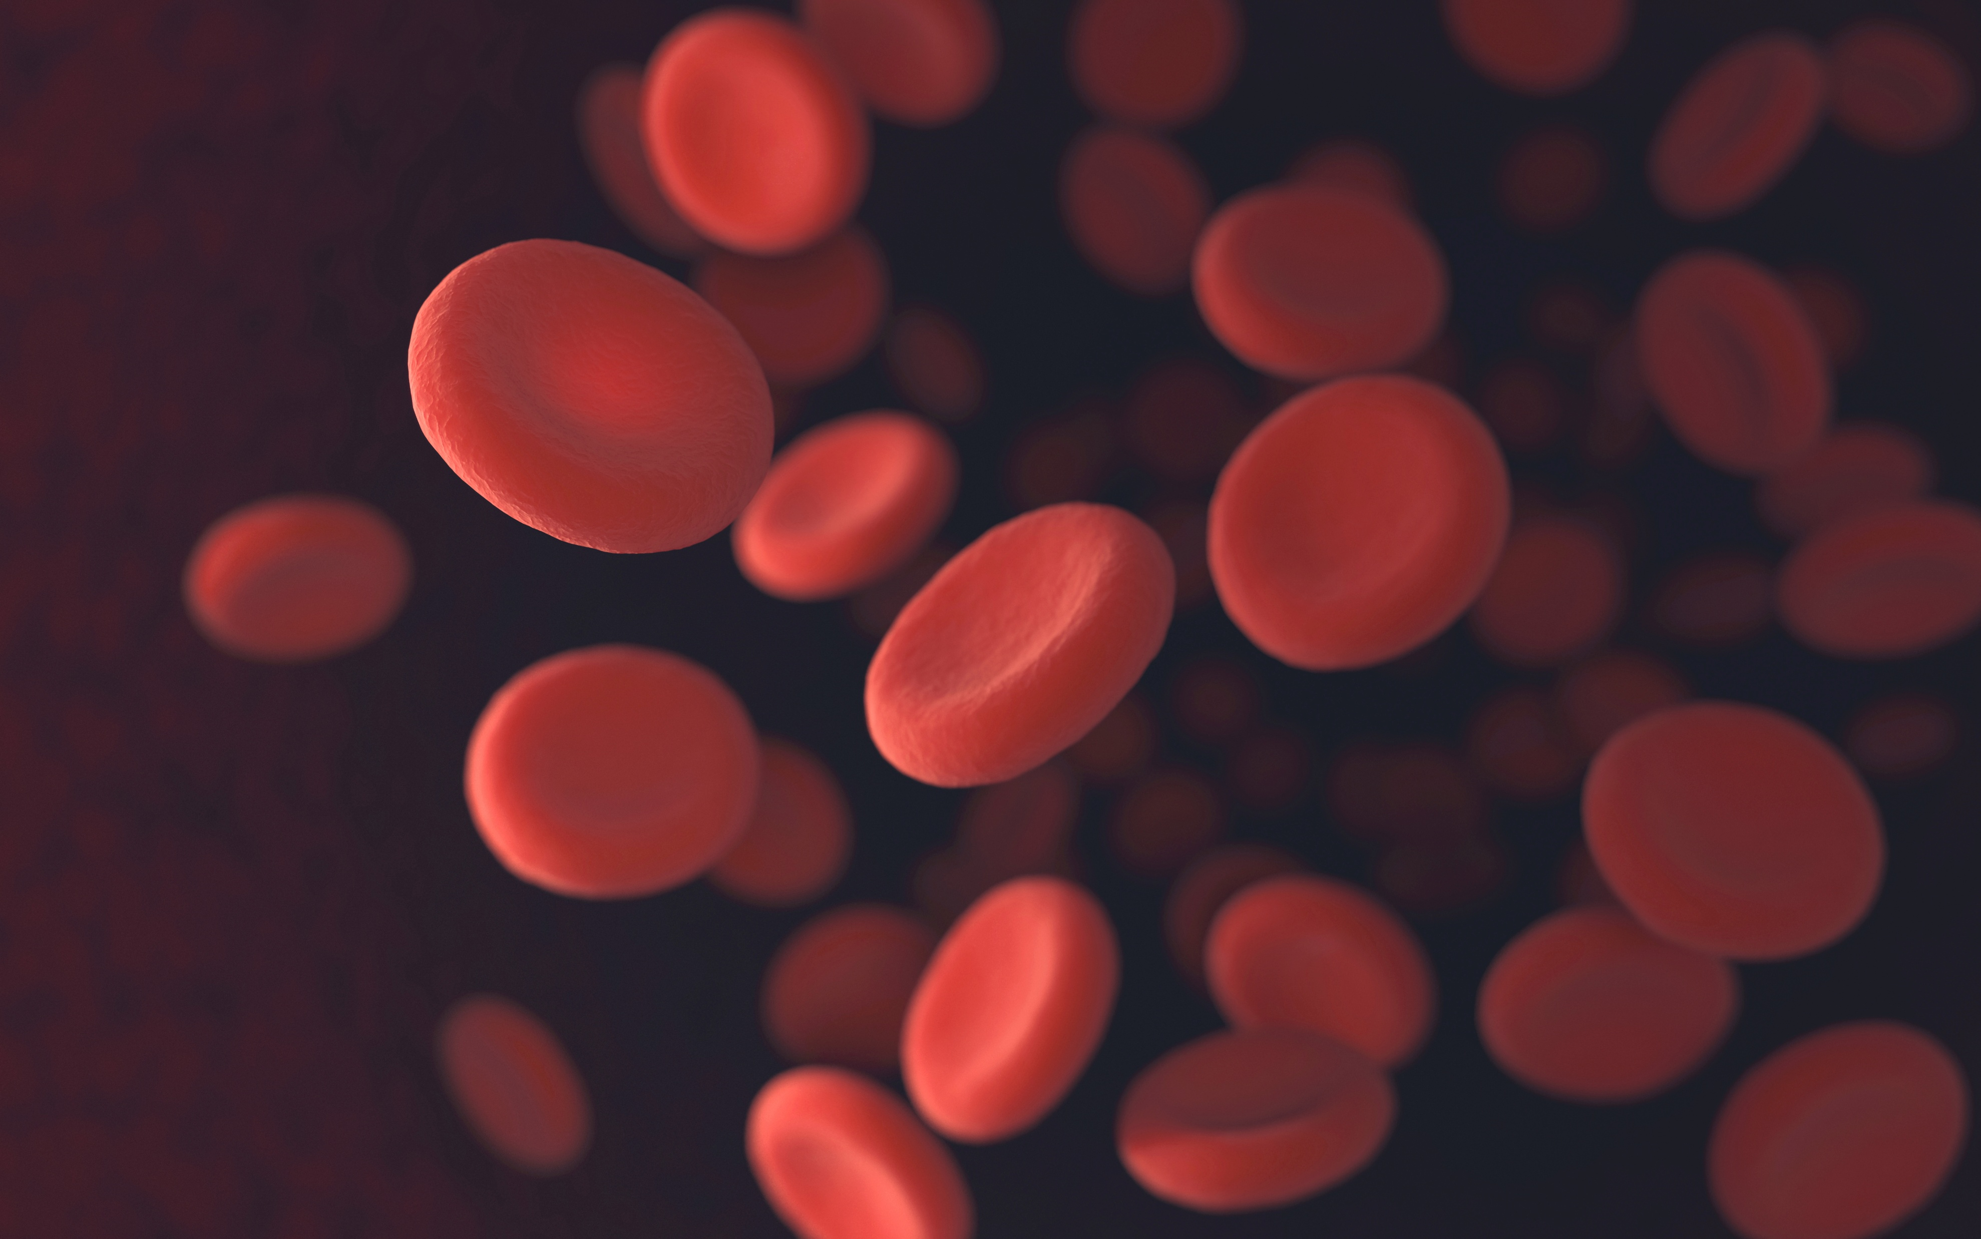


Good governance enables quality; quality delivers safety; safety sustains trust.
Notes:
Governance is the system of accountability, quality is the standard of performance and safety is the protection from harm that both seek to achieve.

Slide 7
Key drivers to improving transfusion governance in the UK
Infected Blood Inquiry report and recommendations
Insights from serial Annual SHOT Reports
Optimal implementation of key healthcare strategic objectives
Gaps identified in various surveys
Transfusion governance
Persistent issues identified in national audits
Supporting national and regional improvement workstreams

Slide 8



Current status of transfusion governance: NBTC survey 2025
Majority of HTCs are active (3-4 meetings per year)
25% of Trusts have recently renamed HTCs, most often to ‘Group’.
16% do not have a direct governance link to their Trust Exec
Key highlights
1/3 of HTCs never have representation from their patient safety or clinical / risk governance group
Nearly 50% HTC not given extra provision in their job plan for the role
2/3 HTC had no dedicated admin support
Patchy and variable representation from specialties
1/3 HTC Chairs are also members of their HTT
Notes:
The vast majority of HTCs are active (3-4 meetings per year). • A small but important number (16%) do not have a direct governance link to their Trust Exec. • 1/3 of HTCs never have representation from their patient safety or clinical / risk governance group. • There are significant numbers of HTCs with poor representation from important specialties like Medicine, Surgery (non-orthopaedic and orthopaedic) and Paediatrics • The vast majority of HTC Chairs are medical, but around 1/3 are also working as members of their Hospital Transfusion Team • Only 50% of Trusts recognise the role of HTC Chair beyond standard SPA in a job plan, and 2/3 of HTCs are provided with no dedicated admin support. • 2/3 of Trusts supply blood outside their own hospitals, but only 1/3 see regular representation of these at HTC meetings • 25% of Trusts have recently renamed HTCs, most often to ‘Group’.

Slide 9

The Infected Blood Inquiry began in 2018 to examine the circumstances in which adults and children treated by the NHS were given infected blood and blood products, in particular since 1970.
The Inquiry’s terms of reference also covered the following: the impact on those Infected and their families; the response of government and other bodies; consent; communication and information-sharing; treatment care and support; candour; responsibilities; and recommendations.

Slide 10
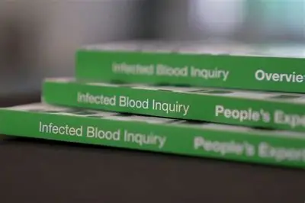
Principles of the Inquiry
People- Infected and Affected people heard first
Thoroughness
Respect
Openness and Transparency
Independence
Listening

Slide 11
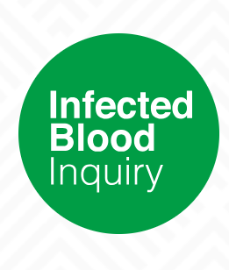
Recommendations Overview
Compensation
Recognising and remembering what happened to people
Learning from the inquiry
Preventing future harm to patient: achieving a safety culture
Ending a defensive culture in the Civil Service and government
Monitoring liver damage for people who were infected with hepatitis C
Patient Safety: Blood Transfusion
Finding the undiagnosed
Protecting the safety of haemophilia care
Giving patients a voice
Responding to calls for an Inquiry
Giving effect to recommendations of this Inquiry
Notes:
Some specific to the inquiry and other parts of the health service or government
Specific to NHSBT and other blood services,
The more general recommendations important

Slide 12

Specifically, the 7e recommendation
7 (e) That all NHS organisations across the UK have a mechanism in place for implementing recommendations of SHOT reports, which should be professionally mandated, and for monitoring such implementation.

Slide 13


Key governance failures identified in the Infected Blood Inquiry report
Lack of strategic leadership and oversight
Poor implementation of safe clinical practice
Inadequate surveillance,
audit and traceability
Weak regulatory and policy control
Failure to act on known risks
Lack of transparency,
openness and candour
Failure of
ethical
governance and consent
Poor information
governance
Failure to learn,
improve
and respond
Systemic culture
failures

Slide 14

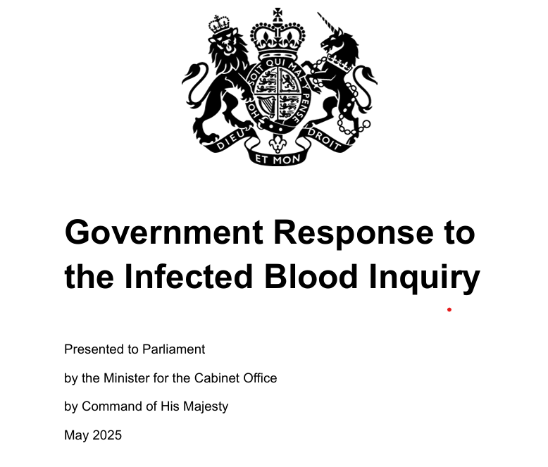
Government response
Recommendation accepted in principle by the UK Government, the Scottish Government, the Welsh Government, and the Northern Ireland Executive.
No funding support available
Notes:
Government statements but no funding agreed/approved

Slide 15
7e recommendation implementation group
Insights to actions
4
1
Shared leadership
Learning from past experiences, maternity, infection prevention control and transfusion
SHOT, NHSE- Pathology Transformation, NHSE- Patient safety
Diverse representation
3
2
UK-wide
Medical, Nursing, Scientific and other backgrounds, inclusive approach
Representatives from all across UK in the group, ensuring alignment
Virtual meetings using Teams
Notes:
Benefited from diverse perspectives
All activities through virtual meetings

Slide 16

7e recommendation- how has this evolved?
1
SHOT Transfusion Safety Standards
2
Effective transfusion governance across UK
3
Monitoring implementation of standards
7 (e) That all NHS organisations across the UK have a mechanism in place for implementing recommendations of SHOT reports, which should be professionally mandated, and for monitoring such implementation.
Notes:
7 (e) That all NHS organisations across the UK have a mechanism in place for implementing recommendations of SHOT reports, which should be professionally mandated, and for monitoring such implementation.

Slide 17

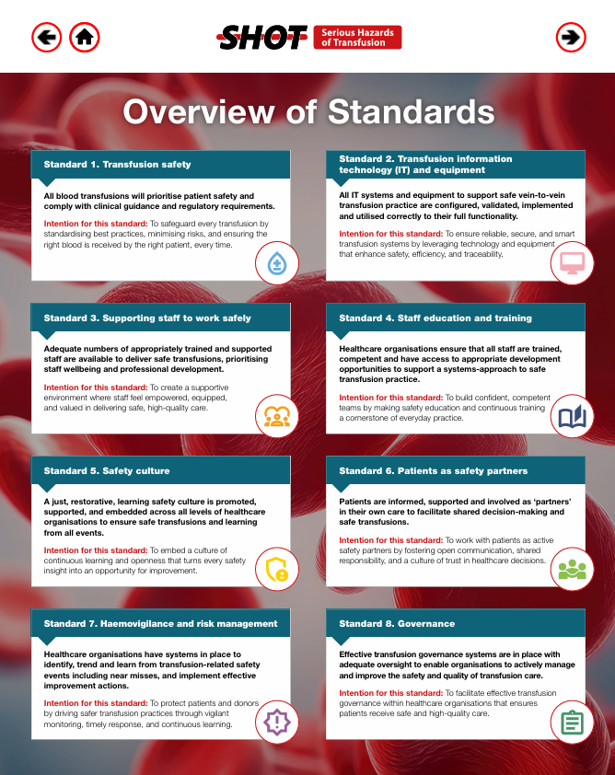


SHOT Transfusion Safety Standards
Notes:
Standard 6 : Patients as safety partners
Patients are informed, supported and involved as ‘partners’ in their own care to facilitate shared decision-making and safe transfusions.
Intention for this standard: To work with patients as active safety partners by fostering open communication, shared responsibility, and a culture of trust in healthcare decisions.
Mention that there is a criteria

Slide 18
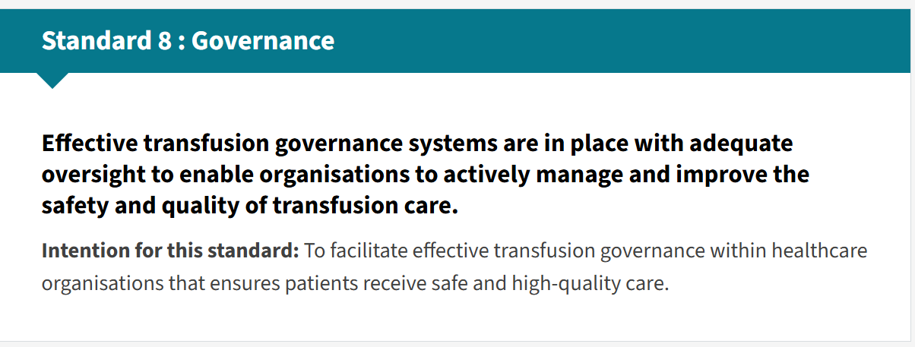
How is governance covered in the standards

Slide 19
Key requirements for the SHOT governance standard
Integration with patient safety governance
Accountability and compliance
Regulatory and professional standards compliance
Standard 8: Transfusion Governance
Key criteria
Escalation of outputs
Governance representation
Executive oversight

Slide 20


Draft hospital-
level transfusion governance framework

Slide 21
Key guiding principles agreed for effective transfusion governance
01
Clear accountability and leadership
06
Effective risk management, incident reporting and learning safety culture
02
Data-driven oversight and transparency
07
Multidisciplinary transfusion team and committee
03
Patient-centred approach and partnering with patients to enhance safety
08
Staff education, training and competency assessments
04
Evidence-based policies and procedures
09
Audit and continuous quality improvement
05
10
Integration with wider safety and quality systems
Safe, well-resourced systems

Slide 22
Governance pitfalls to avoid
Lack of clear roles, responsibilities, and accountability; detached or top-down leadership with limited frontline engagement; siloed decision-making across departments or functions
Leadership & Structure
Blame culture that discourages reporting or learning; failure to engage staff, patients, and families in decision-making; resistance to change or innovation
Culture & Engagement
Information &
Communication
Poor communication and lack of transparency; collecting data without analysis or follow-up action; over-reliance on metrics without understanding context
Inadequate mechanisms to learn from incidents, near misses, or excellence; lack of continuous education, training, and staff development
Learning & Improvement
Underinvestment in staff wellbeing and safety culture; governance processes ignore equity, inclusion, or systemic barriers; lack of investment in IT and automation to support safe practice; lack of recognition and support for PBM
Wellbeing & Resources

Slide 23


What next
1
2
3
Governance framework updated following feedback
Review and feedback from key stakeholders across UK
Release and promote the agreed governance framework, will include self assessment (checklist) for effectiveness

Slide 24



Pending Qs
How do we ensure the governance frameworks are and will remain effective? What will be different this time?
Clarifying accountability and consequence of ineffective governance mechanism
Identifying key aspect for monitoring effectiveness
What good looks like at all levels of governance?
How do we reduce variation in governance practices
across UK?
Notes:
Need to mention TOR for HTC. HTT and toolkit- build on existing ones

Slide 25

Transfusion Safety Framework for Pathology Networks
7aiii, 7c, 7e collaboration
Based on the SHOT Transfusion Safety Standards, UKTLC standards and aligned with BSQR
Southwest Pathology Network colleagues helping develop content
Notes:
Other outputs from the 7e group

Slide 26

Hospital Transfusion Committee Operational Toolkit
Draft HTC operational toolkit completed- will be circulated for review and feedback soon

Slide 27

Transfusion safety improves when governance aligns data, standards, systems, and culture into consistent practice.
This Photo by Unknown Author is licensed under CC BY-NC

Slide 28

Other completed and ongoing improvement initiatives
My Transfusion resource
Benchmarking
e-learning modules to support safe IT
SCRIPT survey
Education and Training
Essential standards for clinical transfusion IT systems
Accreditation to issue National Patient Safety Alerts
Digital

Slide 29


Slide 30
‘To ensure the greatest possible safety, we need to avoid complacency. There is no basis for assuming that threats are all in the past: but watchfulness and learning the lessons of what happened in the infected blood disaster are critical to this’
Infected Blood Inquiry report volume 1, page 200

Slide 31
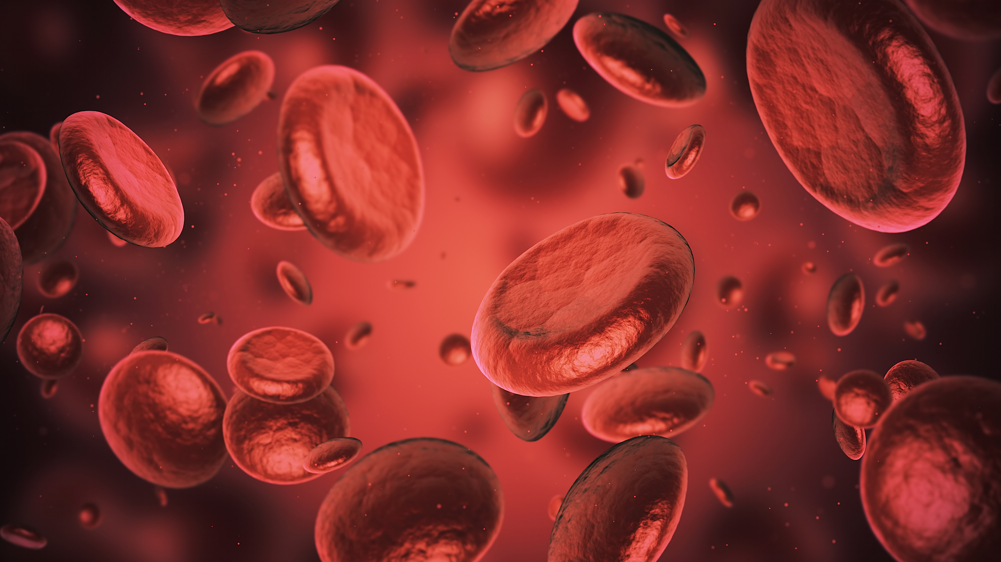
“The focus of the health service is on productivity, operational performance, and financial control. Medicine is industrialised when it needs to be humanised. As well as asking ‘What’s the matter with you?’ we should be asking ‘What matters to you?’ so that healthcare is personal, meaningful, and safer.’ – Henrietta Hughes, Patient Safety Commissioner, England

Slide 32

Your Questions Please
?

