Slide 1

Leading the Way on Foundation Doctor Education
Dr Gethin Pugh
Consultant Intensive Care Medicine & Anaesthesia
Director of Educational Improvement, HEIW | BHNOG Conference | 23 June 2026

Slide 2
Foundation Transfusion Education Programme
  All Wales Foundation Doctor Transfusion Education Programme
    Wales IBI Transfusion Education Oversight Group
    Collaborative Programme of work between BHNOG/Blood Health Team & HEIW
Notes:
Collaborative project led by the IBI Transfusion Education Oversight Group, co-designed by Wales Blood Health Team and HEIW and I will present this work on behalf of the group.

Slide 3
Foundation Transfusion Education Programme
  All Wales Foundation Doctor Transfusion Education Programme
    Wales IBI Transfusion Education Oversight Group
    Collaborative Programme of work between BHNOG/Blood Health Team & HEIW
  IBI Recommendations 3 and 7d
    Focus on doctors in the first two years of clinical practice
    Specific Transfusion Education Programme (distinct from induction process)
    Improvement approach to enable design and implementation
Notes:
Collaborative project led by the IBI Transfusion Education Oversight Group, co-designed by Wales Blood Health Team and HEIW and I will present this work on behalf of the group.

Slide 4

Improvement in Action
Science of Improvement knowledge –
System of Profound Knowledge
Subject matter knowledge
Improving
Patient Safety

Slide 5
Foundation Transfusion Education Programme
Concept Development
Learning
System
IBI Recommendations
Subject Matter Transfusion Experts
Education & Clinical Leads

Slide 6
Foundation Transfusion Education Programme
Concept Development
Quality Improvement
Learning
System
IBI Recommendations
Subject Matter Transfusion Experts
Education & Clinical Leads
Structured PDSA Testing
Continuous Improvement & Innovation
Education & Simulation Standards
Systems Thinking

Slide 7

Foundation Transfusion Education Programme
Concept Development
Quality Improvement
Learning
System
IBI Recommendations
Subject Matter Transfusion Experts
Education & Clinical Leads
Structured PDSA Testing
Continuous Improvement & Innovation
Education & Simulation Standards
Systems Thinking
Implementation
Multiprofessional Capability Building
Transfusion Education Network

Slide 8
Foundation Transfusion Education Programme
Phase I
Patient Blood Management
Transfusion Reactions
Phase II
Phase III
Massive Haemorrhage
Simulation Based Education
Assessment of Learning Outcomes
Transfusion Educational Network
Assessment in the Workplace
Enhanced Patient Safety
Supporting Resources
Notes:
Programme promotes clinical decision making in transfusion, utilising multimodal education approaches encompassing small group teaching, case based discussion and simulation-based education.
This is achieved in a 3 Phase programme.

Slide 9
Foundation Transfusion Education Programme
Phase I
Patient Blood Management
Transfusion Reactions
Phase II
Phase III
Massive Haemorrhage
Simulation Based Education
Assessment of Learning Outcomes
Transfusion Educational Network
Assessment in the Workplace
Enhanced Patient Safety
Supporting Resources
Notes:
Programme promotes clinical decision making in transfusion, utilising multimodal education approaches encompassing small group teaching, case based discussion and simulation-based education.
This is achieved in a 3 Phase programme.

Slide 10
Foundation Transfusion Education Programme
Phase I
Patient Blood Management
Transfusion Reactions
Phase II
Phase III
Massive Haemorrhage
Simulation Based Education
Assessment of Learning Outcomes
Transfusion Education Network
Assessment in the Workplace
Enhanced Patient Safety
Supporting Resources
Notes:
Programme promotes clinical decision making in transfusion, utilising multimodal education approaches encompassing small group teaching, case based discussion and simulation-based education.
This is achieved in a 3 Phase programme.

Slide 11
Foundation Transfusion Education Programme
Phase I
Patient Blood Management
Transfusion Reactions
Phase II
Phase III
Massive Haemorrhage
Simulation Based Education
Assessment of Learning Outcomes
Transfusion Education Network
Assessment in the Workplace
Enhanced Patient Safety
Supporting Resources
Notes:
Programme promotes clinical decision making in transfusion, utilising multimodal education approaches encompassing small group teaching, case based discussion and simulation-based education.
This is achieved in a 3 Phase programme.

Slide 12
Foundation Transfusion Education Programme
First 6 months
Phase I
Patient Blood Management
Transfusion Reactions
Phase II
Phase III
Massive Haemorrhage
Simulation Based Education
Assessment of Learning Outcomes
Transfusion Education Network
Assessment in the Workplace
Enhanced Patient Safety
Supporting Resources
Notes:
Programme promotes clinical decision making in transfusion, utilising multimodal education approaches encompassing small group teaching, case based discussion and simulation-based education.
This is achieved in a 3 Phase programme.

Slide 13
Foundation Transfusion Education Programme
First 6 months
Phase I
Patient Blood Management
Transfusion Reactions
Phase II
Phase III
Massive Haemorrhage
Simulation Based Education
Assessment of Learning Outcomes
Transfusion Education Network
Assessment in the Workplace
Enhanced Patient Safety
Supporting Resources
Longitudinal Application of Learning across Foundation Training Years

Slide 14

Foundation Transfusion Education Programme

Slide 15

Foundation Transfusion Education Programme

Slide 16
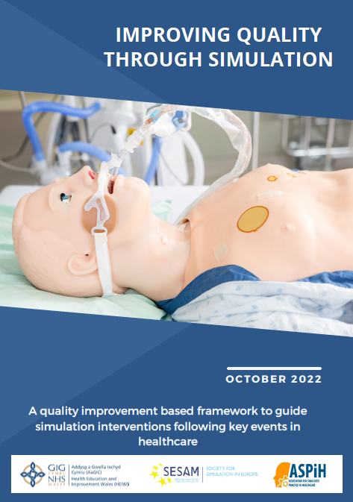
Foundation Transfusion Education Programme

Slide 17
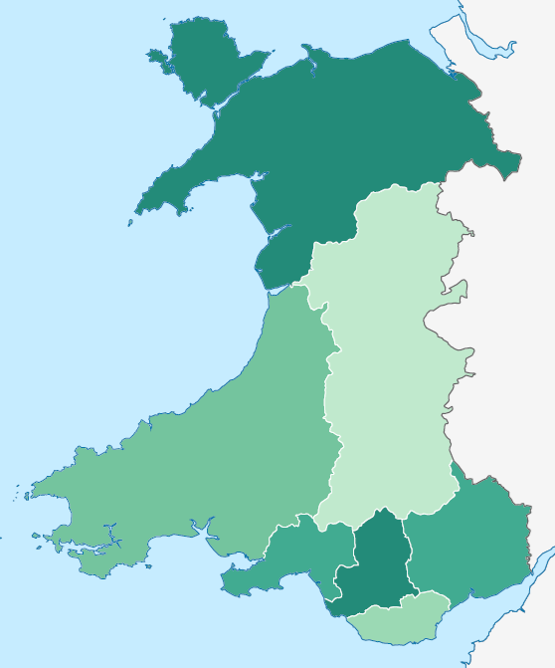

Understanding Our Education Systems
Notes:
Faculty Teams embedded within each learning environment in Wales.

Slide 18
Understanding Our Education Systems
Faculty Teams embedded in
Local Education Providers (LEPs)
Notes:
Faculty Teams embedded within each learning environment in Wales.

Slide 19
Understanding Our Education Systems
Notes:
Faculty Teams embedded within each learning environment in Wales.

Slide 20
Understanding Our Education Systems
Notes:
Faculty Teams embedded within each learning environment in Wales.

Slide 21
Understanding Our Education Systems
Notes:
Faculty Teams embedded within each learning environment in Wales.

Slide 22
Looking Forward | UK Wide Collaboration
  All Wales Implementation 2026/27
    Sustainability of Programme & Future Updates
    Transfusion Education Network Leads from Blood Health Team & HEIW
Notes:
First of 4 nations to meet the requirements of the recommendations

Slide 23
Looking Forward | UK Wide Collaboration
  All Wales Implementation 2026/27
    Sustainability of Programme & Future Updates
    Transfusion Education Network Leads from Blood Health Team & HEIW
  UK Leading Model for Foundation Transfusion Education
    Working with four-nation partners to share experience and learning
    Pilot planned for Scotland October 2026 using Wales model
    Co-delivered by Welsh and Scottish Faculty
Notes:
First of 4 nations to meet the requirements of the recommendations

Slide 24
Thank You | Questions
Gethin.Pugh@wales.nhs.uk

