Slide 1
Blood Transfusion Training for Pre-Registration Nurses 3rd Year BSc (Hons) Nursing Version 2 (2023)
Notes:
Feel free to add your own school logo to this presentation alongside the NHS Wales logo. Prior to attending this session the student MUST have completed the learnbloodtransfusion (LBT) module as per instruction in the workbook.
It is expected that a more advanced clinical scenario will be used for students in year three and will cover the following points as per practice learning framework:
Check patency of venous access
Check availability of component (in accordance with local hospital policy)
Pre-administration checks Including:
Patient ID
Written instruction (“prescription”)
Blood component quality
Taking & recording transfusion observations
Complete transfusion documentation with the RN – understanding that this must be countersigned by the RN
Run through the blood giving set
Administration of any concomitant medication – observe prescription on medicines chart and complete All Wales Transfusion Record
Monitoring the patient for complications or adverse reactions & actions to be taken
Monitoring the venous access site
Monitoring of fluid balance
Disconnect and dispose of the transfusion
Discuss importance of traceability requirements. This will be different for each local HB who will have a policy

Slide 2
Learning Outcomes
At the end of this session the learner should be able to:
Demonstrate an understanding of the roles and responsibilities of pre-registration nurses in relation to blood transfusion as outlined in the Practice Learning Framework
Explain the difference between emergency (group O), electronic issue and cross-matched red cells and describe the ordering process
Identify compatible ABO blood groups (compatibility table)
Discuss transfusion benefits & risks & patient consent
In depth explanation of the All Wales Transfusion Record
Explain what safe administration of blood involves, including explanation of pre-transfusion checks (blood pack check, patient ID)
Describe the importance of monitoring the patient during & post transfusion including recognising a basic transfusion reaction & appropriate actions to be taken

Slide 3
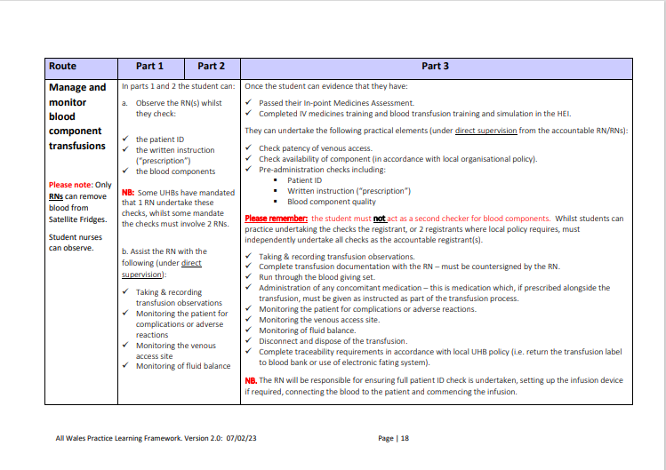
Notes:
We have worked to the Practice Learning Framework for Wales covering the annex B as a guide for this presentation. Please can we make clear to students what they are allowed to undertake based on this framework and what is out of the scope of their practice as a student.
Especially can we remind students that they MUST not be used as a second checker in any UHB that has this policy in place for transfusion. This must only be carried out by another RN who has been competency assessed to administer blood.

Slide 4
Blood Groups
There are 43 recognised different blood group systems¹
The two most important of these are ABO and Rh. They determine someone's blood type (A, B, AB, and O, with + or − denoting Rh D status) for suitability in blood transfusion.
If a patient receives an ABO incompatible blood transfusion, it can lead to a haemolytic reaction (red blood cell destruction) that could result in multi-organ failure and death.
Rh groups become important with pregnancy:
Rh D negative women of child-bearing age/potential should only receive Rh D negative blood.
¹International Society of Blood Transfusion (2021): https://www.isbtweb.org/isbt-working-parties/rcibgt/blood-group-allele-tables.html#blood%20group%20allele%20tables
Notes:
The D antigen in the Rh system determines whether you have positive or negative blood. If you have the RhD antigen, your blood type is positive. If you lack the RhD antigen, your blood type is negative. Your blood group with therefore be documented as a letter A, B, AB or O (abo blood group system) with either a + or – denoting your RhD status. There are four other main antigens in the Rh system but the D antigen is the most important as the D antigen is the most immunogenic, meaning it provokes an immune response that makes it most likely to cause a transfusion reaction in the recipient.
Currently, child bearing age is classed as any female under 50 years of age. However, clinical staff will consider if patient has no child bearing potential e.g. if they have had a hysterectomy. To prevent unwanted transfusion reactions and production of alloantibody, Rh D negative girls and women of child bearing potential should not be transfused with Rh D positive red cells except in an emergency.
This is because alloantibody produced by transfusion of Rh D positive blood to Rh D negative women, or as a result of specific events during pregnancy, can cause Haemolytic Disease of the Fetus and Newborn (HDFN).
HDFN occurs when, either during a previous transfusion or a previous pregnancy, alloantibody in the mother’s blood crosses the placenta, binding to the fetal red cells. This breaks down the fetal red blood cells causing anaemia, referred to as haemolytic anaemia.

Slide 5
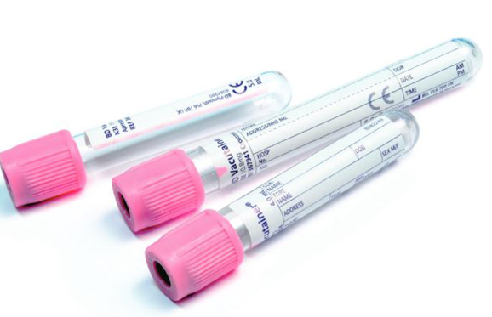
Group and Screen sample
Group and Screen testing determines the patients ABO and Rh blood groups
It screens for any irregular red cell antibodies present
It is the most important serological test performed on a pre transfusion sample
*NB. Students are NOT permitted to undertake any transfusion sampling
Notes:
This will NOT be carried out by nursing students, a separate competency assessment following local Health Board transfusion training on qualification is required. For guidance refer to the Practice Learning Framework

Slide 6
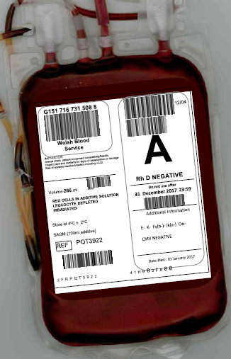
Electronic Issue (EI) of blood
Allows the release of compatible blood components within 5 minutes
subject to specific criteria
A patient may be suitable for electronic issue if:
They have two valid ABO & D results taken from two different group & screen phlebotomy events
(see SHOT bite resource for more information on two samples )
The blood group matches on both of these samples
The antibody screens are negative
There is a fully automated blood grouping system with no manual editing of results
*NB. There may be other reasons to exclude the patient from electronic issue
Notes:
Remote electronic issue is defined as a situation where the testing laboratory is physically separate from the location of blood component issues i.e. blood is kept in remote fridges found within the hospital. The development of electronic issue (sometimes termed "electronic crossmatch") has facilitated rapid provision of RBC units by avoidance of the serologic crossmatch in eligible patients. Especially useful in an emergency to avoid the unnecessary use of O group blood & ensure the patient receives group specific blood.

Slide 7
Crossmatching
If the group and screen sampling detects any irregular red cell antibodies, the laboratory will need to identify the antibodies and then crossmatch the sample
The crossmatching process involves mixing the recipients blood plasma with a sample of the donor red blood cells
This verifies compatibility by testing for potentially harmful interactions between the patients blood and the donors blood
The process can take a minimum of 45 minutes > a few hours if compatible blood components need to be ordered; so it can slow down the issuing of blood
Notes:
Even though a group and screen sample is taken to identify the patients ABO type and RhD status. It’s important to note that donor blood may still be incompatible with the patients because it may contain other antigens that are not routinely typed but may still cause a problem if the recipient's serum contains antibodies that will target them causing an immune response. Therefore, a "cross match" is done to ensure that the donor RBCs actually do match against the recipient's serum.

Slide 8
What happens in ABO Incompatibility?
Antibodies contained in the recipient's plasma, recognise the transfused red cells as 'foreign' and attach to the corresponding antigen, destroying the red blood cells in a process known as haemolysis. In an incompatible transfusion this is an immune response.
This sets off a cascade of events within the body causing renal failure and coagulopathy (impairment of body’s ability to form clots) leading to uncontrolled bleeding
The patient is likely to become unwell very quickly and will need urgent treatment to support renal function and correction of the coagulopathy
ABO incompatibility often leads to major morbidity and even death
Notes:
Despite ABO incompatible transfusions being defined by the Department of Health (DoH) as NEVER EVENTS – Sadly such events do occur, albeit rarely.
These events can cause significant patient harm and even result in patient death.

Slide 9
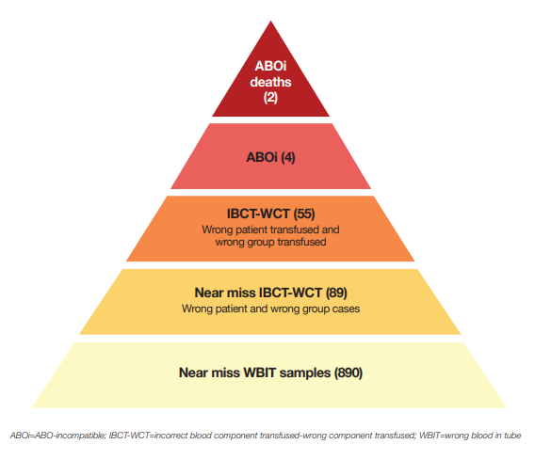
All ABO incompatible transfusions are ‘Never Events’
SHOT data on ABO incompatible Transfusions 2016-2021² Most recent SHOT data on ABO incompatible Transfusions 2022³
²SHOT 2021 annual report: https://www.shotuk.org/shot-reports/report-summary-and-supplement-2021/
³SHOT 2022 annual report: https://www.shotuk.org/wp-content/uploads/myimages/SHOT-REPORT-2022-FINAL-Bookmarked-1.pdf
Notes:
Though the figures seem small in number, they will have been life changing for patients and families involved. Near miss events can be viewed in a positive light as despite a process failure/error, patient harm has been avoided.
The first image shows the cumulative data from incidents over a 6 year period reported to the Serious Hazards of Transfusion (SHOT) Haemovigilance scheme from the years 2016-2021.
The second image shows the most up to date data from the 2022 SHOT report. In 2022 there were 5 ABO incompatible red cell transfusions, of which 2 resulted in patient death. The last ABO incompatible related death occurred in 2015, and there were no reports of red cell ABOi transfusions in 2021.
In 4 of the ABOi cases in 2022 there was a failure to complete Patient Identity checks prior to administration. This is a basic process in healthcare and justification for not properly identifying patients is difficult to come by. The use of a pre-administration checklist has been promoted by SHOT recommendations and is a requirement on the All Wales Transfusion Record which we will show you over the next few slides.

Slide 10
Clinical signs and symptoms of an ABO Incompatible transfusion
Signs & symptoms include:
Fever
Flushing
Urticaria
Hypotension
Increasing anxiety/restlessness
Pain at or near the site of the transfusion
Loin pain
Respiratory distress
Collapse
These usually occur within the first 15 minutes of the transfusion⁴
⁴Transfusion Matters (2011) NHS Blood & Transplant; https://www.bbts.org.uk/downloads/transfusion_matters_8.pdf

Slide 11
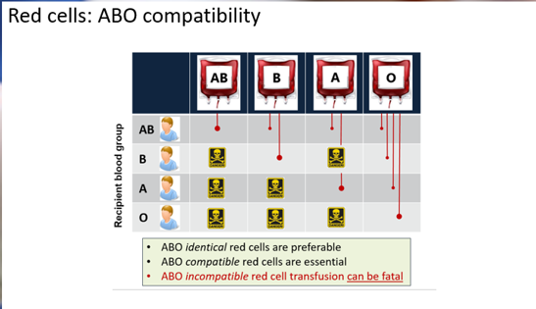
Notes:
Stress the importance of the unit being compatible as red cells do not need to be an identical match (see next slide), if unsure in the clinical environment it is best to contact local transfusion practitioner or laboratory for advice.

Slide 12
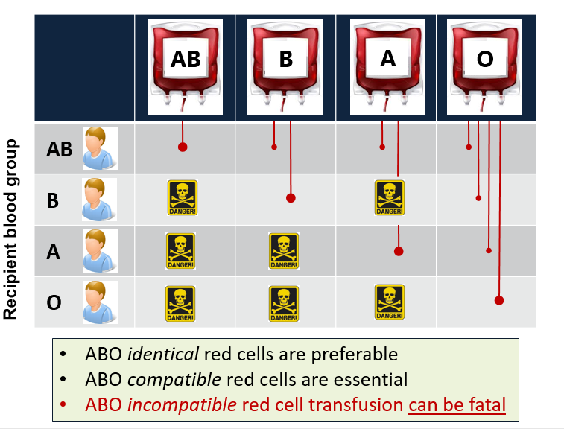
Red cells: ABO compatibility
Red Cells: ABO compatibility including RhD antigen
Notes:
In addition, Red blood cells sometimes have another antigen, a protein known as the RhD antigen. If this is present, your blood group is RhD positive. If it's absent, your blood group is RhD negative.​
This means you can be 1 of 8 blood groups:​
A RhD positive (A+)​
A RhD negative (A-)​
B RhD positive (B+)​
B RhD negative (B-)​
O RhD positive (O+)​
O RhD negative (O-)​
AB RhD positive (AB+)​
AB RhD negative (AB-)​
About 85% of the UK population is RhD positive (36% of the population is O+, the most common type).​
In most cases, O RhD negative blood (O-) can safely be given to anyone. It's safe for most recipients because it does not have any A, B or RhD antigens on the surface of the cells, and is compatible with every other ABO and RhD blood group.​
Nb. O+ can now also be used during an emergency for males & females (of non child bearing age/potential) – please discuss with students as they will now see this in their HBs as a new policy (discussed more in depth in notes pages slide 15)

Slide 13
Red Cell Compatibility Table: 5 minute exercise
Red Cells ABO Compatibility
 | Donor
Patient | O | A (anti-B) | B (anti-A) | AB (no anti-A or B)
AB
B
A
O
Rh D Compatibility
 | Donor
Patient | Rh D + | Rh D -
Rh D +
Rh D -
Notes:
Can use this exercise to com
plete with students

Slide 14
Red Cell Compatibility Table: Answers!
Red Cells ABO Compatibility
 | Donor
Patient | O | A (anti-B) | B (anti-A) | AB (no anti-A or B)
AB
B
A
O
Rh D Compatibility
 | Donor
Patient | Rh D + | Rh D -
Rh D +
Rh D -
*
* However, in emergency situations (and in order to preserve stocks of O RhD- red cells), RhD + red cells may be given to RhD – female patients who are not of child bearing potential.
NB: Additional typing may be required for some groups of patients e.g. women of childbearing age, sickle cell patients.
Notes:
Answers

Slide 15
Emergency Blood (Red cells)
Group O people are universal donors but they are only able to receive Group O blood if they are to have a blood transfusion
This is because they have no A or B antigens on their red cells that other blood groups could react to, therefore a patient with any blood group can receive their blood (although consideration of RhD must be given to women of child bearing age/potential)
Group O D- is the recognized emergency issue blood as there are no RhD antigens on the red cells for the patient to react to
Group O D+ may also be used in an emergency for male patients and women over child bearing age/potential. This is stipulated as the usual policy for most hospitals in Wales as of 2021
Notes:
Blood stocks for group O red cells are in high demand due to the nature of its compatibility across all blood groups & the fact it is used in an emergency. However, it is not a finite resource and the blood services rely on blood donors to support this by attending donation sessions to give blood.
The Welsh Blood Service supply all hospitals in Wales with blood & blood products that we collect & manufacture from blood donors. Hospitals also work to ensure that demand can be met can be met by encouraging the appropriate use of blood within the clinical area & put in place strategies to minimize the unnecessary wastage of blood. One of these recent strategies has been the implementation of the use of O+ for males & women over child bearing age/potential in an emergency.
Please visit the Welsh Blood Service website if you would like more info on blood donation or becoming a donor: https://www.welsh-blood.org.uk/giving-blood/

Slide 16
Patient consent for transfusion
It is vital that before a patient receives a blood transfusion they:
have an understanding of the need for the transfusion
are fully informed of what is involved including the risks, benefits & available alternatives
This ensures shared decision making between the patient & clinician is undertaken
In 2020 the expert advisory committee on the Safety of Blood, Tissues and Organs (SaBTO) ⁵ updated their guidance on patient consent for blood transfusion. The key points:
Informed and valid consent for transfusion is completed for all patients who will likely, or definitely, receive a transfusion
Patients who have a been given a blood transfusion and were not able to give informed and valid consent prior to the transfusion are informed of the transfusion prior to discharge and provided with relevant paper or electronic information
⁵ SABTO guidance: https://www.gov.uk/government/publications/blood-transfusion-patient-consent/guidelines-from-the-expert-advisory-committee-on-the-safety-of-blood-tissues-and-organs-sabto-on-patient-consent-for-blood-transfusion

Slide 17
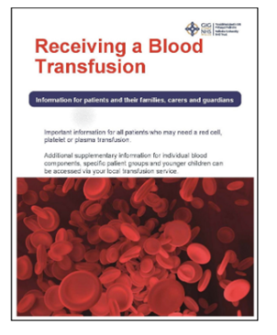
Transfusion Benefits & Risks
Blood transfusions are common procedures that can save and improve lives and death due to transfusion is extremely rare. Most patients who receive a blood transfusion experience no complications or problems. However, there are associated risks, which fall into four main categories:
Patient Identification Error
Transfusion Reactions
Infection
Complications of long term transfusion
For more information see ‘Receiving a Blood Transfusion’ leaflet via the Blood Health National Oversight group webpage:
https://bhnog.wales.nhs.uk/patient-information-leaflets/

Slide 18
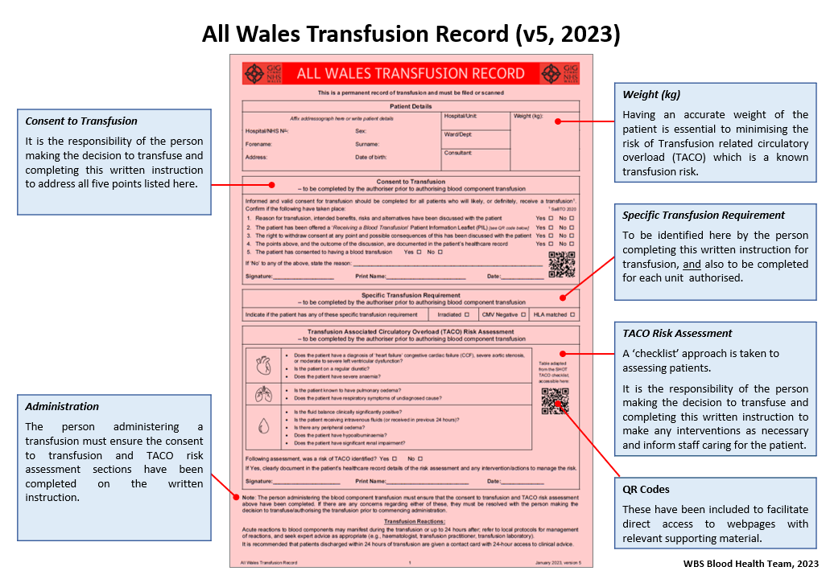
The All Wales Transfusion Record
The All Wales Transfusion Record (AWTR) is a standardised clinical record of transfusion used across all Health boards in Wales.
It includes essential information and prompts and is split into sections.
Notes:
The new All Wales Transfusion Record (version 5) was implemented in April 2023
The authoriser (A doctor or specially trained healthcare professional) will complete their sections indicating that they have carried out a thorough clinical assessment of the patient, they identify any specific transfusion requirements, records the reason for the transfusion (using indication codes), confirms that consent has been given by the patient and authorises the component for use.
The administrator (nurse or another healthcare professional trained and assessed in the process) carries out the pre-administration checks, including the final check & signs for these, puts the unit sticker for the unit on the AWTR & completes the administration & observations section for each unit as identified on the form.
Transfusion-Associated Circulatory Overload (TACO) risk
TACO is defined as acute or worsening respiratory compromise and/or acute or worsening pulmonary oedema during or up to 12 hours of transfusion, with additional features including cardiovascular system changes not explained by the patient’s underlying medical condition; Patients who develop respiratory distress during or up to 24 hours following transfusion where transfusion is suspected to be the cause must be reported to SHOT.
A formal pre-transfusion risk assessment for transfusion-associated circulatory overload (TACO) should be undertaken whenever possible for all patients receiving blood transfusion by the person authorising the blood component. This is why a checklist has been added to the AWTR so that the person making the decision to authorise the component checks the patient for this risk. A QR code has been added to the new record with a direct link to the SHOT TACO checklist.

Slide 19
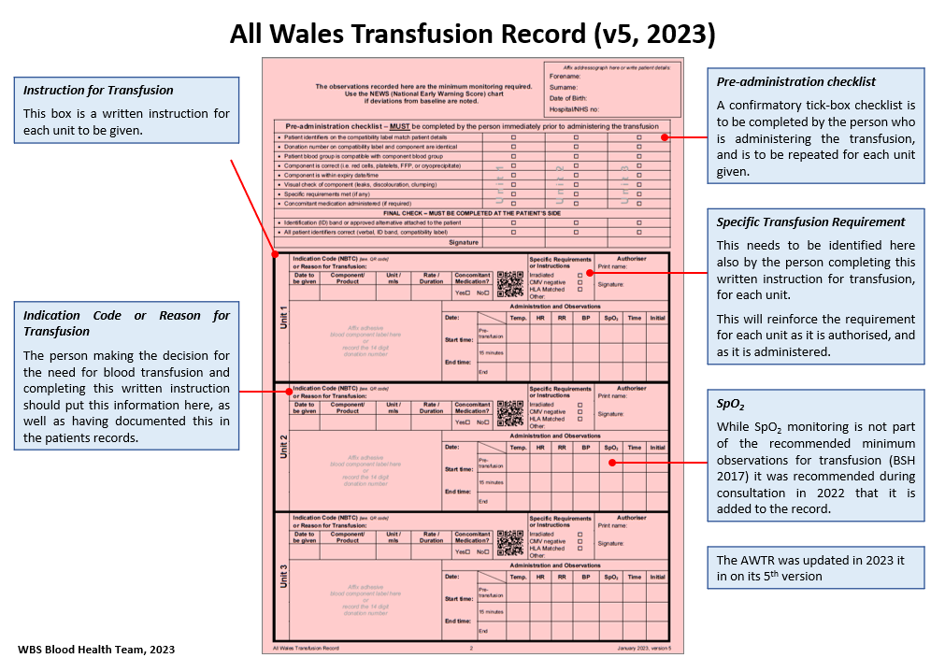
The All Wales Transfusion Record Continued
Notes:
Transfusion observations must be documented in the patient’s clinical record and should be distinguishable from other routine observations

Slide 20
Safe administration of blood
As a student Nurse you will NOT be expected to administer blood although you will be assisting in the process as defined in the learning practice framework and so you must be aware of how to administer blood safely. You should never be utilised to second check a component transfusion in those HB with this procedure in place
You MAY assist in the monitoring of patients who are receiving a transfusion under direct supervision of the accountable RN. Therefore, it is important that you understand basic types of transfusion reactions and what your role is in the event of this rare occurrence
You will receive extra training and support from your Hospital Transfusion Team following qualifying and will undertake a further competency assessment in order to be deemed competent to administer blood safely

Slide 21
Pre-transfusion checks
Prior to arranging collection of blood, the following checks should be made:
Correctly completed All Wales Transfusion Record
Products are authorised correctly
Patient aware of transfusion & gives their consent
Patent venous access
Giving set and other equipment
Observation chart – ensure pre-transfusion observations are complete prior to ordering
Availability of appropriate staff to support transfusion
Ensure any concomitant medication is prescribed on drug chart and available
The component can now be ordered
These checks ensure patient safety, avoids delay to the patient of receiving their transfusion and avoids wastage of the blood component
Notes:
The Pre-administration checklist on the All Wales Transfusion Record and should be used to reduce errors in administration.
As described in a previous slide this is a confirmatory tick-box checklist is to be completed by the person who is administering the transfusion, and is to be repeated for each unit given.
Step 1: Check the blood component has been authorised. Check the prescription form and/or fluid balance chart to ensure that the component has been prescribed and if the patient has any special requirements e.g. irradiated blood, and if they require any concomitant drugs prescribed, e.g. a diuretic
Step 2: Undertake baseline observations within 1 hour prior to the transfusion commencing. Ensure that the patient’s temperature, pulse, resps, oxygen saturations and blood pressure are recorded before the blood component is administered
Step 3: Check the component before approaching the patient. Undertake a visual inspection of the blood component for signs of discolouration, leaking, clots etc and check the expiry date and time (see next slide)

Slide 22
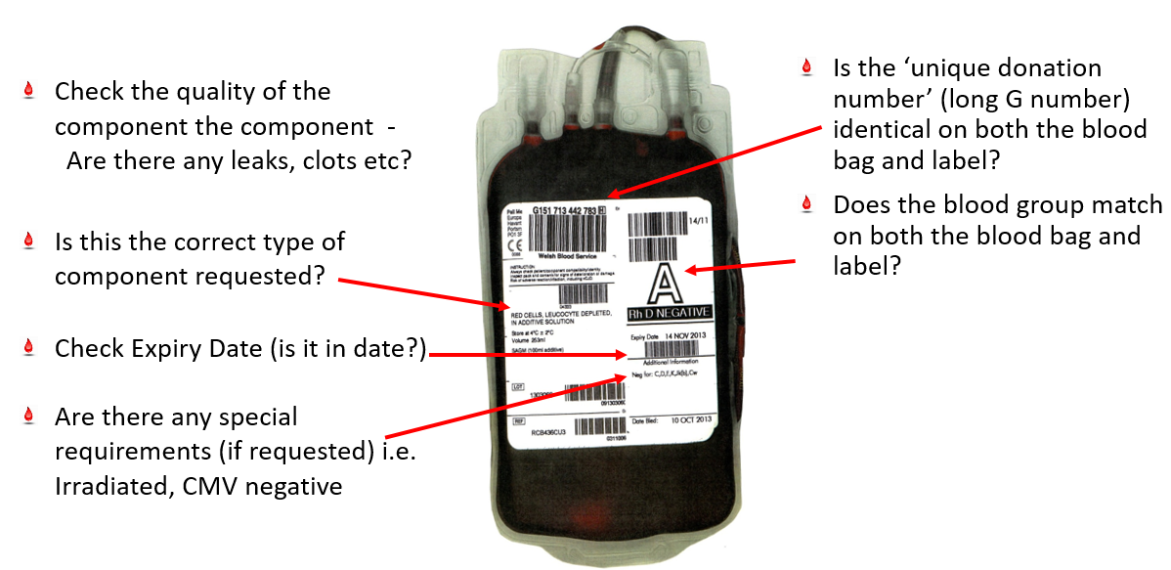
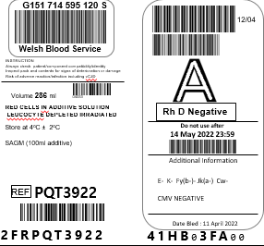
Pre-transfusion checks continued – blood component check
Check the quality of the component
Are there any leaks, lots etc?
Is the blood group on the blood bag compatible with the group on the label
These checks ensure patient safety, avoids delay to the patient of receiving their transfusion and avoids wastage of the blood component

Slide 23
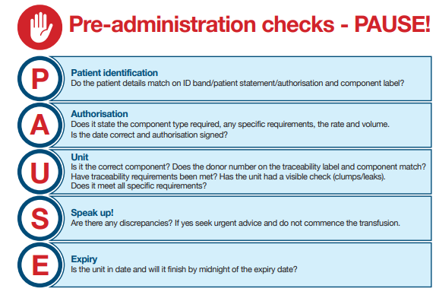
Pre-administration checks conclusion
Notes:
Reiterating the point that Patient ID is essential and the information on the wristband must also match the information on the blood bag & compatibility label slide 25 will explain this process in the video

Slide 24
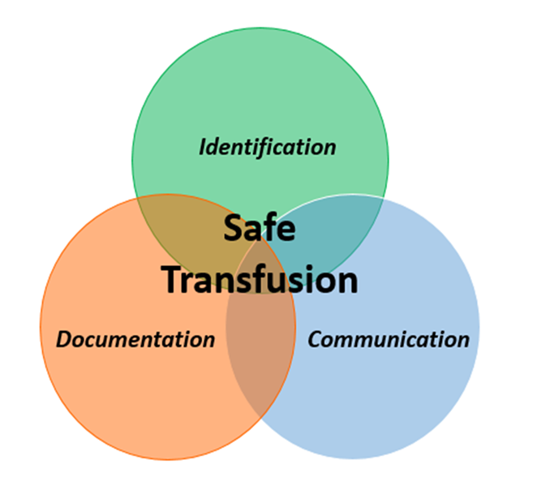
The Three Fundaments of safe transfusion practice
Notes:
Revisited from year 2
The British Committee for Standards in Haematology (2009) has produced national guidance for hospitals on the administration of blood components. This states that every stage of the transfusion process should be underpinned by three principles:
Positive patient identification; (discussed on next slide)
Documentation;
Communication
“Confirmation of identity at every stage of the transfusion process and good communication are essential to prevent errors.” (Bolton-Maggs and Cohen, 2012). Most administration errors are known to have been caused by lack of Positive patient identification.
2. Documentation
In line with the Blood Safety and Quality Regulations 2005, for traceability purposes, hospitals, blood management practitioners and nurses are required by law to have unambiguous evidence of the final fate of every blood component issued.
Nurses play a vital role in ensuring full documentation of the administration or other final fate of every unit, which provides an audit trail.
Individual trusts and health boards have local policies detailing how to achieve and demonstrate traceability of each unit.
3. Communication
As the transfusion process includes several steps involving various personnel in different departments, there is the potential for confusion and errors to occur.
Written or electronic communication should be used whenever possible; copying details from one document to another should be avoided where possible because of the potential for transcription errors leading to misunderstandings and errors.
Urgent written requests should be supplemented by telephone discussion between clinician and laboratory staff to clarify exactly what is required.

Slide 25
The Three Fundaments of safe transfusion practice
Notes:
Revisited from year 2
In 2022 there were 55 cases reported to SHOT of a wrong blood component transfused (WCT) a potentially fatal event. 19 of these were due to lack of proper Positive Patient Identification (PPID)
Positive patient identification (PPI) is the act of positively identifying the correct patient by checking with the patient – an essential component of good patient care. Before any component is administered, practitioners must be sure they are treating the right patient.
Ask the patient to state their first name, surname, 1st line of address & DOB. Then check these and the hospital number on the compatibility/traceability label attached to the blood bag against the patient’s ID wristband to ensure they match.
PPID must be done at each step of the transfusion process when at the patient’s bedside. This should be done using the ID band attached to the patient and wherever possible the patient should be included in the process.
If the patient is unable to identify themselves to you, the ID band containing the core identifiers must be used to confirm PPI prior to administering the transfusion.
Watch the video and identify the key points of the patient identification process
Not performing these checks at critical points such as administration increases the risk of error and of an ABOi transfusion which could result in the death of the patient
If you are interrupted – STOP and start the checking procedure again

Slide 26
Pre-transfusion checks continued
DO NOT PROCEED IF THERE ARE ANY DISCREPANCIES WITH ANY PRE TRANSFUSION CHECKS
Notes:
This checklist is part of the All Wales Transfusion Record and should be used to reduce errors in administration

Slide 27
Monitoring of the transfused patient
Once the transfusion has commenced, close monitoring of the patient is vital
Communicate with patient
Record vital signs in line with All Wales Transfusion Record
Pre transfusion (prior to ordering blood - valid for 1 hour)
15 minutes after the start of the transfusion
Post transfusion (up to 1 hour following completion)
If the patient is unwell the accountable RN should STOP the transfusion and seek urgent medical advice (as a student you will only undertake transfusion observation under direct supervision of the RN)
Follow transfusion reaction algorithm and record more frequent observations on NEWS/PEWS/MEOWS/NEWTT charts as directed by accountable RN (under direct supervision)
Be extra vigilant when monitoring unconscious or compromised patients-more frequent observations, depending on the condition of the patient are required
Notes:
Patients should be transfused in an area where they can be readily observed and they should have a ‘call button’ to obtain assistance. It is recommended that patients are observed by a registered nurse for the first 15 minutes of the transfusion process, during which time the 15 minute observations should be recorded.
You should advise your patient of the possible adverse effects of transfusion and tell them to inform someone if they experience any signs of a reaction.
The early check is the most important observation - the majority of major adverse reactions occur within first 15 minutes, thereafter observation should be conducted according to agreed local policy but you must continue to observe your patient throughout the transfusion.

Slide 28
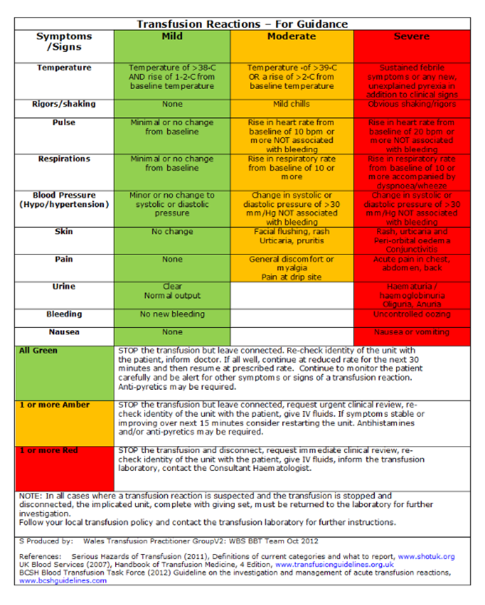
Transfusion reaction algorithm
Notes:
Patients should be transfused in an area where they can be readily observed and they should have a ‘call button’ to obtain assistance.
Severe blood transfusion reactions are uncommon.
Mild transfusion reactions are most likely to occur, please see algorithm above for guidance. The most important step to take in a suspected transfusion reaction is to immediately STOP the transfusion and call for URGENT medical advice. The clinical team should assess the patient accordingly using a ABCDE approach and treat as appropriate. Depending on the severity of the reaction, the transfusion may or may not continue as above. Further advice can be sought from Consultant Haematologist and Blood Bank if required.

Slide 29
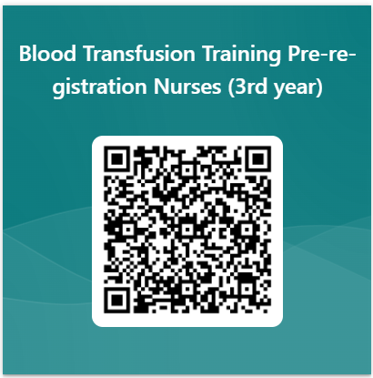
Please complete the following evaluation

Slide 30
Further Information
Please check your local Hospital Blood Transfusion Policy & Procedures
Please use your local Transfusion Practitioners (TP’s) & Hospital Transfusion Laboratory in the event of ANY queries regarding blood transfusion
Useful Links
Blood Assist App: https://www.bloodassist.co.uk/
British Society for Haematology Guidelines: www.bshguidelines.com
National Institute for Health and Care Excellence (NICE). NICE guidelines [NG24] Blood transfusion. https://www.nice.org.uk/guidance/ng24, Oakland K, Chadwick G, East JE, et al.
Serious Hazards of Transfusion (SHOT) www.shotuk.org

