Slide 1
Blood Transfusion Training for Pre-Registration Nurses 2nd Year BSc (Hons) Nursing Version 2 (2023)
Notes:
Feel free to add your own school logo to this presentation alongside the NHS Wales logo. It is suggested that a role play scenario is used for the three fundamentals of transfusion for year 2, specifically covering positive patient identification (PPI).

Slide 2
Learning Outcomes
At the end of this session the learner should be able to:
Demonstrate an understanding of the role & responsibilities of pre-registration nurses in relation to blood transfusion as outlined in the Practice Learning Framework
List the different blood components
Explain why different components are used
Explain basics of blood groups and antibodies
Describe the ‘cold chain’ and its importance to transfusion
Describe the 3 fundamentals of safe blood transfusion practice:
Patient identification
Documentation (Intro to All Wales Transfusion Record)
Communication
Describe the process for taking transfusion observations
Identify different types of common transfusion reactions

Slide 3
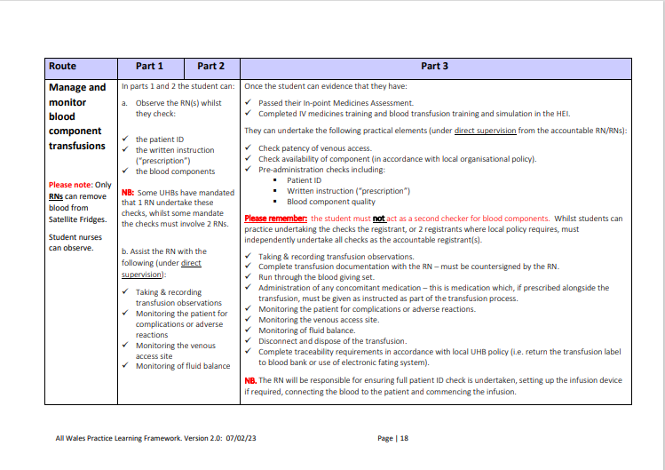
Notes:
We have worked to the Practice Learning Framework for Wales covering the annex B as a guide for this presentation. Please can we make clear to students what they are allowed to undertake based on this framework and what is out of the scope of their practice as student.
Especially can we remind students that they MUST not be used as a second checker in any UHB that has this policy in place for transfusion. This must only be carried out by another RN who has been competency assessed to administer blood.

Slide 4
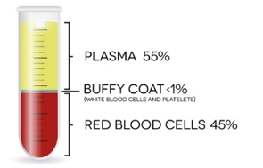
What is blood made up of?
Blood is a complex connective tissue in which living blood cells, the formed elements, are suspended
Blood has 4 main components:
Plasma - Carries blood cells, platelets and other components and supports the immune system (made up of mostly water)
White Blood Cells – help defend the body against disease and infection
Platelets – help stops bleeding
Red Blood Cells – contain a protein called haemoglobin, carries oxygen around the body from the lungs & carbon dioxide back to the lungs

Slide 5
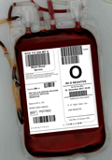
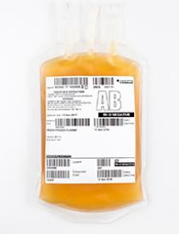
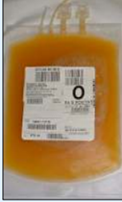
Blood Component | Clinical use | Storage Conditions & shelf life | Transfusion Time
Red Blood Cell (RBC) | Anaemia Blood loss Chronic Transfusion Dependent Patients | 2–6°C in controlled temperature storage 35 day shelf life | 4 hours to transfuse the unit from the time it leaves temperature controlled storage
Fresh Frozen Plasma (FFP) | Treatment of patients with bleeding due to multiple clotting deficiencies Congenital conditions Major Haemorrhage Treatment for coagulopathy (bleeding disorder) in patient who is actively bleeding or prior to patient undergoing a procedure Plasma exchange | Stored at <–25°C (thawed when required, this can take >20 minutes) Once thawed it can be kept in a controlled temperature fridge for 24 hours 3 year shelf life | 30 minutes (max 4 hours)
Platelets | To treat or prevent bleeding in patients with a low platelet count (thrombocytopaenia) or platelet dysfunction | 20–24°C with agitation 7 day shelf life | 30 minutes
Notes:
Blood products (transfusionguidelines.org)

Slide 6
ABO Blood Group System
ABO blood group is the most clinically significant of all the blood group systems
We are born with ABO antigens on the red cell surface.
ABO antibodies are naturally occurring.
Approximate group frequencies in the UK are:
O = 44%
A = 42%
B = 10%
AB = 4%
ABO Grouping is the most important serological test performed on a pre-transfusion sample.
Transfusion of an incompatible ABO transfusion can cause death and is a Department of Health ‘Never Event’.

Slide 7
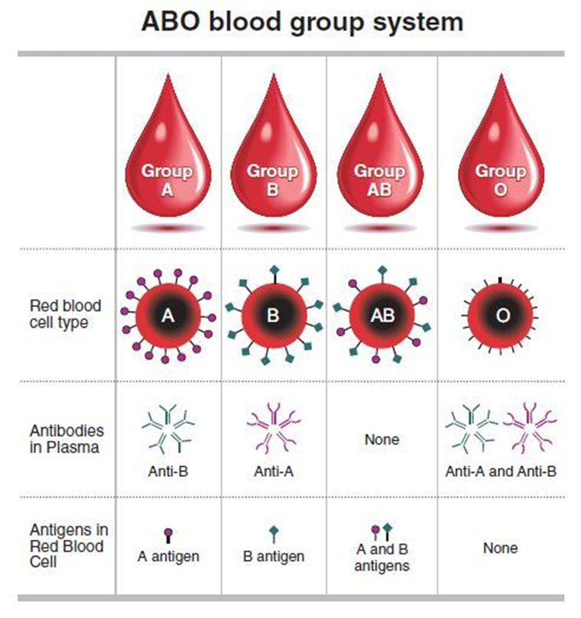
Red cells: ABO compatibility
Group AB recipients can be given any ABO group red cells
(4% of UK population¹)
Group O recipients can only be given group O red cells
(44% of UK population¹)
Group O red cells can be given to any ABO group patient
Notes:
Those with an AB blood group are know as ‘universal recipients’
Those with an O blood group are known as ‘universal donors’ because group O can be given to any blood group. This is because they have no antigens on the red cell & so a transfusion of their red cells will not cause a reaction. However, for this reason they can only receive group O back if they need a transfusion otherwise they will have a reaction if transfused with any other blood group.

Slide 8
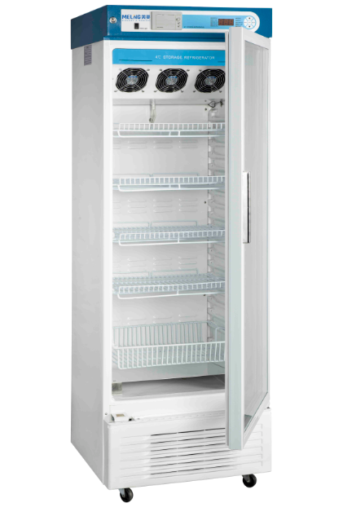
The Cold Chain
The World Health Organisation (WHO) describes the blood cold chain as "a systematic process for the safe storage and transportation of blood from its collection from the donor to its administration to a patient who requires transfusion”¹
This is referred to as the cold chain because blood must be kept cold in order to reduce the risk of bacterial contamination to the product and to prolong its life
In the UK this process is governed by the Blood Safety and Quality Regulations (BSQR) 2005 to which the UK blood centres and hospitals must comply
The cold chain for the hospital starts from the receipt of the blood from the blood centre into the blood bank to the time the unit is transfused at all times including during transportation
¹WHO BloodTransfusionSafety https://www.who.int/publications/i/item/9241545798

Slide 9
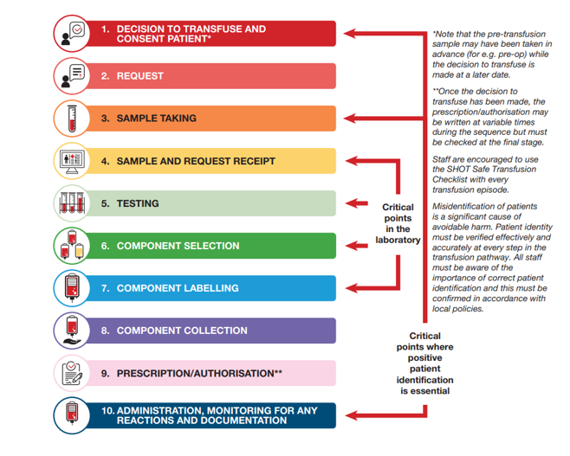
10 steps in the Transfusion process
Notes:
This slide shows the 10 steps in the transfusion process as identified by the Serious Hazards of Transfusion (SHOT). SHOT are the UKs independent professionally led hemovigilance scheme. Since 1996 SHOT has been collecting and analysing anonymised information on adverse events and reactions in blood transfusion from all healthcare organisations (including hospitals & blood services) that are involved in the transfusion of blood and blood components in the United Kingdom. Where risks and problems are identified, SHOT produces recommendations to improve patient safety.
The red arrows show the critical points in the process & where if things go wrong could be detrimental to the patient causing harm and even death.
Steps 4 to 7 are what happens in the laboratory
Steps 1 & 2 are completed by authorisers (usually the doctors or a nurse who has undergone specialist training programme) who make the decision a transfusion in required & then requests the component from the laboratory
Steps 8 to 10 are what happens at a ward level
Step 10 is usually carried out by the Nurse who will administer the product or in emergency situations this can be a healthcare professional who has undergone a competency assessment
Transfusion is therefore a risky procedure & steps are taken to minimise risks wherever possible but they cannot fully protect the patient from harm
HANDOUT TO BE PROVIDED TO STUDENT (IN PACK)

Slide 10
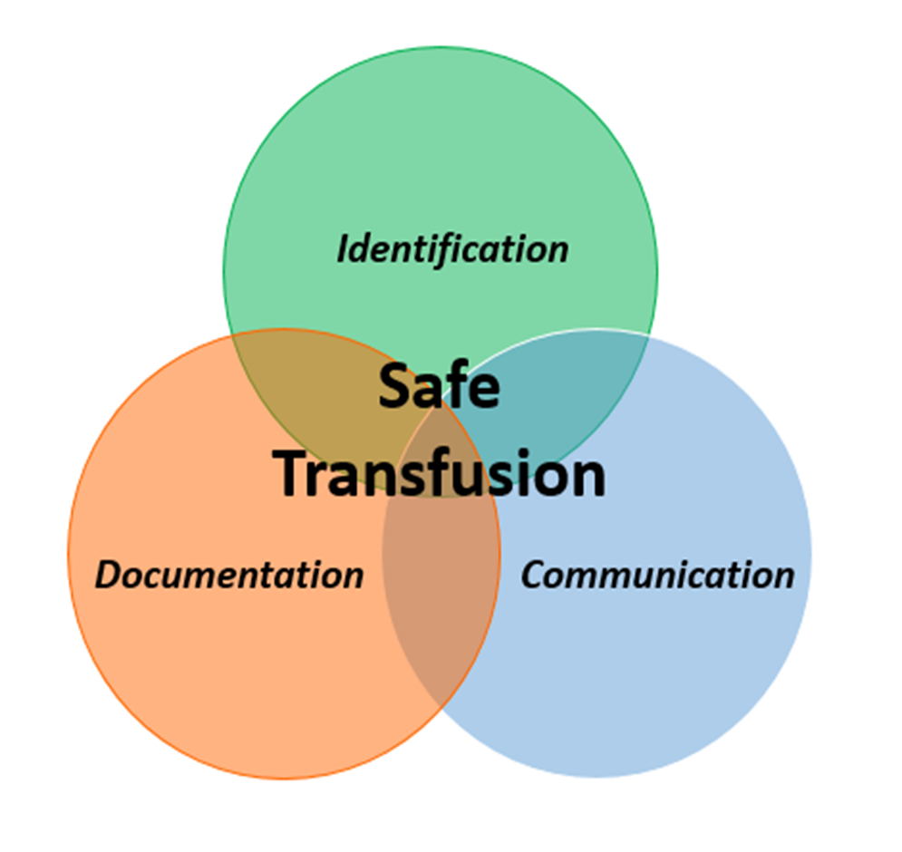
The Three Fundamentals of Safe Transfusion Practice
Notes:
The British Committee for Standards in Haematology (2009) has produced national guidance for hospitals on the administration of blood components. This states that every stage of the transfusion process should be underpinned by three principles:
Positive patient identification; (discussed on next slide)
Documentation;
Communication
“Confirmation of identity at every stage of the transfusion process and good communication are essential to prevent errors.” (Bolton-Maggs and Cohen, 2012) Most administration errors are known to have been caused by issues with Positive patient identification.
2. Documentation
In line with the Blood Safety and Quality Regulations 2005, for traceability purposes, hospitals, blood management practitioners and nurses are required by law to have unambiguous evidence of the final fate of every blood component issued.
Nurses play a vital role in ensuring full documentation of the administration or other final fate of every unit, which provides an audit trail.
Individual trusts and health boards have local policies detailing how to achieve and demonstrate traceability of each unit.
3. Communication
As the transfusion process includes several steps involving various personnel in different departments, there is the potential for confusion and errors to occur.
Written or electronic communication should be used whenever possible; copying details from one document to another should be avoided where possible because of the potential for transcription errors leading to misunderstandings and errors.
Urgent written requests should be supplemented by telephone discussion between clinician and laboratory staff to clarify exactly what is required.

Slide 11
The Three Fundamentals of Safe Transfusion Practice
(Positive Identification)
Notes:
In 2022 there were 55 cases reported to SHOT of a wrong blood component transfused (WCT) a potentially fatal event. 19 of these were due to lack of proper Positive Patient Identification (PPID)
Positive patient identification (PPI) is the act of positively identifying the correct patient by checking with the patient – an essential component of good patient care. Before any component is administered, practitioners must be sure they are treating the right patient.
Ask the patient to state their first name, surname, 1st line of address & DOB. Then check these and the hospital number on the compatibility/traceability label attached to the blood bag against the patient’s ID wristband to ensure they match.
PPI must be done at each step of the transfusion process when at the patient’s bedside. This should be done using the ID band attached to the patient and wherever possible the patient should be included in the process.
If the patient is unable to identify themselves to you, the ID band containing the core identifiers must be used to confirm PPI prior to administering the transfusion.
Watch the video and identify the key points of the patient identification process
Not performing these checks at critical points such as administration increases the risk of error and of an ABOi transfusion which could result in the death of the patient
If you are interrupted – STOP and start the checking procedure again

Slide 12
Transfusion Observations
These are recorded on the All Wales Transfusion Record & other appropriate observations charts
Minimum monitoring of each unit transfused should include:
Regular visual observation of the patient during the transfusion and encouragement of patient to report new symptoms
Baseline pulse rate, blood pressure (BP), temperature and respiratory rate (RR) must be recorded no more than 60 minutes pre-transfusion
A further check is undertaken around 15 minutes after the start of transfusion (many serious reactions, such as ABO incompatibility or bacterial transmission present early in the transfusion episode).
Also if the patient reports new symptoms, the observations must be repeated.
Another set of observations are recorded no more than 60 minutes after the end of the transfusion
**as a student you are only permitted to assist with transfusion observations/monitoring and at all times will be under direct supervision from the accountable RN, if at any point a transfusion reaction is suspected immediate assistance is required. The accountable RN must STOP (but not disconnect) the transfusion until further investigation by a medical professional

Slide 13
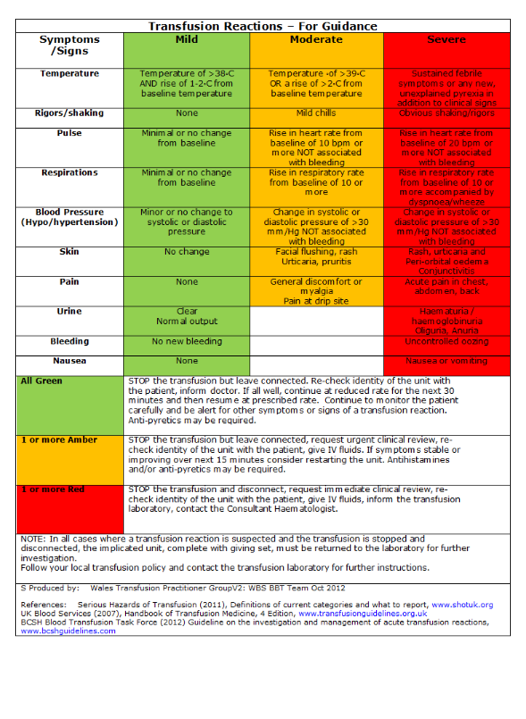
Transfusion Reactions Guidance
Notes:
Patients should be transfused in an area where they can be readily observed and they should have a ‘call button’ to obtain assistance. It is recommended that patients are observed by a registered nurse for the first 15 minutes of the transfusion process, during which time the first set of observations should be recorded
You should advise your patient of the possible adverse effects of transfusion and tell them to inform someone if they experience any signs of a reaction
The early check is the most important observation - the majority of major adverse reactions occur within first 15 minutes, thereafter observation should be conducted according to agreed local policy but you must continue to observe your patient throughout the transfusion.
Severe blood transfusion reactions are uncommon. Mild transfusion reactions are most likely to occur, please see algorithm above for guidance. The most important step to take in a suspected transfusion reaction is to immediately STOP the transfusion and call for URGENT medical advice. The clinical team should assess the patient accordingly using a ABCDE approach and treat as appropriate. Depending on the severity of the reaction, the transfusion may or may not continue as above. Further advice can be sought from Consultant Haematologist and Blood Bank if required
HANDOUT TO BE PROVIDED TO STUDENTS (IN PACK)

Slide 14
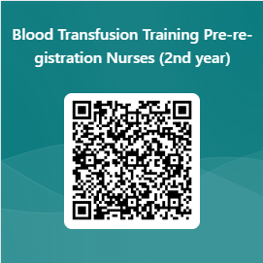
Please complete the following evaluation

Slide 15
Further Information
Please check your local Hospital Blood Transfusion Policy & Procedures
Please use your local Transfusion Practitioners (TP’s) & Hospital Transfusion Laboratory in the event of ANY queries regarding blood transfusion
Useful Links
Blood Assist App: https://www.bloodassist.co.uk/
British Society for Haematology Guidelines: www.bshguidelines.com
National Institute for Health and Care Excellence (NICE). NICE guidelines [NG24] Blood transfusion. https://www.nice.org.uk/guidance/ng24, Oakland K, Chadwick G, East JE, et al.
Serious Hazards of Transfusion (SHOT) www.shotuk.org

