Slide 1
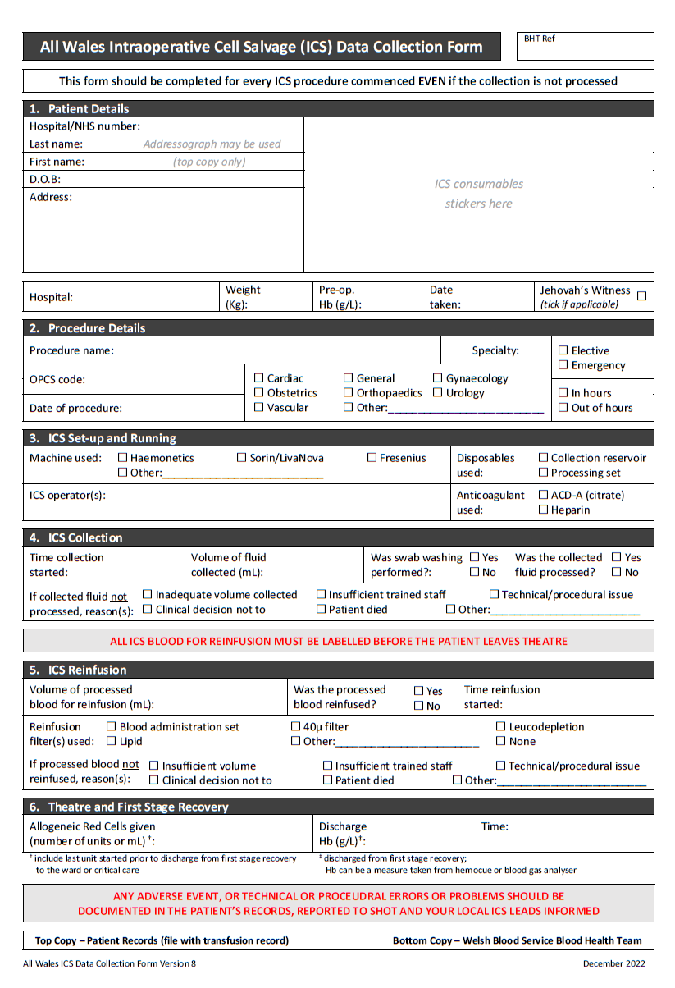
All Wales ICS Data Collection Form (version 8, Dec. 2022)
The revised version of the All Wales ICS Data Collection Form has some additions to the data collection requirement.
Pre-op. Hb This has been moved up to the top of the form, with the intention that this is completed by staff running the ICS instead of transfusion laboratory staff. Enter the most recent pre-op. haemoglobin available, with the date taken.
OPCS Code The primary OPCS code for the procedure should be entered here.
ICS Collection A form should be completed up to this section for every ICS procedure started, even if it was collection only and the salvaged blood was not processed.
Allogeneic Red Cells Given & Discharge Hb To be completed by recovery staff prior to patient discharge to ward/HDU, instead of transfusion laboratory staff (this form no longer needs to go to the transfusion laboratory for data completion). Allogeneic (donor) red cells given to include the whole intraoperative and first stage recovery period. Hb – this is to be taken in first stage recovery.
Separation of the Form On completion of this form (at discharge from first stage recovery) the top copy of the form (white copy) is to be retained in the patient’s records and the bottom copy (pink) is to be collected for submission to the Welsh Blood Service Blood Health Team. Local arrangements to be agreed in regards to this process – for information contact your local ICS lead or Hospital Transfusion Team.
WBS Blood Health Team, 2023

