Slide 1
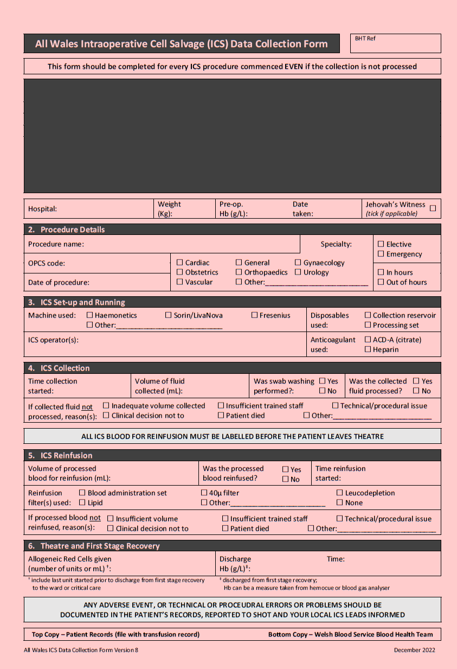
All Wales Intraoperative Cell Salvage (ICS) Data Collection Form
Recovery When the patient is ready to be discharged from first stage recovery, back to the ward (or HDU), please ensure that sections 5. and 6. have been completed [see comment below also] and then separate the top (white) copy to stay with the patient’s notes and leave the pink copy for collection.
PINK COPY - put this copy of the form HERE These will be collected **monthly** by **ICS lead/Transfusion Practitioner/Other** Any queries? Please contact your ICS lead, or your Transfusion Practitioner, or wbs.bloodhealthteam@wales.nhs.uk
Ensure this section has been completed on the top (white) copy before separating Allogeneic Red Cells Given The number of units (or mL) given in theatre and first stage recovery (include any started even if not finished). Discharge Hb Taken in recovery prior to discharge to the ward or HDU.
WBS Blood Health Team, 2023

