Slide 1
All Wales Transfusion Record

Slide 2
All Wales Transfusion Record (AWTR)
All transfusion – related documentation should include the patient core identifiers. The use of specifically designed transfusion care pathways to record this information is encouraged
Transfusion observations must be documented in the patient’s clinical record and should be distinguishable from other routine observations
Notes:
Why have a transfusion record? BSH guideline published in 2017 identify the need for it.
Since 2011 a single document has been produced and used across all of Wales to meet these recommendations – the All Wales Transfusion Record (AWTR)

Slide 3
All Wales Transfusion Record (AWTR)
Notes:
The AWTR underwent a scheduled review in 2022, which resulted in some changes.
We have sent this information to all HBs to inform them that the AWTR is changing

Slide 4
Why Change?
The current form is fine
Haven’t we got enough to do
I’ve only just got used to this one!
New form looks quite busy
We have made changes to the AWTR to:
Provide relevant up to date information at the point of use
Promote current guidelines and risk assessment that will ensure safety
Utilise interactive aspects of technology such as QR codes and apps
https://gov.wales/sites/default/files/publications/2021-09/nhs-wales-blood-health-plan.pdealth%20and%20wellbeing%2C%20avoiding%20unnecessary%20intervention%202.
Notes:
But why do we need to change….
….few people like change especially when they have grown used to a particular process or system,
….change means learning something all over again, and even something as relatively small as a change in documentation can cause frustration and annoyance.
In order to successfully implement the change people have to see the benefits – does it improve the process, will it make it safer, will it be easier for me?

Slide 5
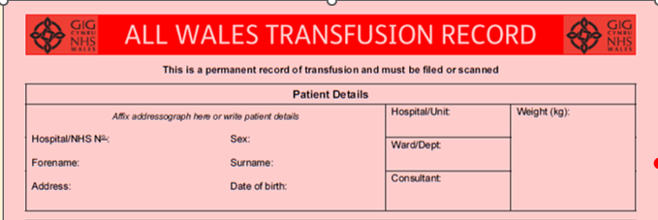
What is changing: Patient Information
Notes:
We have added ‘weight’ to the patient details.
This is critical to determining the safe ‘dose’ of blood components for some patients, and is therefore important to have documented close by.

Slide 6
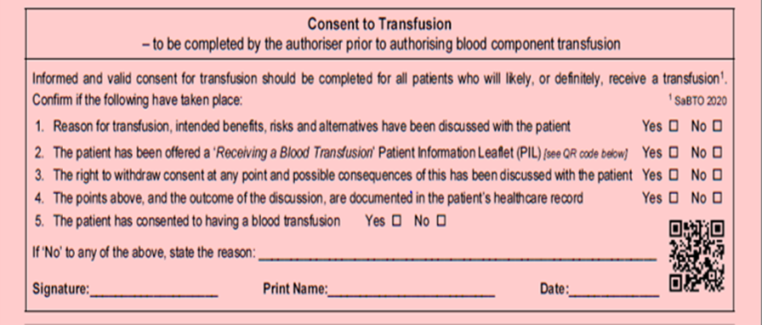
CONSENT:
Updated SaBTO guidance in 2020¹ placed even greater emphasis on the topics to be discussed with the patient
It is the responsibility of the person making the decision to transfuse and completing this written instruction to address all five points listed here.
1: https://www.gov.uk/government/publications/blood-transfusion-patient-consent
Notes:
We have also expanded the confirmation of consent to transfusion; this is in line with updated SaBTO guidance from 2020.
But also in response to a recent audit that was done across Wales…

Slide 7
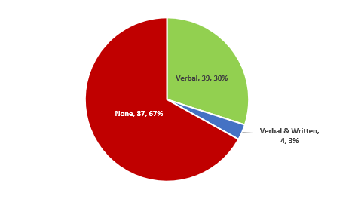
Consent: QS:138 NICE Quality Standards
Statement 4: people who have had a transfusion were given verbal and written information about blood transfusion
All-Wales: Patient Information Given
Notes:
So the audit was undertaken with all the HBs across Wales as part of the NICE Quality Standards relating to blood transfusion.
There are 4 statements & no 4 states: people who have had a transfusion were given verbal and written information about blood transfusion
The audit gave us some very poor responses (show All Wales – then look at C&VUHB)
Obviously with ongoing enquires and the general acceptance of consent /Duty of candour this doesn’t make for pleasant reading

Slide 8
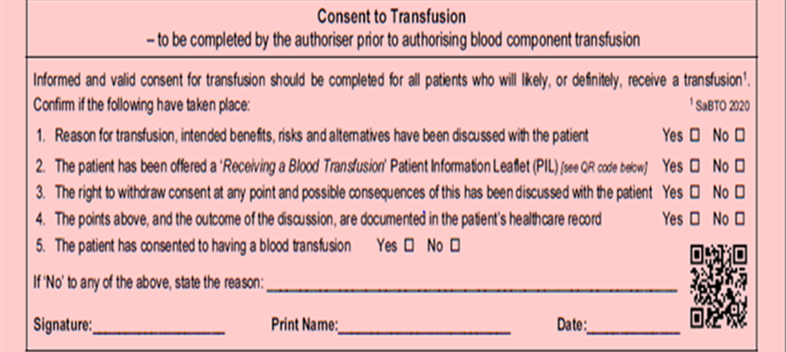
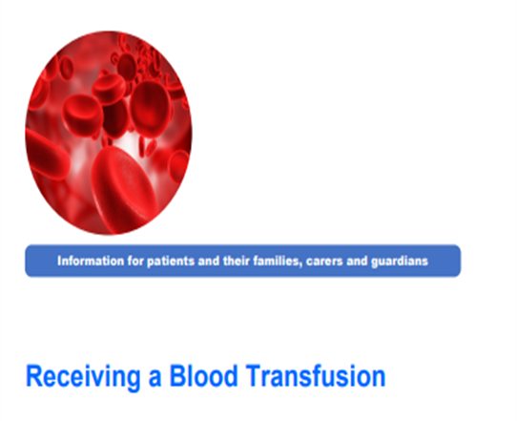
CONSENT : QS 138 NICE Quality Standards
The QR Code above provides a direct link to the Patient Information leaflet : Receiving a Blood Transfusion. This allows authorisers to fully explain the risks and benefits of receiving a transfusion in accordance with consent guidance.
Notes:
We want the AWTR to have a positive impact on these findings, so in addition to expanding the consent section we have added a QR code which takes you directly to the receiving a blood transfusion patient information leaflet.
By providing this at the point of use to both the authoriser and the patient we are hoping that this will provide a more informed discussion.
The PIL contains data around risks and benefits of Tx (show PIL) giving the HCP the confidence to discuss Tx fully with the patient and allowing the patient to make an informed decision based on their need.

Slide 9
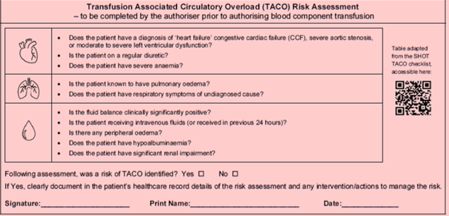
TACO
A checklist approach is taken to assessing patients
It is the responsibility of the person making the decision to transfuse and completing this written instruction to make any interventions as necessary and inform staff caring for the patient.
Notes:
The next part of the form looks at Transfusion Associated Circulatory Overload (TACO). So why have we added this……..

Slide 10
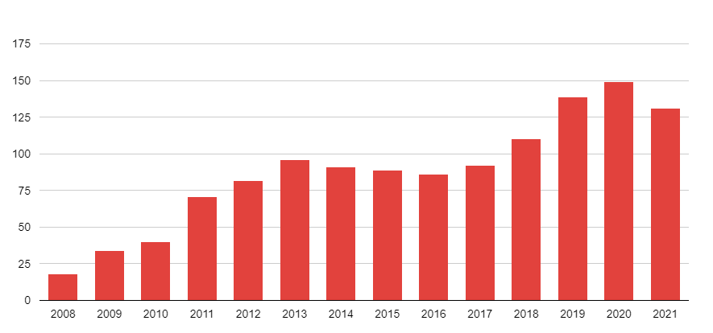
SHOT TACO Data:
A formal pre-transfusion risk assessment for TACO should be undertaken whenever possible for all patients receiving blood transfusion (especially if older than 50 years or weighing less than 50kg) and mitigating actions taken, as TACO is the most commonly reported cause of transfusion –related mortality and major morbidity
ACTION: All staff authorising transfusions
SHOT Incidence of TACO Data 2008 - 2021
Definition:
TACO is defined as acute or worsening respiratory compromise and/or acute or worsening pulmonary oedema during or up to 12 hours of transfusion, with additional features including:
cardiovascular system changes not explained by the patient’s underlying medical condition;
evidence of fluid overload and a relevant biomarker
https://www.shotuk.org/wp-content/uploads/myimages/SHOT-Bites_pulmonary-complications-final-20.01.2020.pdf
Notes:
TACO is defined as……..
The incidence of TACO in the UK has been monitored over the last 15 years by SHOT and as you can see the incidence is staying fairly high. We have also included the SHOT recommendation for risk assessment prior to Tx thus potentially preventing TACO.
So to help authorisers with this requirement ………

Slide 11
TACO
The QR code on the record provides a direct link to the SHOT TACO checklist giving authorisers access to current, up to date information as they are completing it.
Notes:
We have included the SHOT checklist on the form but also again provided another QR code for authorisers to view to assist decisions

Slide 12
Pre- Administration Checklist
A confirmatory tick-box checklist has been introduced to be completed by the person who is administering the transfusion of each unit of blood component.
Notes:
We have expanded this checklist

Slide 13
Indication Code or Reason for Transfusion
The person completing this written instruction should put this information here, as well as having documented this in the patients records.
The indication codes are provided by the NBTC and already used extensively in England
Notes:
Finally we have updated the indication for transfusion code. We are aware that approx. 20% of transfusions were not appropriate and so in 2021 we included the indication codes on our transfusion request form to support authorisers in making an appropriate decision to transfuse in adult patients.

Slide 14
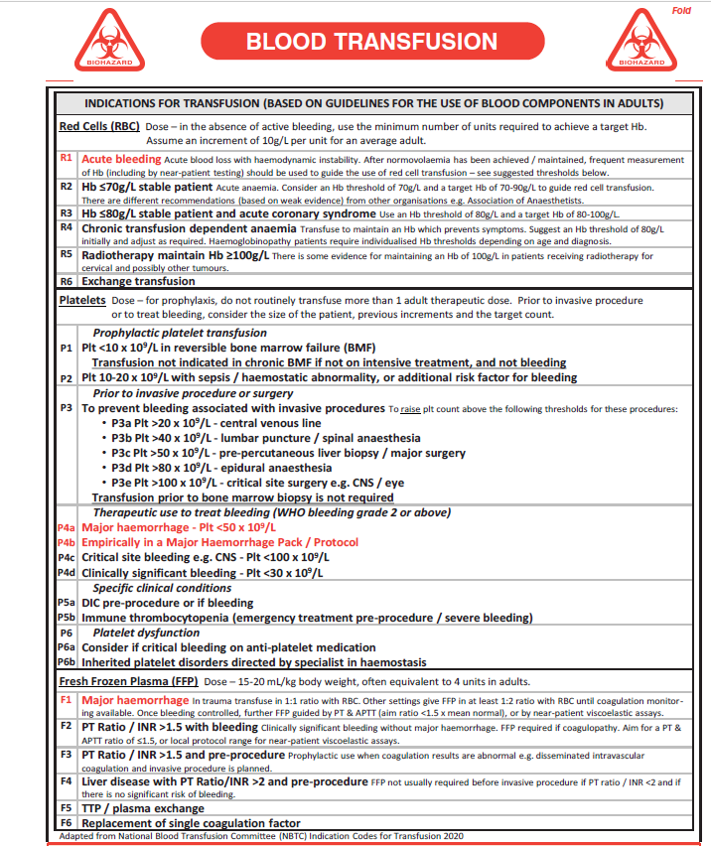
Indication Code or Reason for Transfusion
The indication codes provide authorisers with guidance around the appropriateness of transfusion
The request form was updated in 2021 ……… we did an audit in 2022
Notes:
We updated the transfusion request form in 2021 to include the codes and in 2022 we audited the use of indication codes…

Slide 15
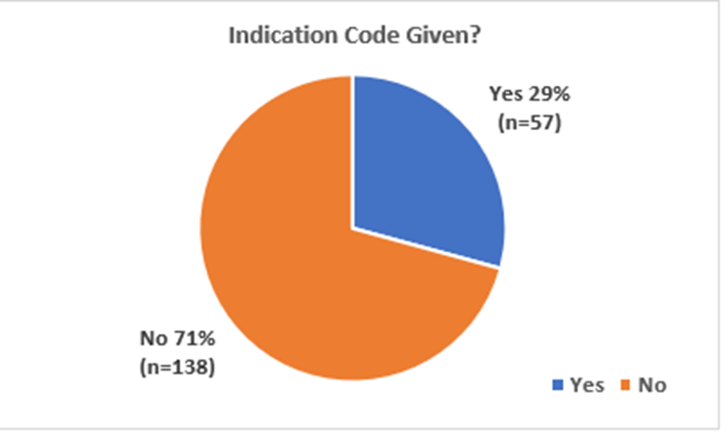
Indication Code or Reason for Transfusion: Audit 2022 Results
All Wales Transfusion request Form Audit 2022
Was the indication code given
Notes:
So across Wales we only had a 29% compliance rate.
But to make things even easier…

Slide 16
Indication Code or Reason for Transfusion
The QR code on the record links directly to the Blood Components App providing authorisers with further information if required to help guide decision making.
Notes:
We again included a QR code which links the authoriser directly to the NBTC indication codes.

Slide 17
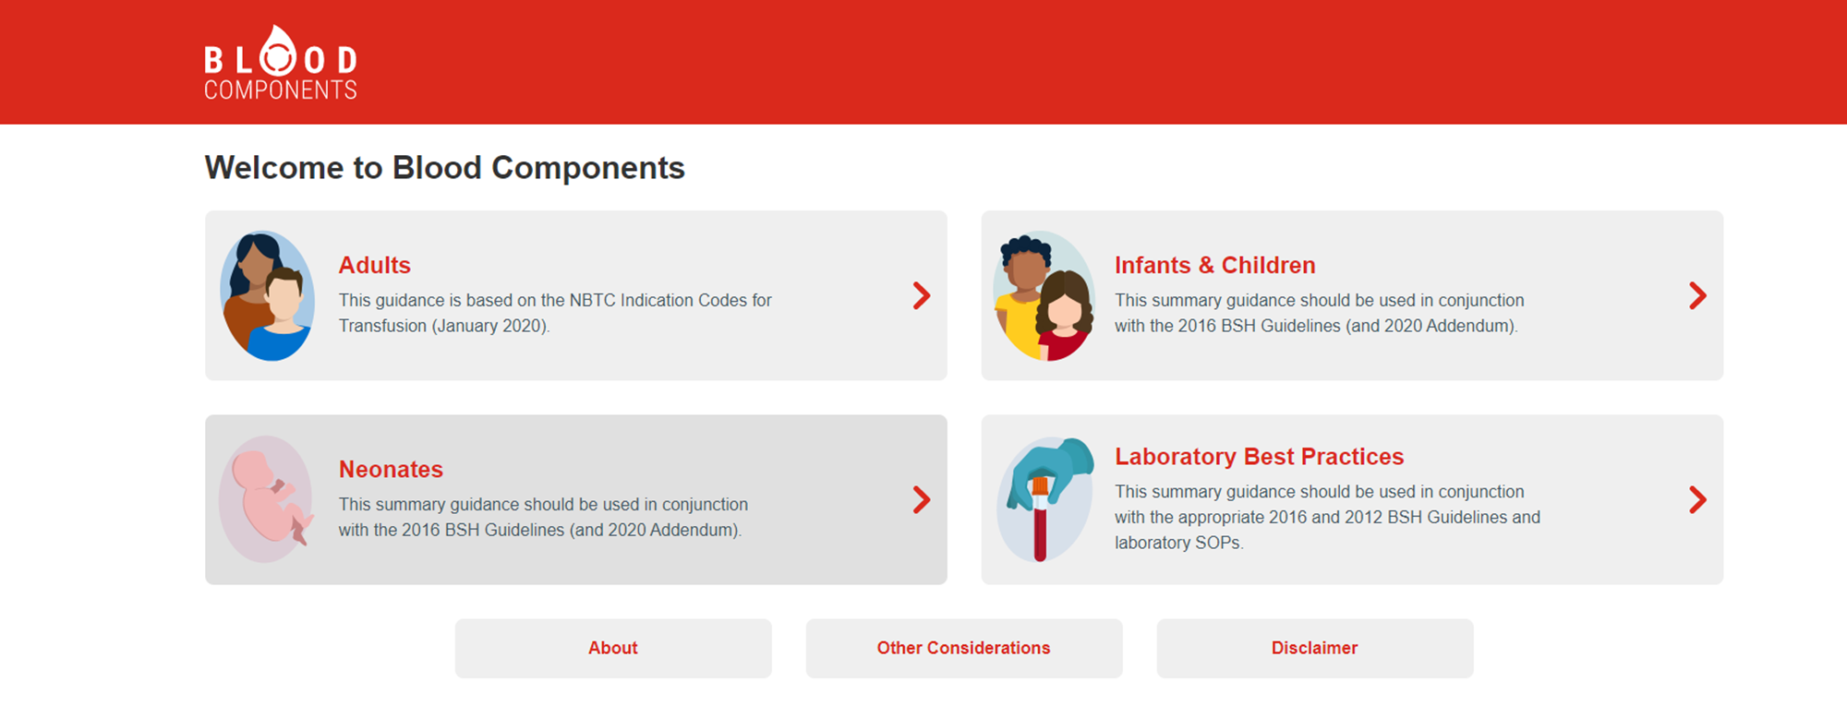
Blood Components Website & App
https://www.bloodcomponents.org.uk
Notes:
‘Blood Components’ is developed by NHSBT and will assist in the decision making process; it provides up to date information and guidance when authorising transfusions, incorporating the NBTC indication codes.
This can be accessed at https://www.bloodcomponents.org.uk/ and the NHS Blood Components app can be downloaded from the App Store and Google Play.

Slide 18
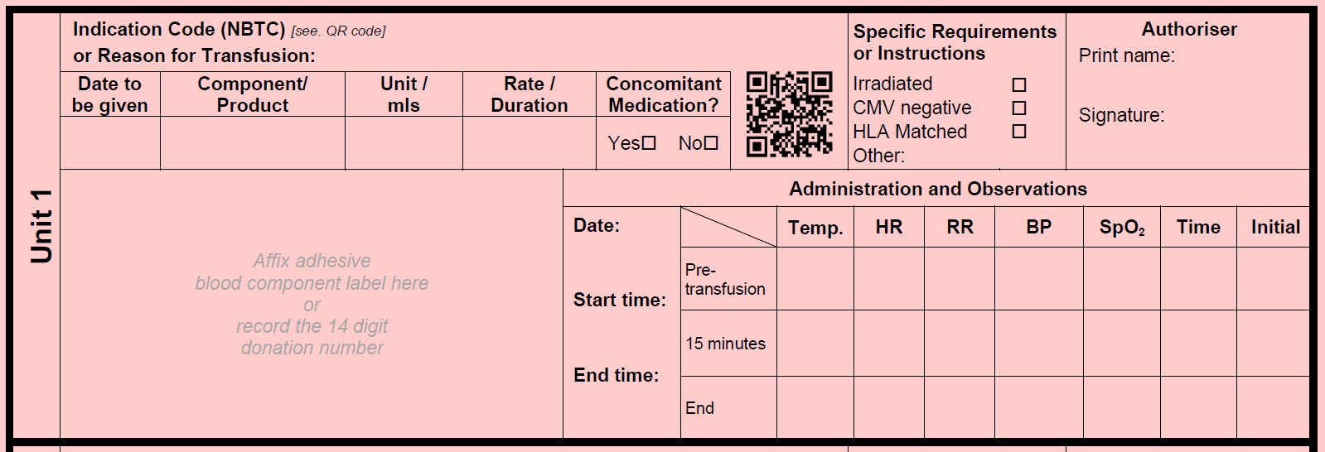
Oxygen Saturation
SpO2 has been included as part of routine observations
Notes:
SpO₂ has been included as part of the routine observations for blood component transfusion. Although this is not part of the recommended minimum observations for transfusion (BSH 2017), the survey of users as part of the latest AWTR review gave sufficient evidence to merit inclusion.

Slide 19
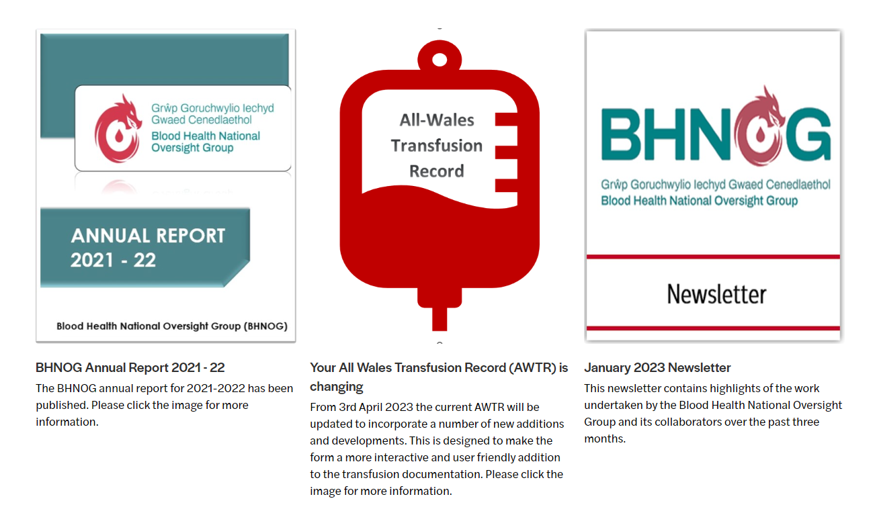
Where to find the AWTR
https://bhnog.wales.nhs.uk/
Notes:
Version 5 of the AWTR will be going live in April 2023;
A specimen version for training purposes, together with other educational resources including this slide deck are available at:
XXXXXXXXXXXXXXXXXXXXXXX

Slide 20
Summary
The AWTR is changing from 03/04/2023 the new form will be available for use in your HB.
The changes have been made to make the form more interactive and provide both authorisers and patients with the most up to date information to help make an informed safe transfusion decision
The form has also been expanded to become a 4 page form allowing up to nine components to be recorded on each form

Slide 21
Any questions, contact your hospital transfusion team or wbs.bloodhealthteam@wales.nhs.uk

