Slide 1
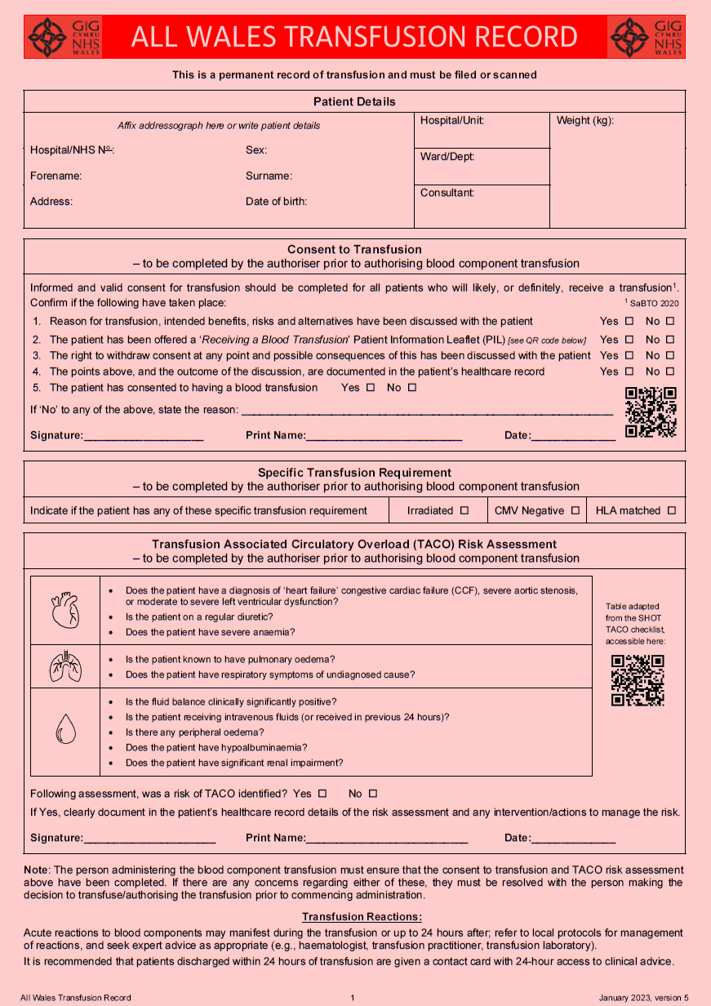
All Wales Transfusion Record (v5, 2023) – what’s new?
Weight (kg) Having an accurate weight of the patient is essential to minimising the risk of overload.
Specific Transfusion Requirement To be identified here by the person completing this written instruction for transfusion, and also to be completed for each unit of blood component authorised.
TACO Risk Assessment A ‘checklist’ approach is taken to assessing patients. It is the responsibility of the person making the decision to transfuse and completing this written instruction to make any interventions as necessary and inform staff caring for the patient.
QR Codes These have been included to facilitate direct access to webpages with relevant supporting material.
Consent to Transfusion Updated SaBTO guidance in 2020¹ placed even greater emphasis on the topics to be discussed with the patient. It is the responsibility of the person making the decision to transfuse and completing this written instruction to address all five points listed here. ¹https://www.gov.uk/government/publications/blood-transfusion-patient-consent
Administration The person administering a transfusion must ensure the consent to transfusion and TACO risk assessment sections have been completed on the written instruction. Clinical leaders, and those producing written instructions for transfusion themselves, must be fully supportive of staff who challenge when a section has not been completed.
WBS Blood Health Team, 2023

Slide 2
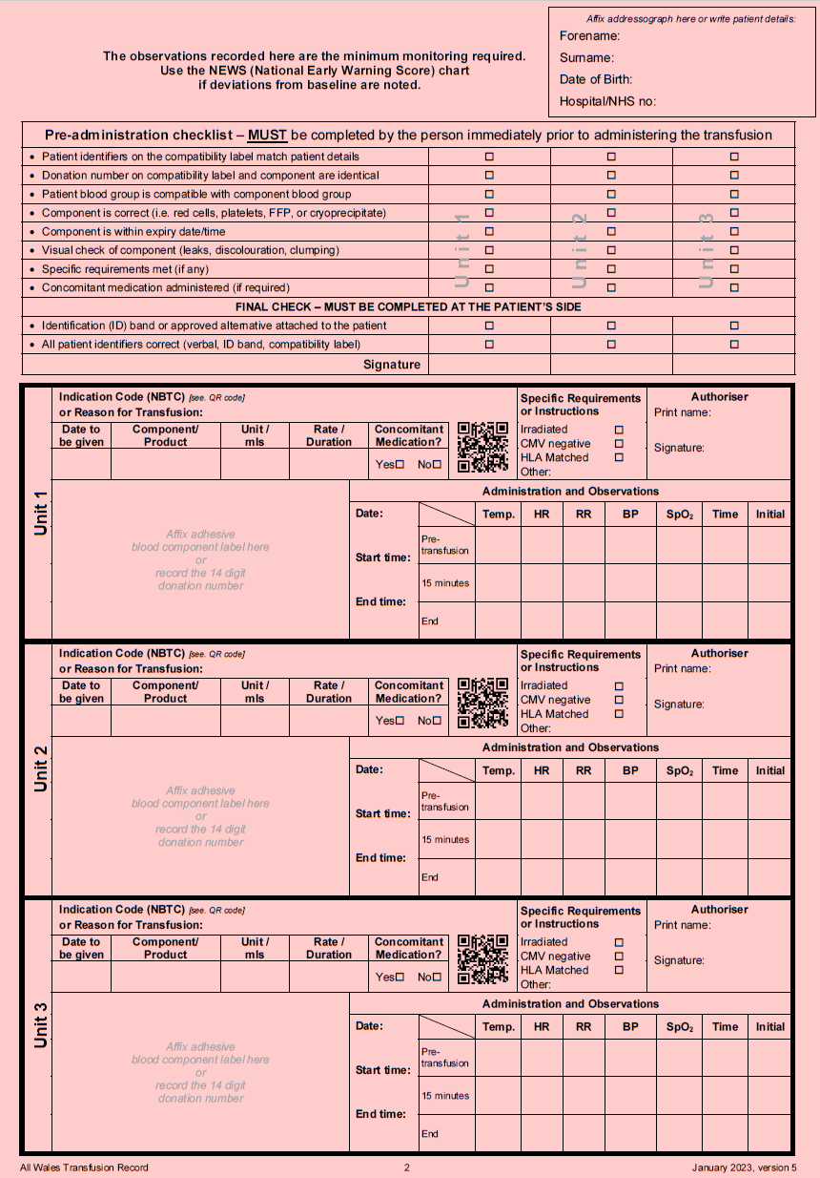
All Wales Transfusion Record (v5, 2023) – what’s new?
Instruction for Transfusion The written instruction for each unit is now completely contained in just one part of the All Wales Transfusion Record (AWTR).
Indication Code or Reason for Transfusion The person making completing this written instruction should put this information here, as well as having documented this in the patients records. This then constitutes a holistic transfusion record, and will also directly inform the person administering the transfusion. The NBTC indication codes for transfusion is a summary of national guidelines for the use of blood components in adults that aims to act as a prompt for clinicians to facilitate appropriate use. Further guidance on these indication codes can be found here: www.bloodcomponents.org.uk/ ; the associated app to this website, NHS Blood Components, can be downloaded from App Store and Google Play.
Pre-administration checklist A confirmatory tick-box checklist has been introduced to be completed by the person who is administering the transfusion, to be repeated for each unit given.
Specific Transfusion Requirement This needs to be identified here also by the person completing this written instruction for transfusion, for each unit. This will reinforce the requirement for each unit as it is authorised, and as it is administered.
SpO₂ While SpO₂ monitoring is not part of the recommended minimum observ-ations for transfusion (BSH 2017), the outcome of the AWTR review consultation process in 2022 was to include this here.
AWTR Page 3 & 4 (unit 4-9) The AWTR is now four A4 sides. Page 3 and 4 are the same as page 2 shown here with the space for the written instruction and record for units 4 to 9.
WBS Blood Health Team, 2023

