Slide 1
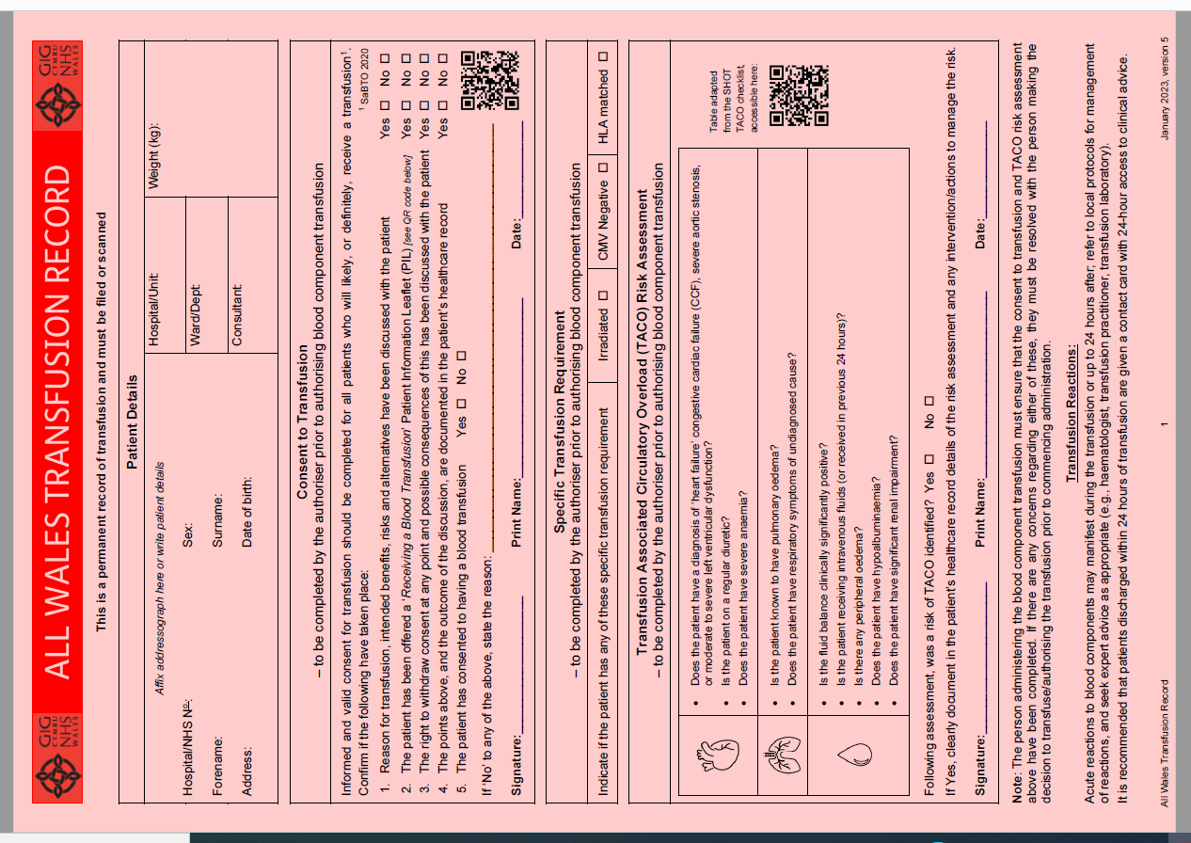
All Wales Transfusion Record (v5, 2023) – written instruction
Weight This is new to the All Wales Transfusion Record (AWTR); it is the responsibility of the person completing the written instruction to ensure that this is measured and documented here.
Consent to Transfusion This section has been expanded; a series of checkboxes have been introduced, to be completed by the person making the decision to transfuse and producing this written instruction; these are to confirm what should be also being documented in the patient records. A direct QR code link to a patient information leaflet online has been put here to support the consent discussion.
Specific Transfusion Requirements It continues to be the responsibility of the person producing this written instruction to determine if there are any requirements and identify them here (as well as informing the transfusion laboratory).
Transfusion Associated Circulatory Overload (TACO) The person producing this written instruction must assess if the patient is at risk of circulatory overload, including how blood component transfusion might contribute to this risk. Any interventions or actions to minimise the risk of TACO must be included in this written instruction (where applicable), documented in the patient’s record, and the staff who will be administer the transfusion informed directly of the risk and reduction measures to be taken. A direct QR code link to the SHOT TACO checklist has been put here to provide additional supporting information on assessment and intervention.
WBS Blood Health Team, 2023

Slide 2
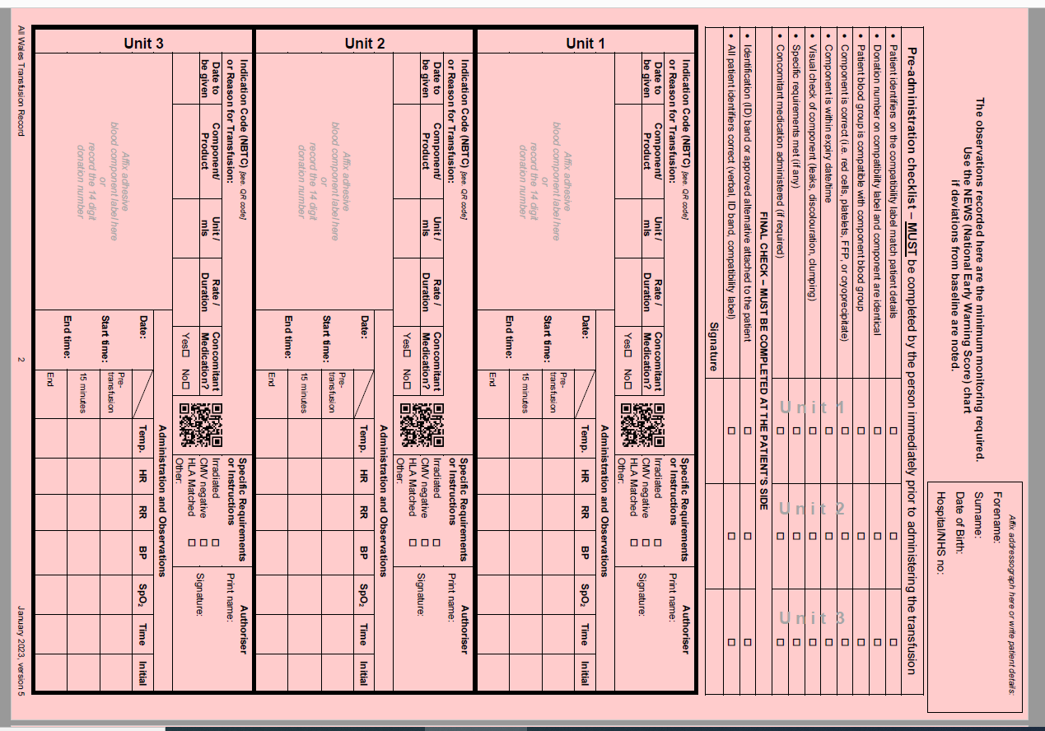
All Wales Transfusion Record (v5, 2023) – written instruction
Instruction for Administration of Units The written instruction for each unit is no longer on the first page of the AWTR, but is now immediately above the space where details of the administration and observation of that unit are to be recorded. The AWTR is now four A4 sides, pages 3 and 4 having the space for the written instruction and record for units 4 to 9.
Indication Code or Reason for Transfusion Another new element to the AWTR. The person completing this written instruction should put this information here (as well as having documented this in the patients records); this will provide a clear and direct understanding of why the patient is having this transfusion. The NBTC indication codes for transfusion is a summary of national guidelines for the use of blood components in adults that aims to act as a prompt for clinicians to facilitate appropriate use. A direct QR code link to a these codes has been put here. Further guidance can also be found here: www.bloodcomponents.org.uk/; the associated app to this website NHS Blood Components can be downloaded from App Store and Google Play.
Concomitant Medication Indicate here whether any is prescribed (on the medicine chart) or not.
Specific Transfusion Requirements Must be identified here for each unit as well as on the first page. There is also space here for other requirements or instructions, such as blood warmer.
Authoriser The person producing the written instruction for each unit must complete.
WBS Blood Health Team, 2023

