Slide 1
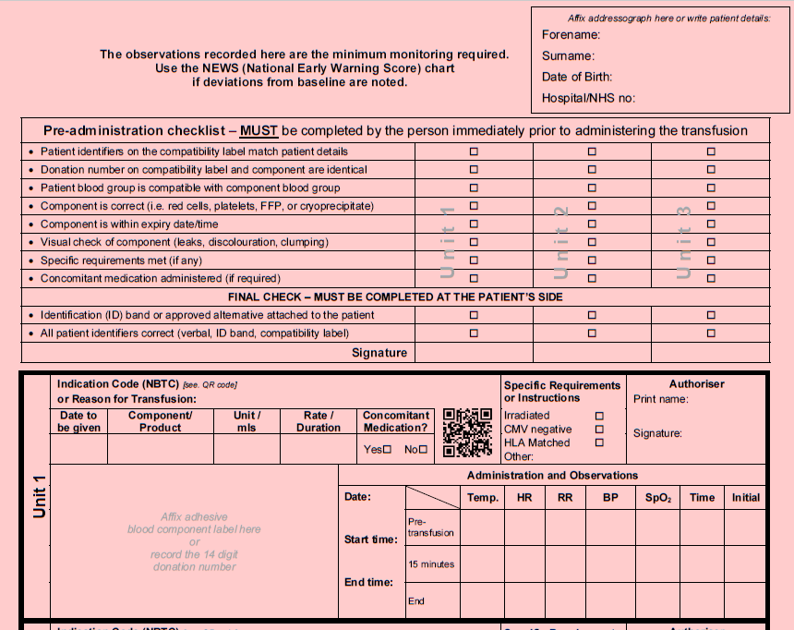
All Wales Transfusion Record (v5, 2023) – administration of transfusion
Page 1… The person administering a transfusion does not need to document anything on page 1 of the revised All Wales Transfusion Record (AWTR v5).
Transfusion Associated Circulatory Overload (TACO) If the patient has been identified as being at risk of TACO, then the staff administering the transfusion should be aware of any risk reduction interventions/actions.
Completion of Consent and TACO sections It is important that these sections are fully completed by the person making the decision to transfuse and producing this written instruction.
Page 2 onwards…
Pre-administration Checklist A series of tick-boxes has been introduced to allow active confirmation of each of the points. as being at risk of TACO, then the staff administering the transfusion should be aware of any risk reduction interventions/actions.
Signature The person administering the transfusion signs here to confirm completion of the pre-administration checks and commencement of the transfusion of that blood component unit.
Instruction for Administration of Units This section is to be completed by the person making the decision to transfuse. The indication code or reason for transfusion will provide a clear and direct understanding of why the patient is having this transfusion.
Unit Donation Number, Administration and Observations This section is to be completed during the administration of the blood component.
WBS Blood Health Team, 2023

