Slide 1
Blood Health National Oversight Group (BHNOG)
Dr. Brian Tehan
Committee chair

Slide 3
I’ll try to cover….
What is the BHNOG?
Our annual report- what we have done so far
Setting a new direction
New terms of reference

Slide 4
origins
WHC/2017/028- “to highlight the publication by the Welsh Blood Service of the NHS Wales Blood Health Plan (“the Plan”) that has been developed by staff across NHS organisations, supported by the Health Board/Trust Medical Directors, and co-ordinated by the Welsh Blood Service (“WBS”)”.
Given that production of the Plan has been a collaborative effort, each health boards/trust should be working towards implementation and ensuring that the overarching strategic aims and commitments are in its Integrated Medium-Term Plan A national leadership group is being established by the WBS to oversee delivery of the Plan through a clear work programme and the next step is to secure appropriate representation from NHS Wales.

Slide 5
The “Plan”
The Plan sets the direction of optimising blood health and transfusion practice under three core aims that draw on the principles of prudent healthcare:
supporting individuals to manage their health and wellbeing, avoiding unnecessary intervention;
using evidence and transparent data to drive service planning and improvement to reduce inappropriate variation; and
avoiding harm.

Slide 6
My role
Dr. grant robinson- first chair
Invited to join as medical directors' nominee
with background of
consultant in anaesthesia & intensive care
Medical management at several levels
Quality improvement
Msc leadership (quality improvement) ashridge
Past Generation q fellow & current health foundation fellow
Chair in January 2020

Slide 7
BHNOG Annual report
Workstreams established
appropriate use of o d neg work stream
appropriate single unit transfusion /transfusion related circulatory overload (taco)
appropriate use of platelets work stream
anaemia management
Education
Non-Medical Authorisation of Blood Transfusion (NABT)
Senior Student Assistantship (SSA)
Additional BHP Projects
Engagement with Hospital Transfusion Teams/Committees (HTTs/HTCs)
BHNOG Conference
Clinical Audit

Slide 8
The future….?
What are we trying to achieve?
- The “Plan” but how does this relate to our terms of reference
Who’s plan?- effective engagement with health boards and ensuring the Plan is “our plan”
Do we have the workstreams necessary to achieve the plan and are they positioned to achieve?
What is the standing / authority of the group?
What is the positioning of the group in relation to welsh government and the health boards
How do we know a change is an improvement?- metrics
What changes can we make which will achieve the goals agreed?

Slide 9
Creating a recognisable brand

Slide 10
Formal appointment of chair by the cmo
Relationship with the all-wales medical directors' group
Dialogue with welsh government on positioning going forward
Revision of the terms of reference to clarify purpose and more closely align with oversight of the blood health plan
Review of membership to align with purpose- key change to invite chairs of health board htc
Re-designed reporting arrangements for workstreams with emphasis on performance v intended trajectory and actions being taken where off track (e.g., a3 methodology)
Developing metrics and dashboards to support improvement at an all-wales level with drill down
Anaemia workstream- leadership by champions / experts (tor which allow a membership which balances expertise, representation and political standing)
A broad remit across all of healthcare
Linkages into hospital / health board champions for pre-operative assessment and anaemia management
Bid for anaemia champion nurses
Engagement – welsh fracture neck of femur network guidelines and blood management
Communication- developing a web presence & exploring use of social media
Covid-19 –
Pause during first wave
Conference cancelled for 2020
Different ways of working- teams
Convalescent plasma steering group
Threat / opportunity- dwindling supply – engagement with health boards highlighting challenges

Slide 11
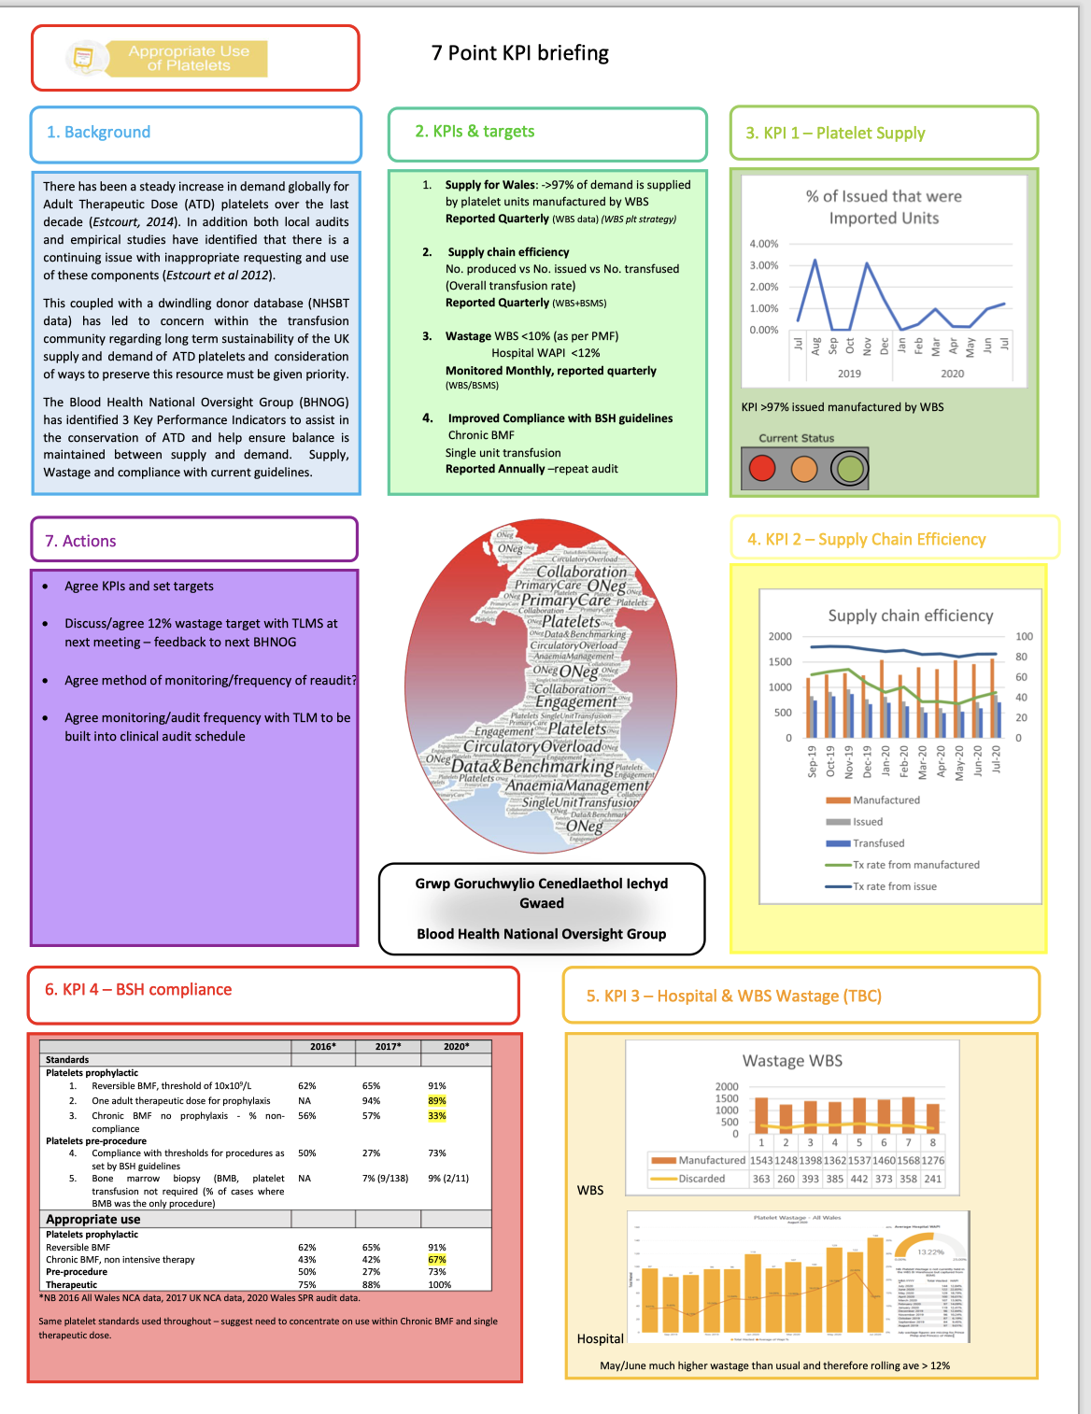
How do we know a change is an improvement?
Audit
Workstream reporting
Moving on to dashboards and rolling metrics
Easily digestible information

Slide 12
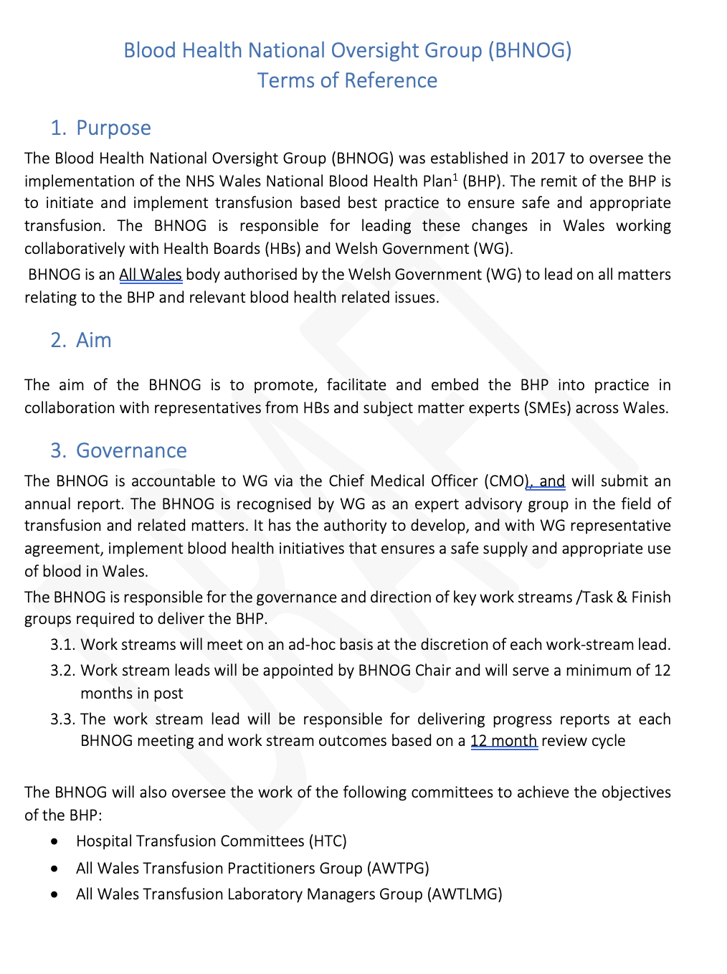
Terms of reference-
Finalised with support of the all-wales medical directors
Makes clear statements of aim and purpose
Describes governance arrangements which include
delivery of the bhp through the htc
These report to boards on delivery of the bhp
under the oversight of the bhnog
All healthboard HTC are members of bhnog

Slide 13
